Slide 1
Concrete Pavement Recycling Practices and Technologies
2017 CAPTG Workshop
Halifax, NS
Gary L. Mitchell, P.E.
Vice President
American Concrete Pavement Association

Slide 2
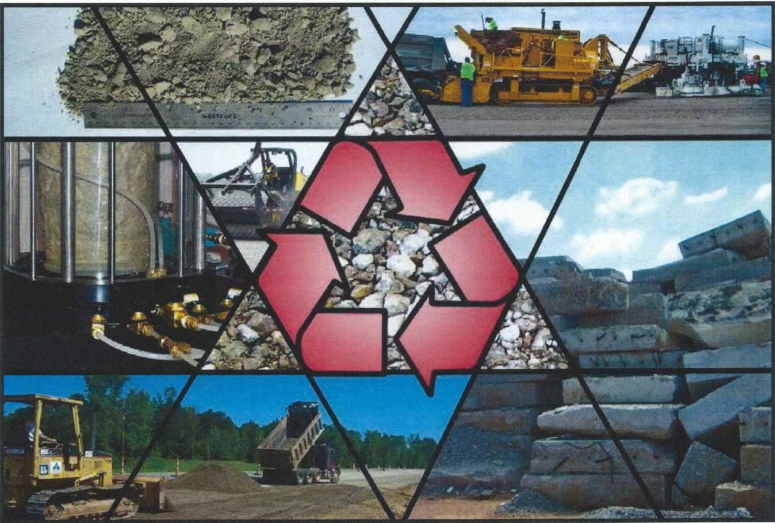
Introduction
IPRF Report 01-G-002-03-5
July 2006

Slide 3
Background
USGS Estimates: 330 million tons of base (roads)
50 million tons of RCA recycled annual (Saeed 2004)
Most recycling research by FHWA, TRB, NCHRP, Corps of Engineers
Research did not address potential issues with PCCP with ASR or Sulfate Attack
IPRF under cooperative agreement with FAA investigated the issue
Objective – develop minimum standards and construction guidelines

Slide 4
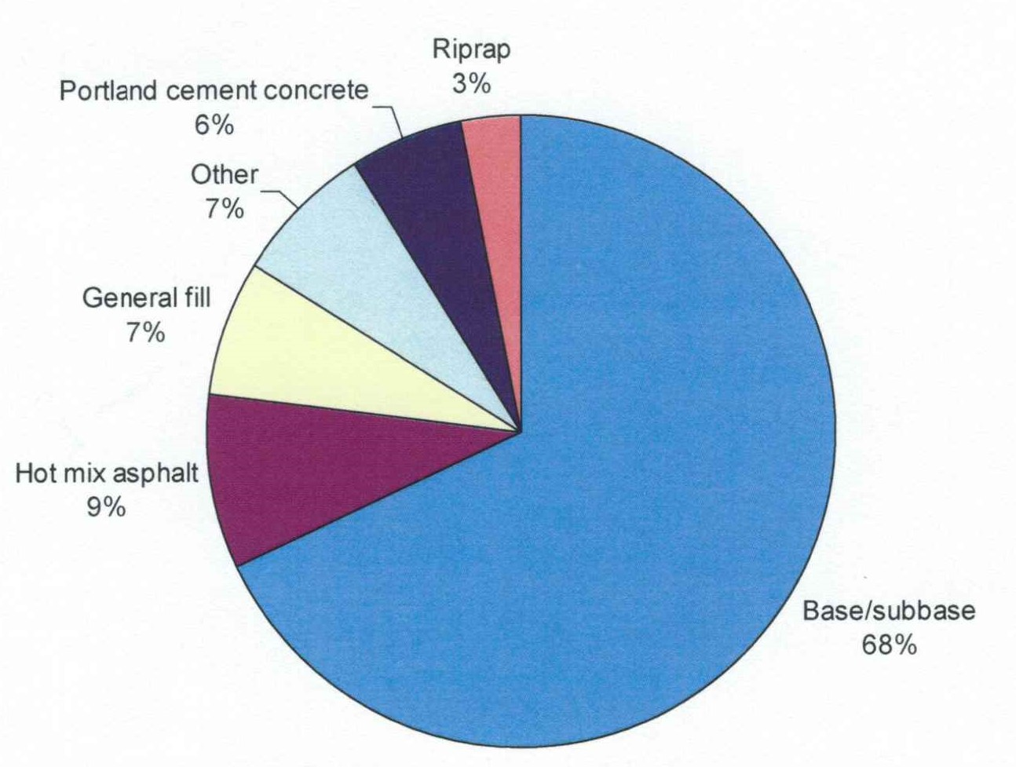
Recycled Concrete usage
Uses of RCA (source IPRF 03-5)

Slide 5
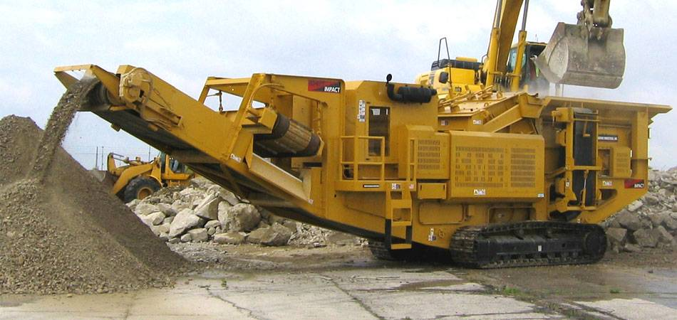
RCA Production
PCCP broken (or cut) into large pieces
Hauled to crusher
Reinforcing steel and dowel bars removed
Crushed to specific gradation

Slide 6
Engineering Properties
Particle shape
Grading
LA Abrasion
Permeability
Density
Moisture content
Shear strength (performance-related property)
Potential to degrade (not applicable to RCA)
Determines Compactive Effort

Slide 7
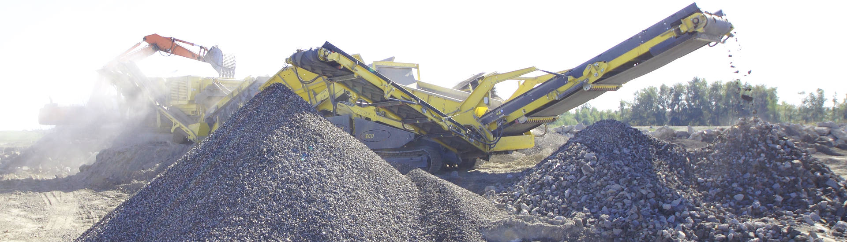
Physical Properties
Similar grading
Lower specific gravity
More surface texture
Higher optimum moisture content
Higher sulfate soundness loss
Less abrasion resistance

Slide 8
Mechanical Properties
Higher CBR
Higher shear strength
Higher rutting resistance
Higher resilient Modulus (stiffness)
Generally no breakdown during handling
Increased stiffness with time?
  Research by Poole et al. residual cement hydration is too small to be of practical use
  May form crust – false impression of stiffness

Slide 9

Environmental Assessment
No evidence of environmental problems
Environmental testing not required if used on-site
Slow rate for leaching for chemical constituents
Leaching studies shows no significant amount of toxic materials

Slide 10
Economic Assessment
LCCA preferable – enough data exist to assess?
Evaluate the economic viability of RCA:
    Tangible cost comparison (btwn. virgin agg. vs RCA)
Major cost consideration:
    disposal of existing PCCP in compliance with Fed., State, and local requirements
Economic factors to consider:
    Determined rationally and defended as project level cost
Societal benefits are Subjective:
    Difficult to quantify and should be left to the policy level

Slide 11
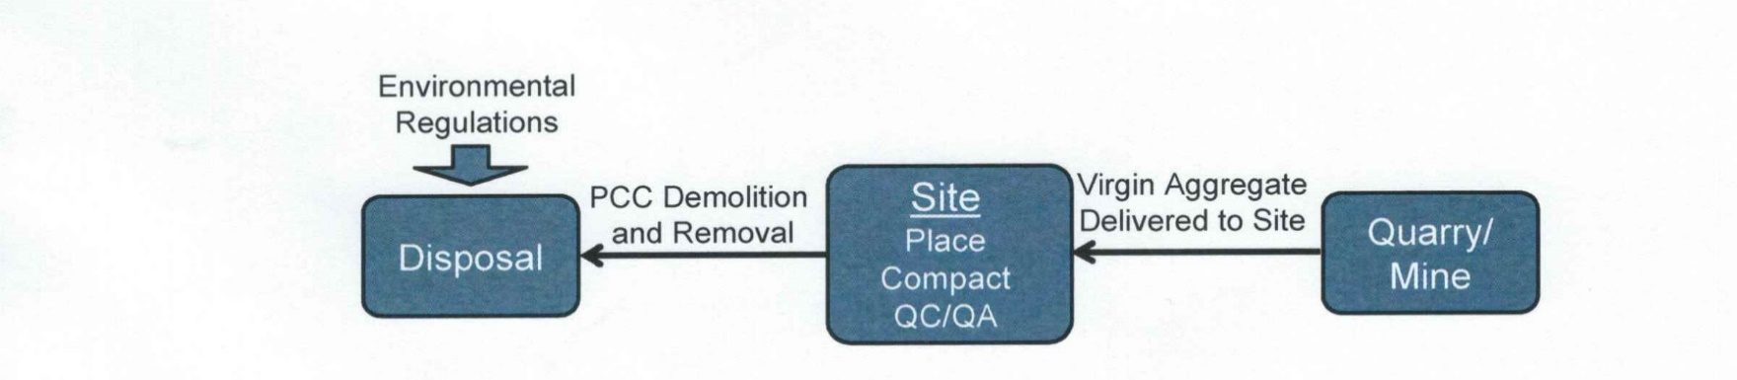
Construction cost components for virgin aggregates
Cost of aggregates delivered to the site
Cost to demolish and remove the existing PCC
Cost of disposal of existing PCC (within environmental regulations)
Cost of placement of virgin aggregate (if different from RCA)
Cost of compaction (if different from RCA)
Cost of QC/QA (if different from RCA)
Economic factors to be considered in economic analysis – virgin aggregates

Slide 12
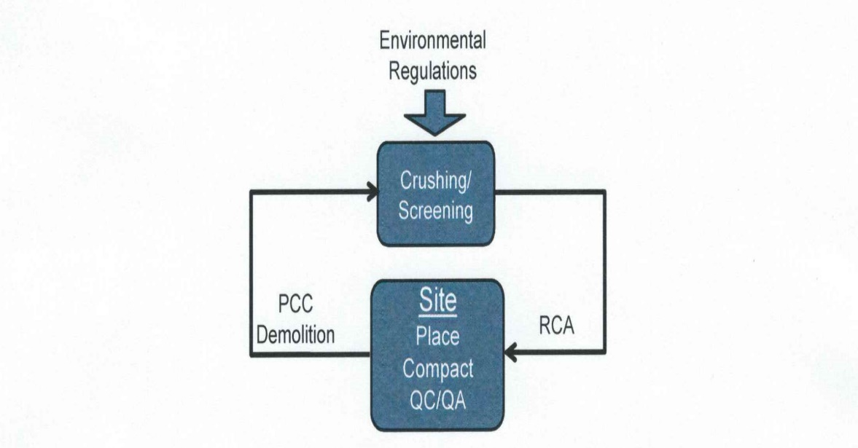

Construction cost components for RCA aggregates
PCC removal cost
Land cost for crusher
Crushing/Screening/Stockpiling
Crusher/Stockpile environmental regulations
Haul to/from crushing/stockpile
Placement cost
Compaction cost
QC/QA cost
Economic factors to be considered in economic analysis – RCA aggregates

Slide 13
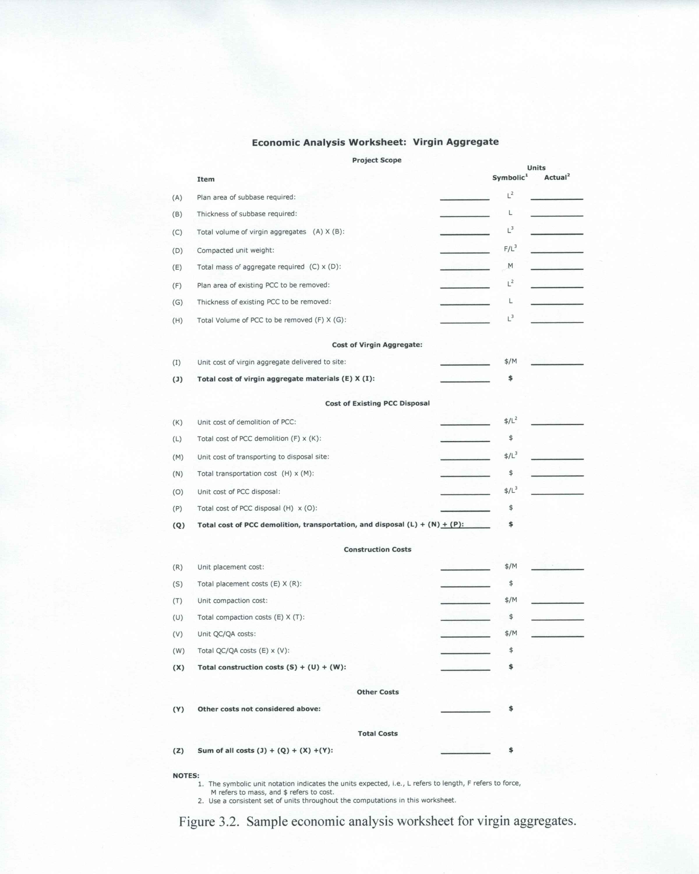
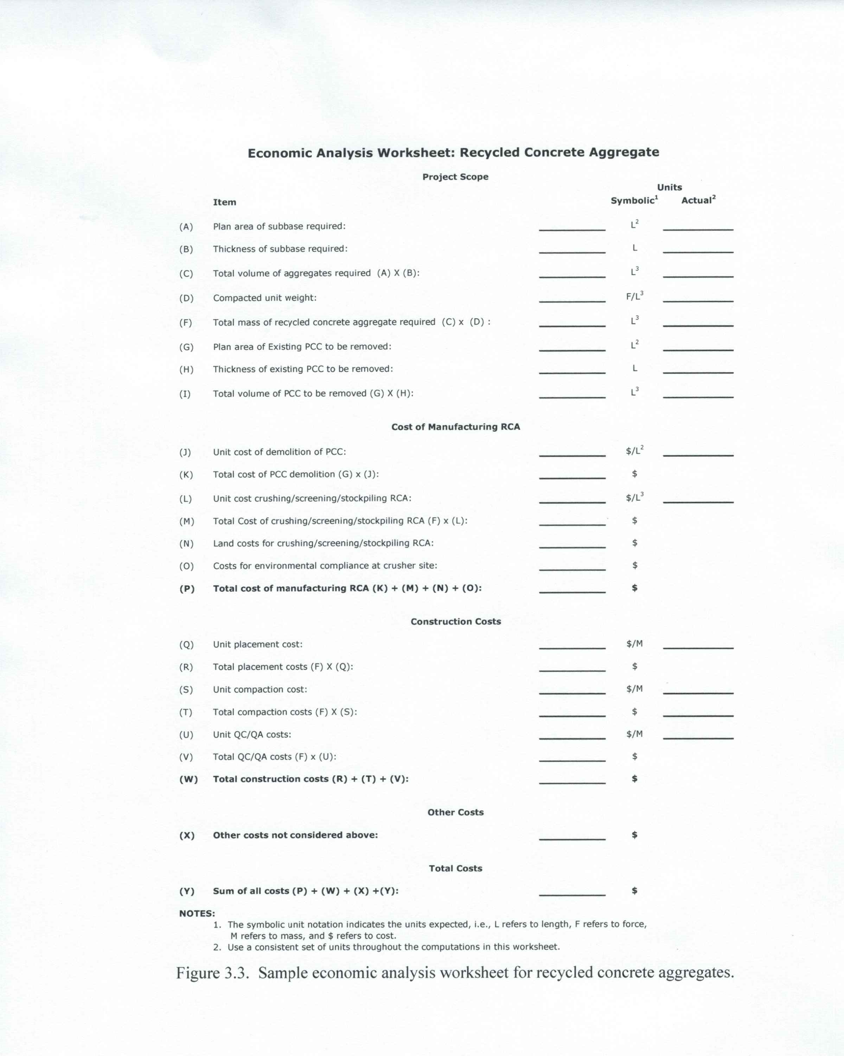
Sample Economic Worksheets

Slide 14
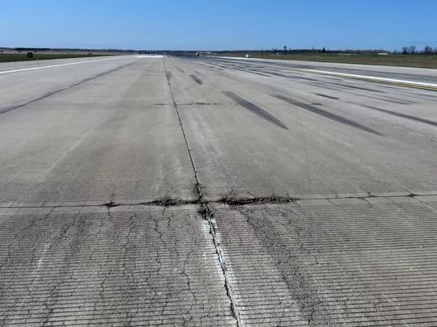
Alkali Silica Reactivity
Well known problem
ASR Expected to continue
Insignificant damage in unbound layer
  Porosity
  Room for ASR jell
Still concern for critical facilities

Slide 15
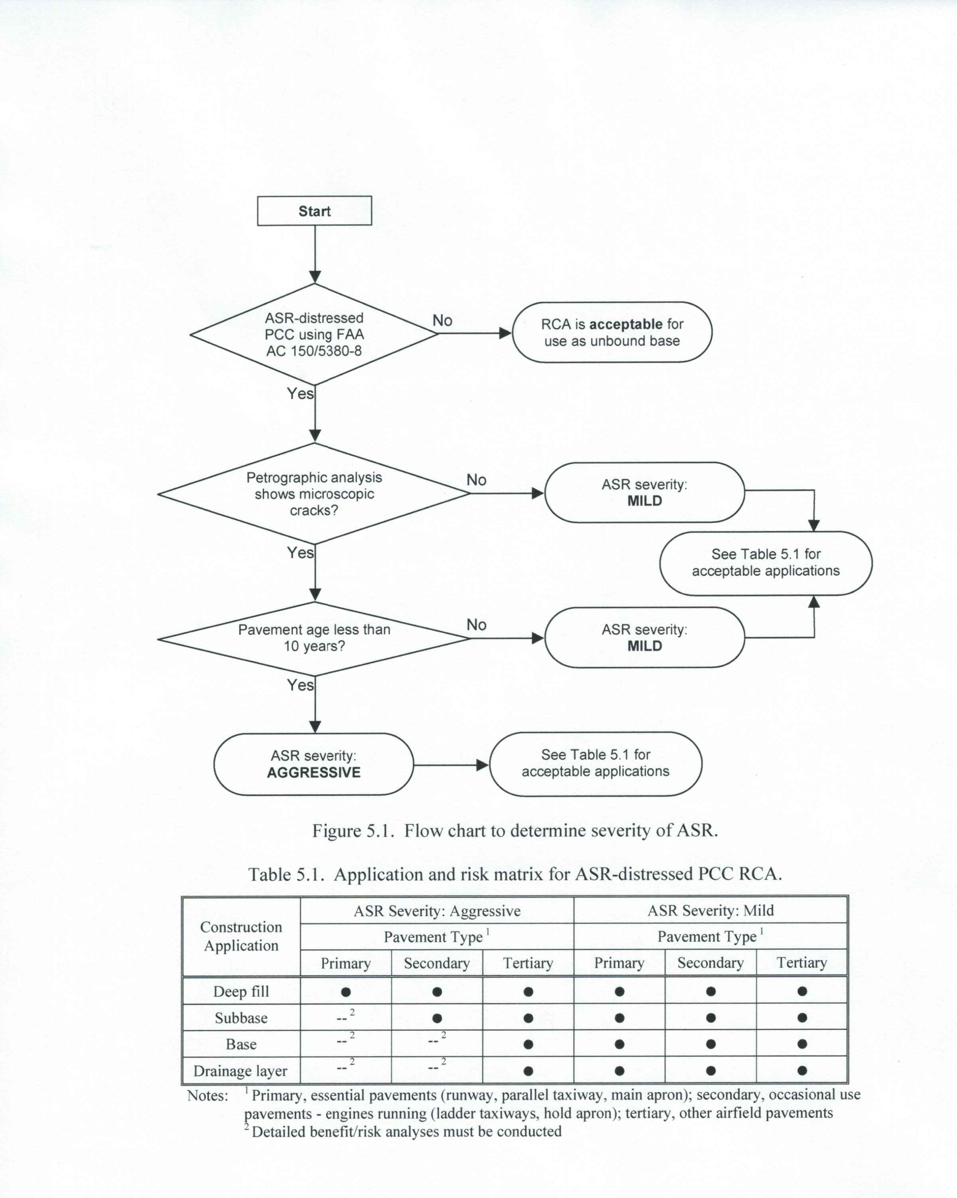
Risk Matrix for ASR distressed RCA

Slide 16
Other Tools
FAA 150/5380-8A Field Diagnosis of ASR
US Air Force ETL 07-6 Risk Assessment Procedure

Slide 17
Material Standards
Gradation
Same as P-209 CABC except #30 (10-30) & #200 (0-8)

Slide 18
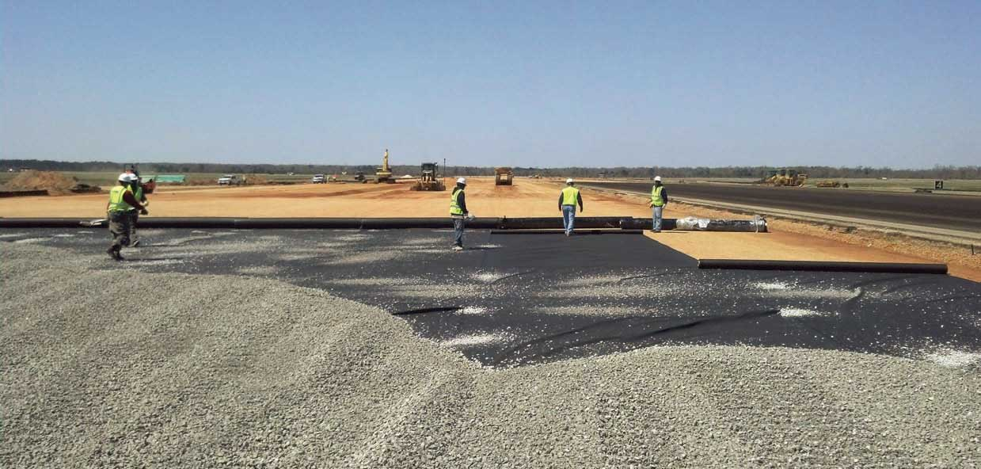
Construction Guidelines—same as virgin aggregate
Aggregate Stockpiling
Preparation of pavement layers
Installation
  Mixing
  Placing
  Compaction
  Finishing
Maintenance

Slide 19
Material Standards
Abrasion Loss – 45 Percent (from 40%)
Flat and Elongated Particles (l/w > 3) – 30%
Fractured particles – at least 50%
Soundness – usually waived (chemically unsuited)
Liquid and plastic limits – LL<25; PI<5

Slide 20
Current Specifications
FAA Item P-219 Recycled Concrete Aggregate Base Course
UFGS 32 11 23; item 2.2.1 Coarse Aggregate; paragraph (c) Crushed Recycle Concrete
**************************************************************************
NOTE: Verify the subgrade soil contains less than
0.3 percent of sulfates, to prevent expansive ettringite reaction with the recycled concrete. See UFC 3-250-11, Appendix C for testing procedure. Otherwise, delete recycled concrete option.
Do not permit recycled concrete aggregate (RCA) to be used in a airfield pavement section without evaluating for Alkali-Silica Reactivity (ASR). See IPRF-01-G-002-03-5, "Evaluation, Design and Construction Techniques for Airfield Concrete Pavement Used as Recycled Material for Base." For Air Force porjects, perform risk assessment in accordance with ETL 07-06, "Risk Assessment Procedures for Recycling Portland Cement Concrete (PCC) Suffering From Alkali-Silica Reaction (ASR) in Airfield Pavement Structures."
**************************************************************************

Slide 21
Case Studies

Slide 22
US Airfields Using distressed RCA
Airfield Site Conditions Using RCA as Base Material

Slide 23
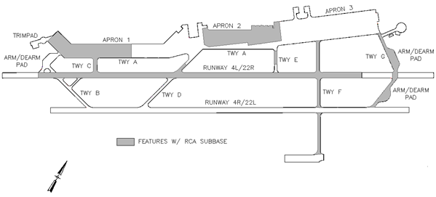
Shaw AFB, South Carolina
Frist project in 1987
Runways & aprons
Crushing plant set up near base entrance
RCA treated as virgin aggregate
Field personal claimed easier to compact
No environmental testing
Good performance

Slide 24
Shaw AFB

Slide 25
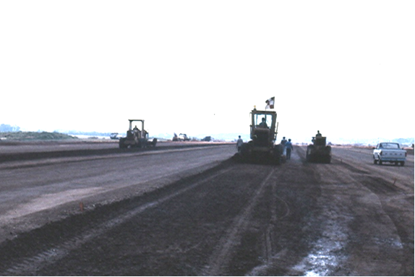
Shaw AFB

Slide 26
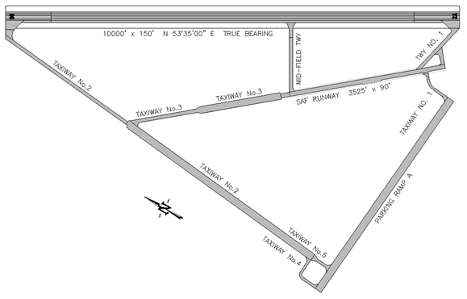
North Auxiliary Field, Charleston AFB, SC
Taxiway
Met LA Abrasion loss < 40%
Soaked CBR 30
Exceeded spec requirements
Crusher set up on site
Place with motor grader
Vibratory rollers
100% compaction

Slide 27
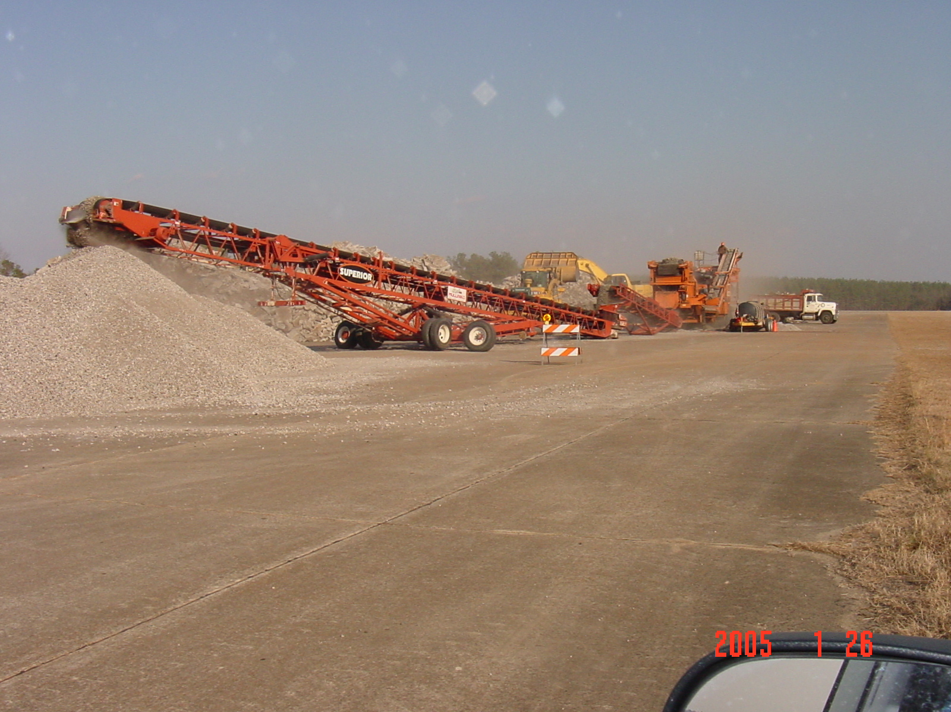
North Auxiliary Field, Charleston AFB, SC

Slide 28
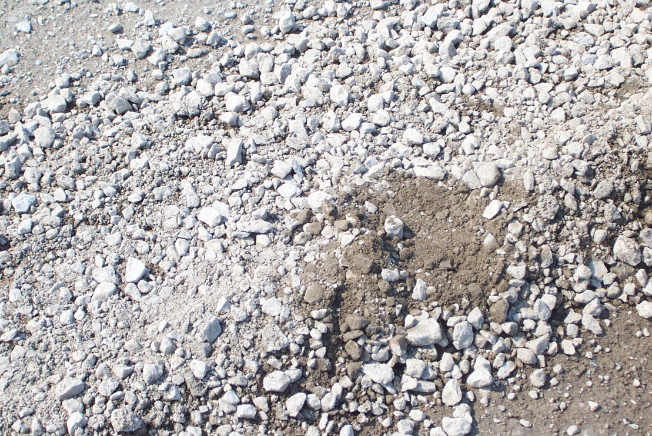
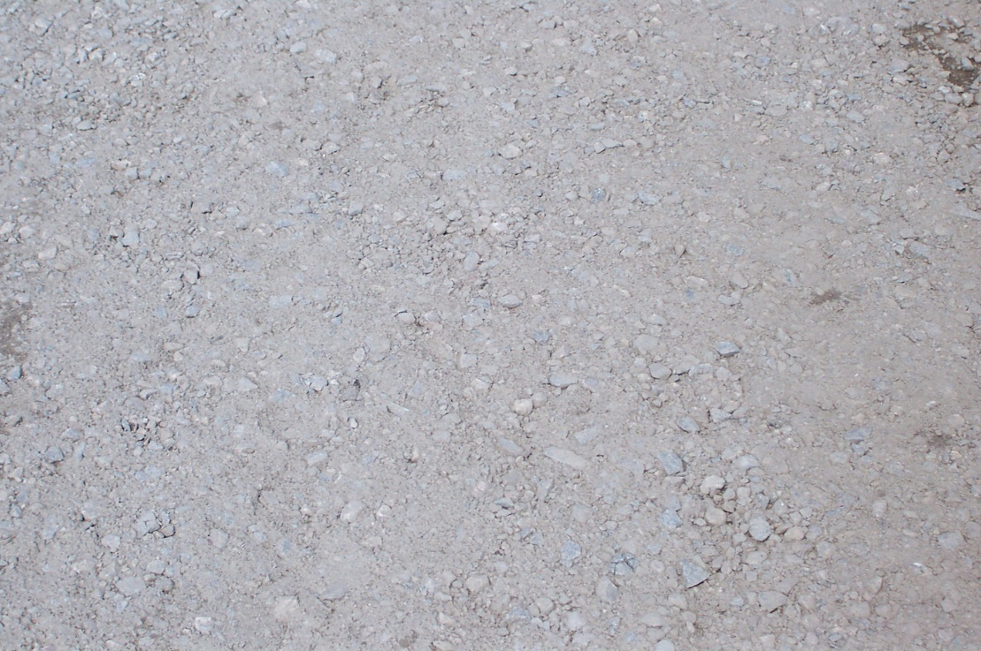
North Auxiliary Field, Charleston AFB, SC
Before
Compaction
After Compaction

Slide 29
US 167 Dubach, Louisiana
Contractor option
Rigid and flexible pavement
8” under rigid; 12” under flexible
Crushing plant on site
Recycle PCC came from various projects
Water added at central plant and hauled to site
Spread with dozer and compacted with vibratory roller

Slide 30
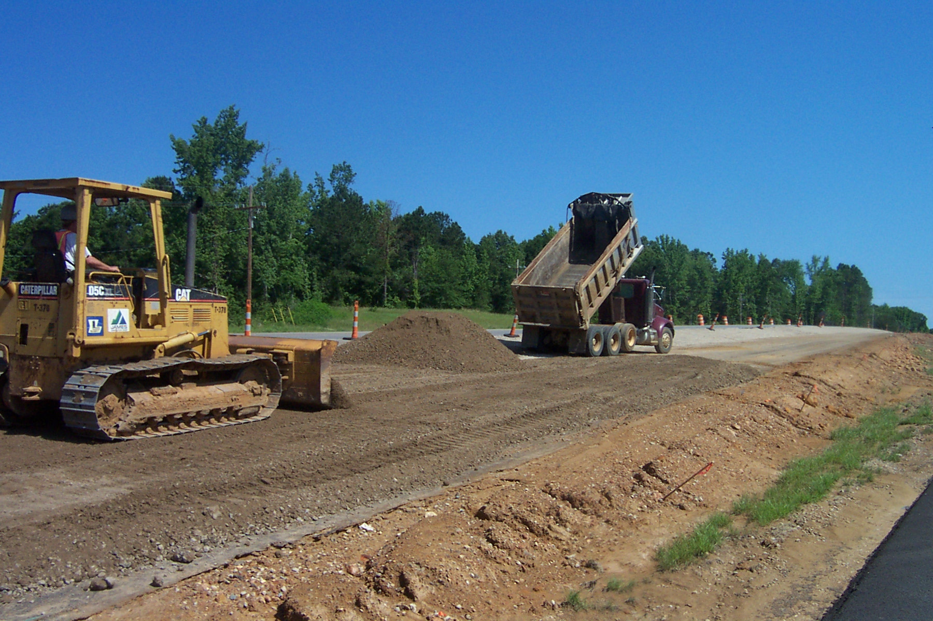
US 167 Dubach, Louisiana

Slide 31
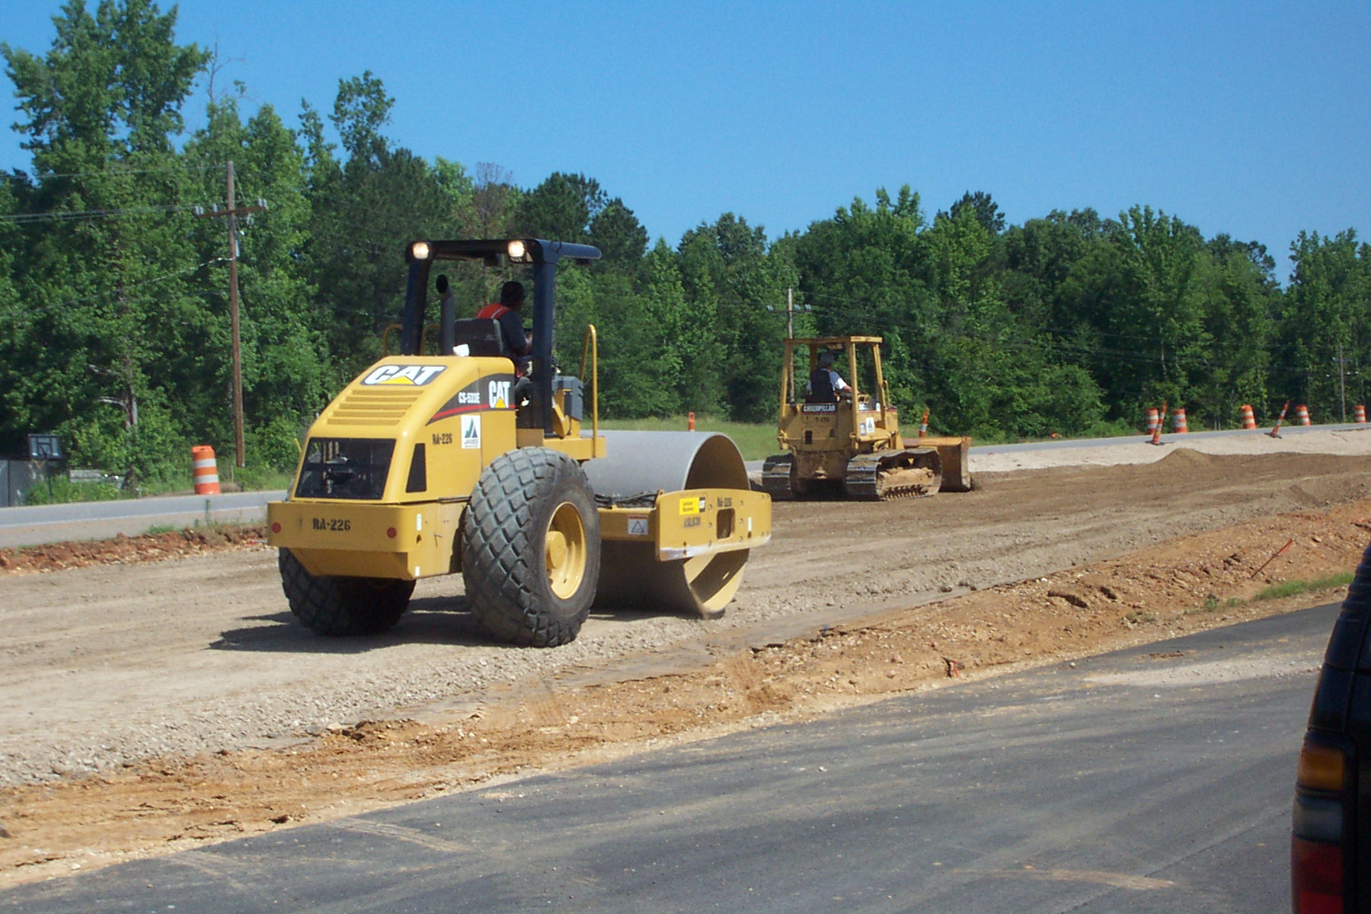
US 167 Dubach, Louisiana

Slide 32
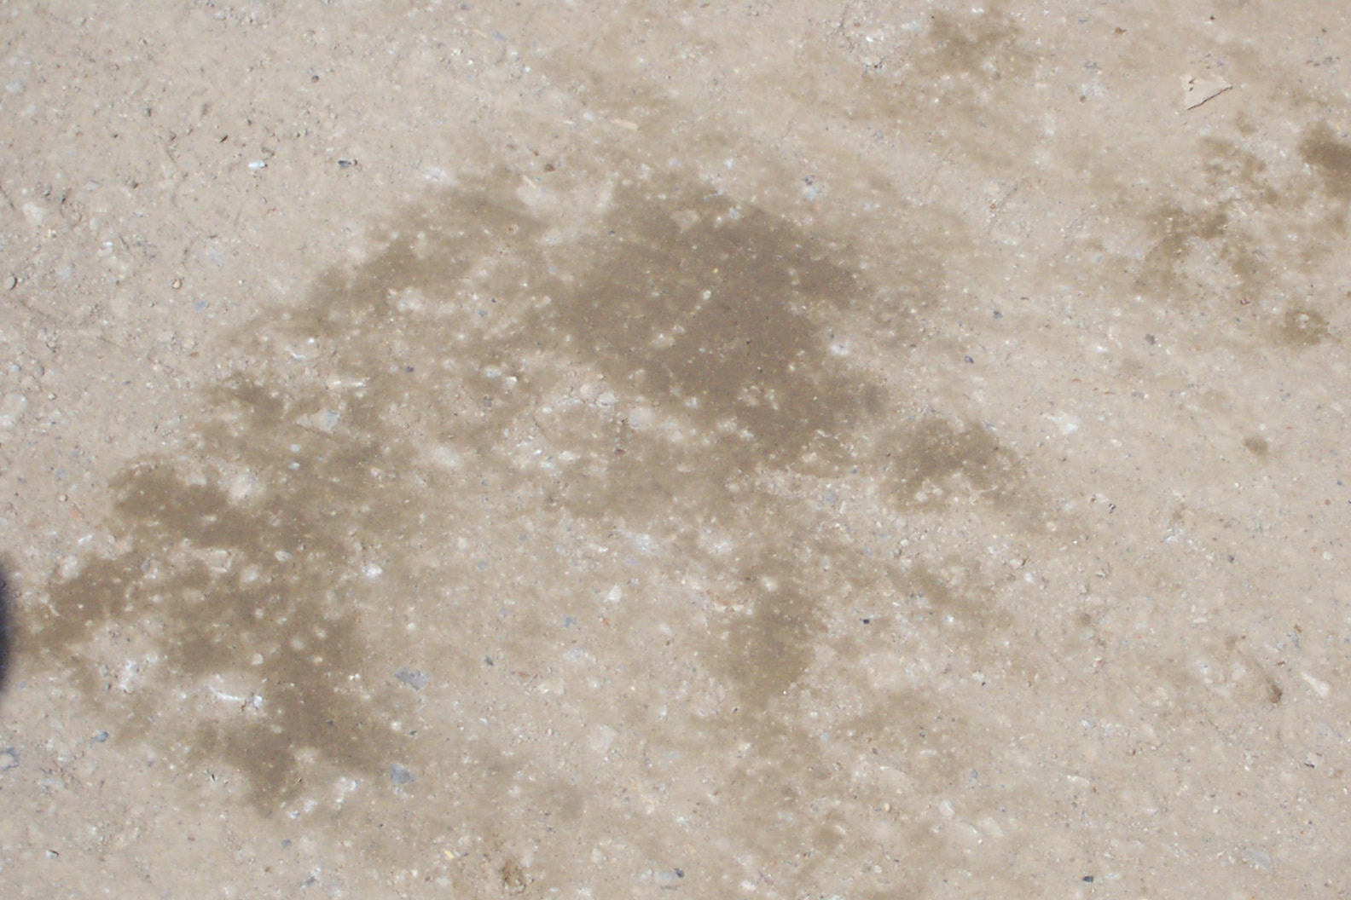
US 167 Dubach, Louisiana

Slide 33
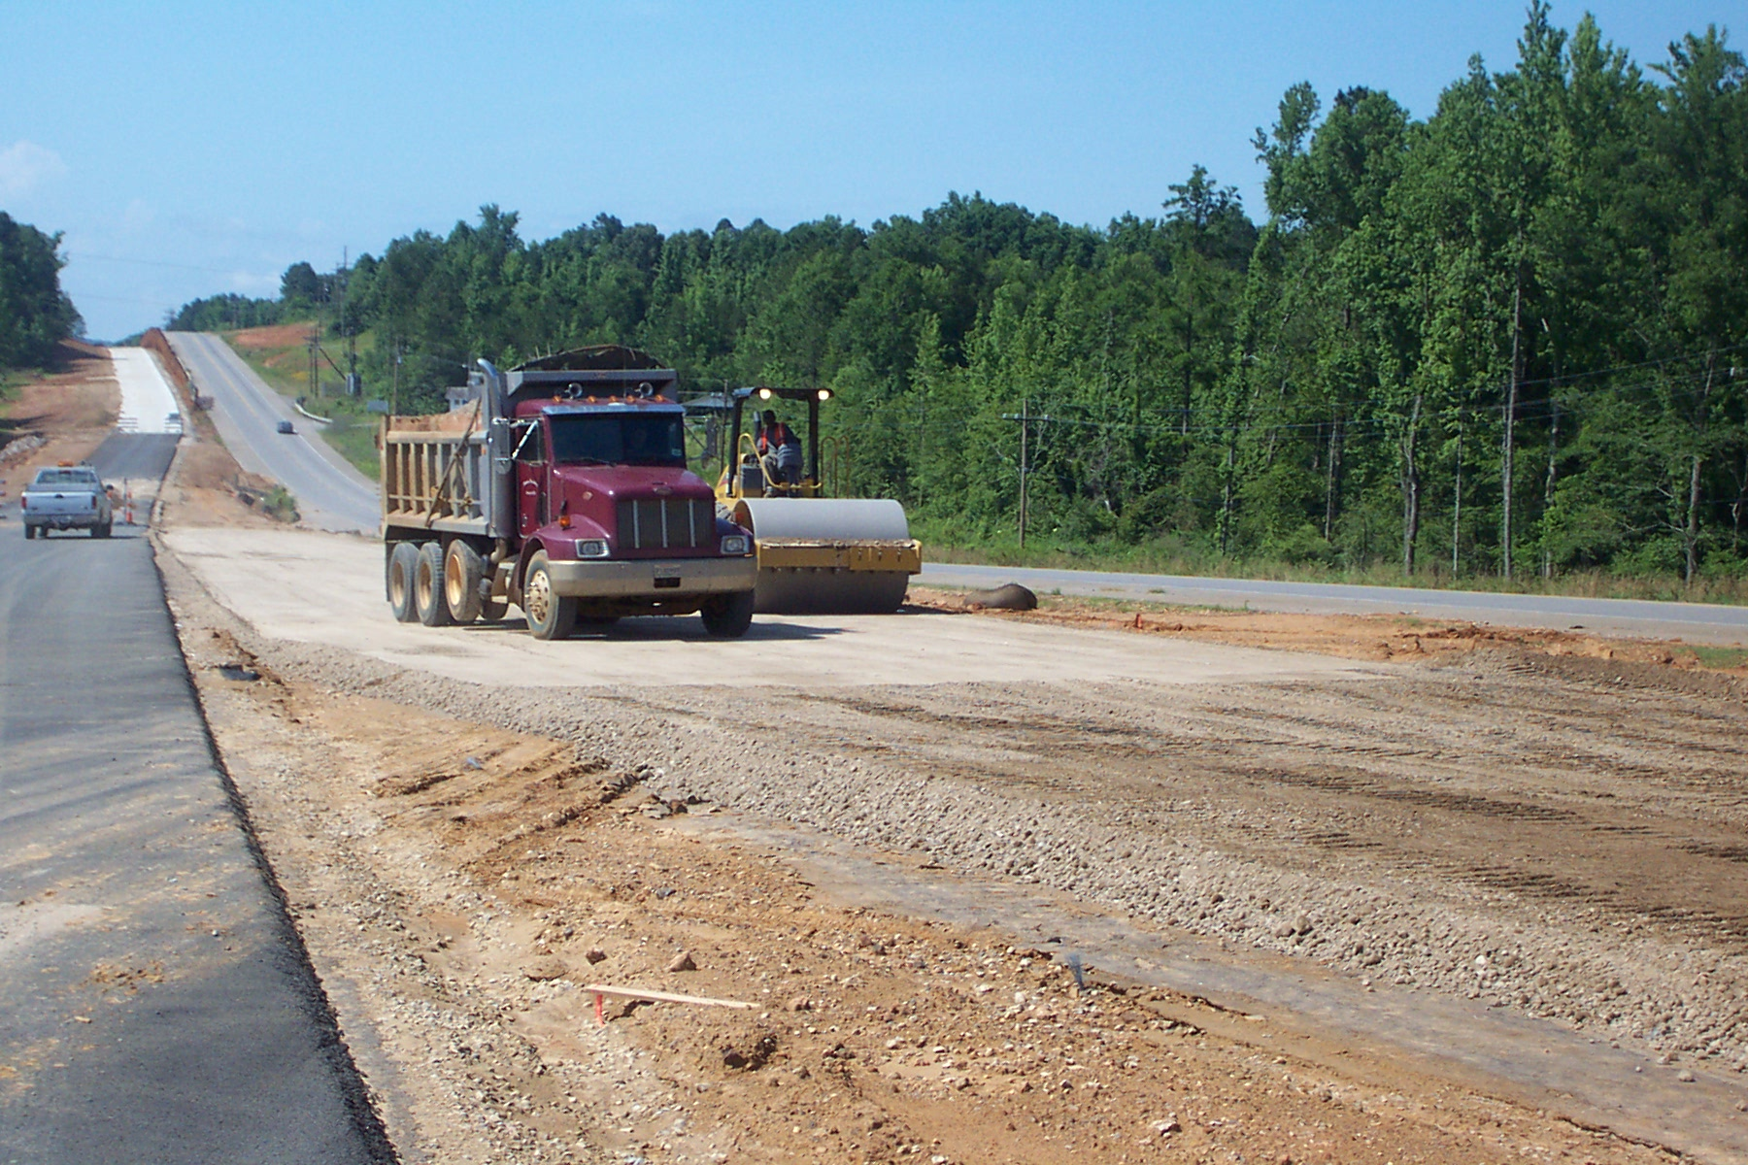
US 167 Dubach, Louisiana

Slide 34
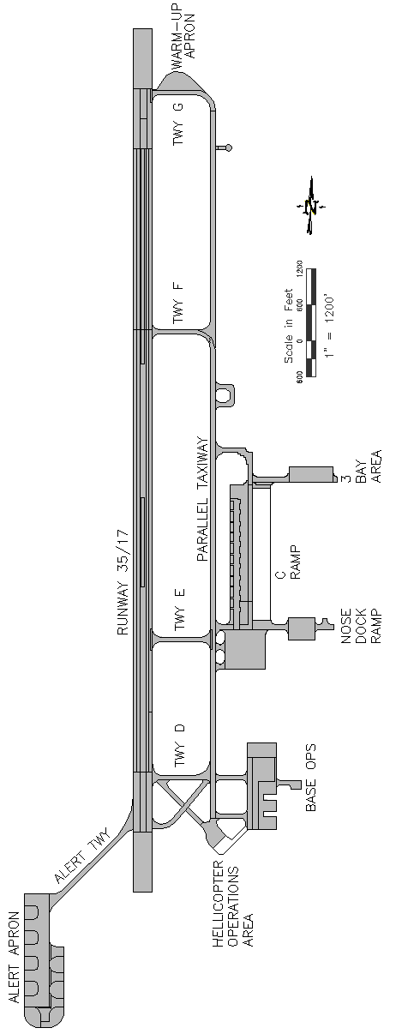
Grand Forks AFB, ND and MN border
Severe winter climate
Existing D-cracked pavement
Rubblized and crushed
On site plant
Jaw crushers with stack of sieves
Experienced issues with gradation and segregation
No construction issue

Slide 35
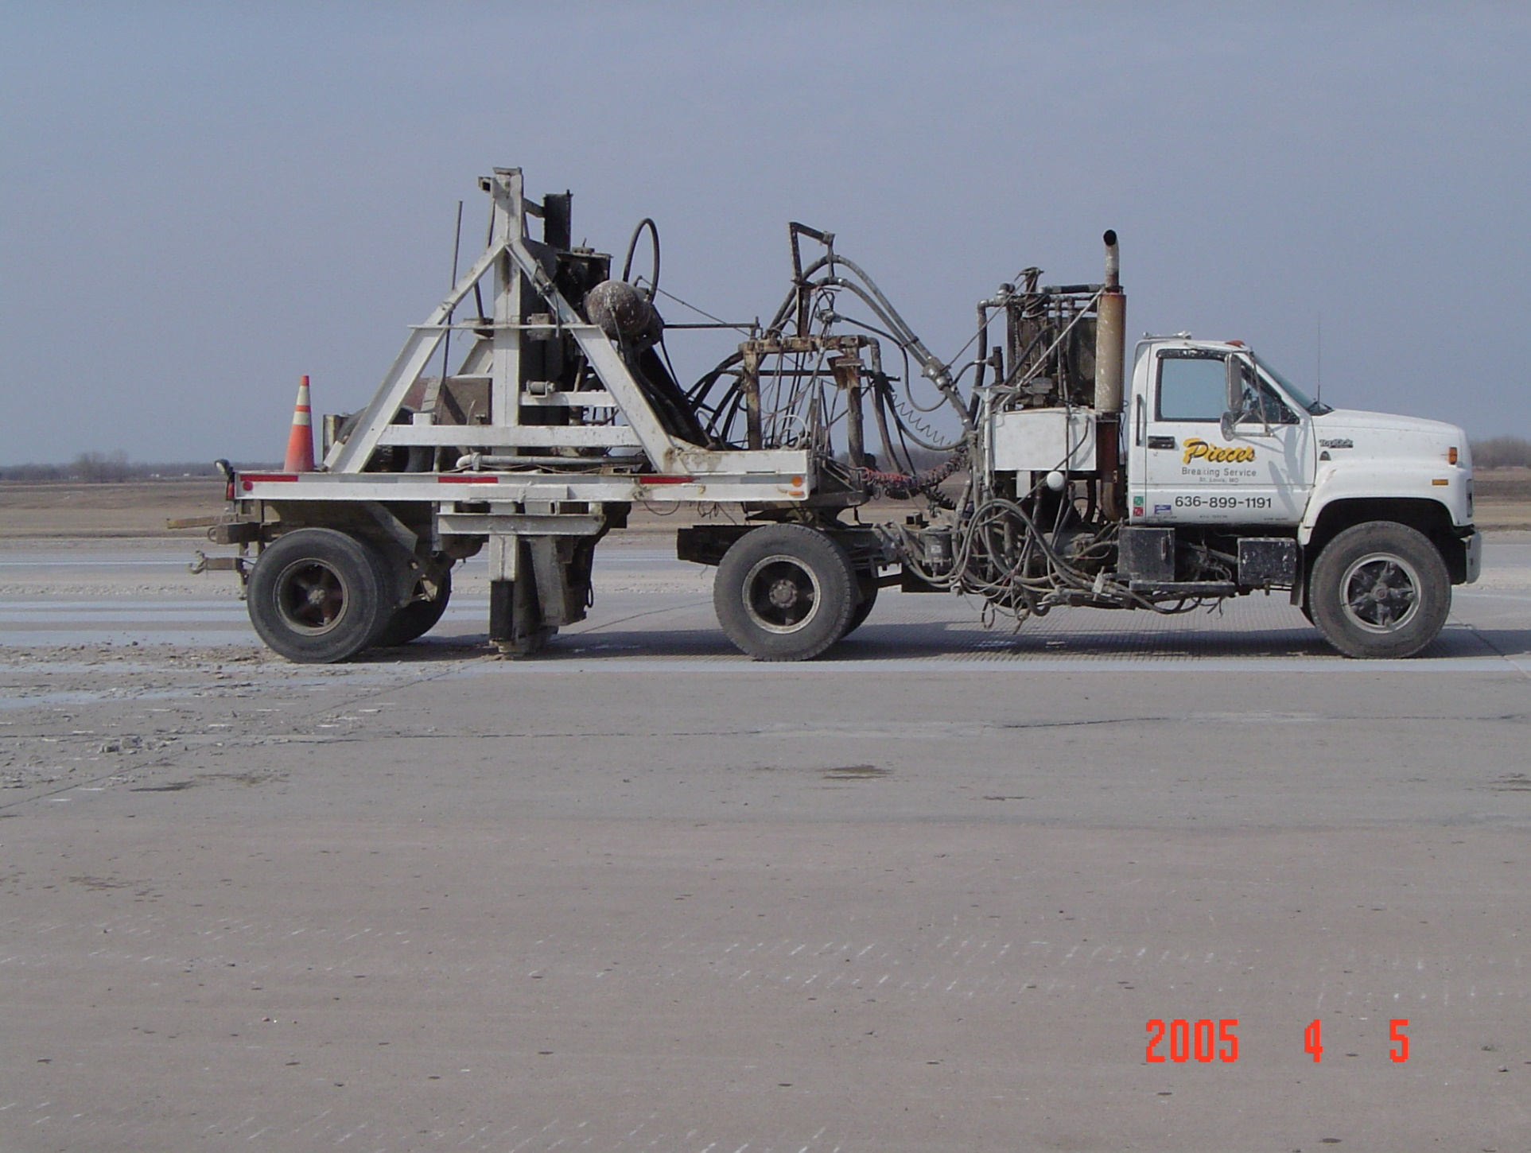
Grand Forks AFB, ND and MN border

Slide 36
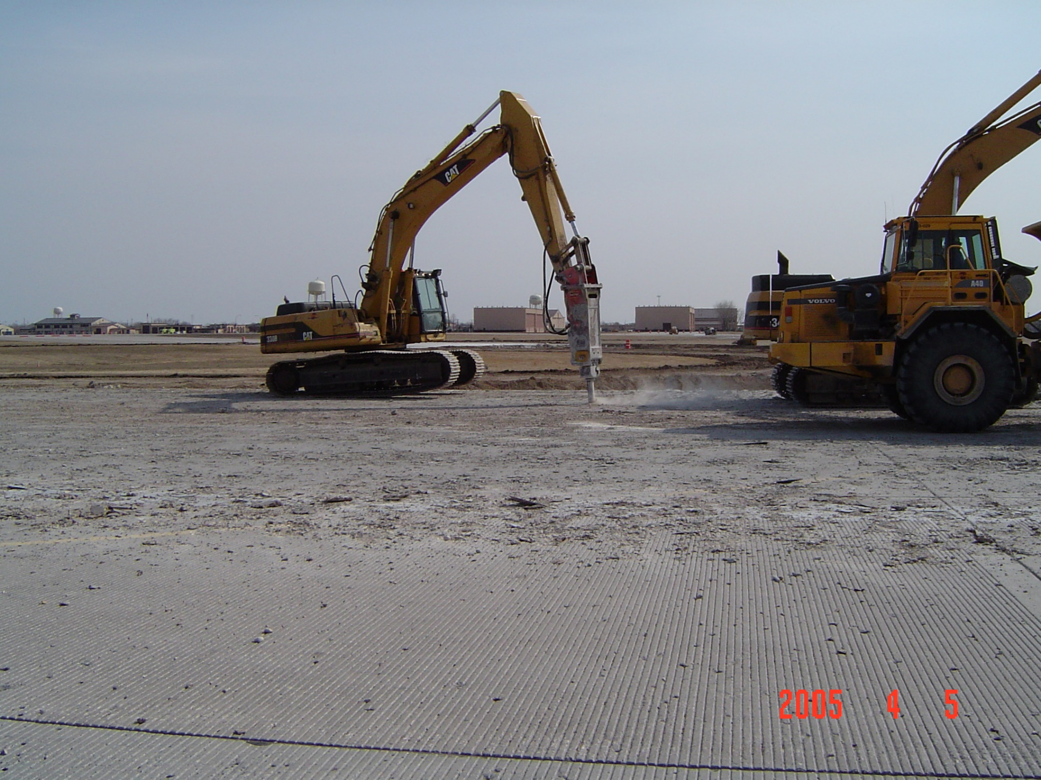
Grand Forks AFB, ND and MN border

Slide 37
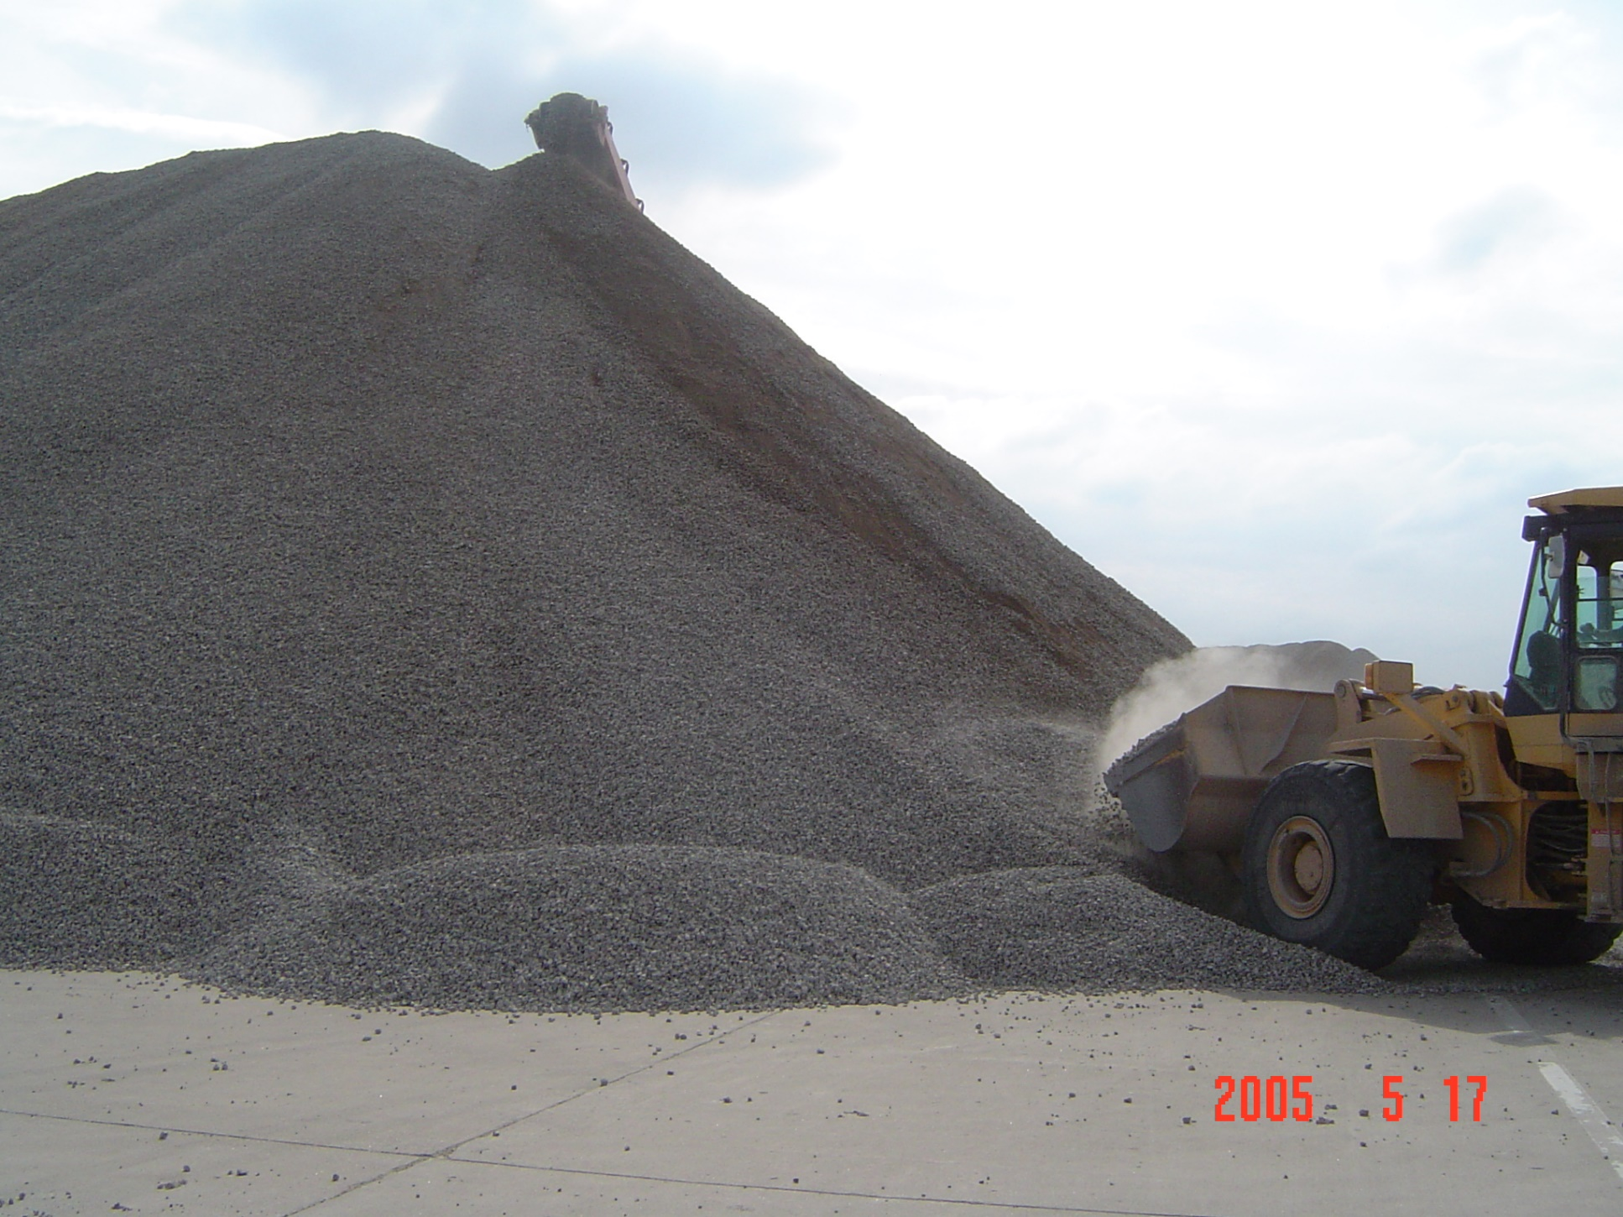
Grand Forks AFB, ND and MN border

Slide 38
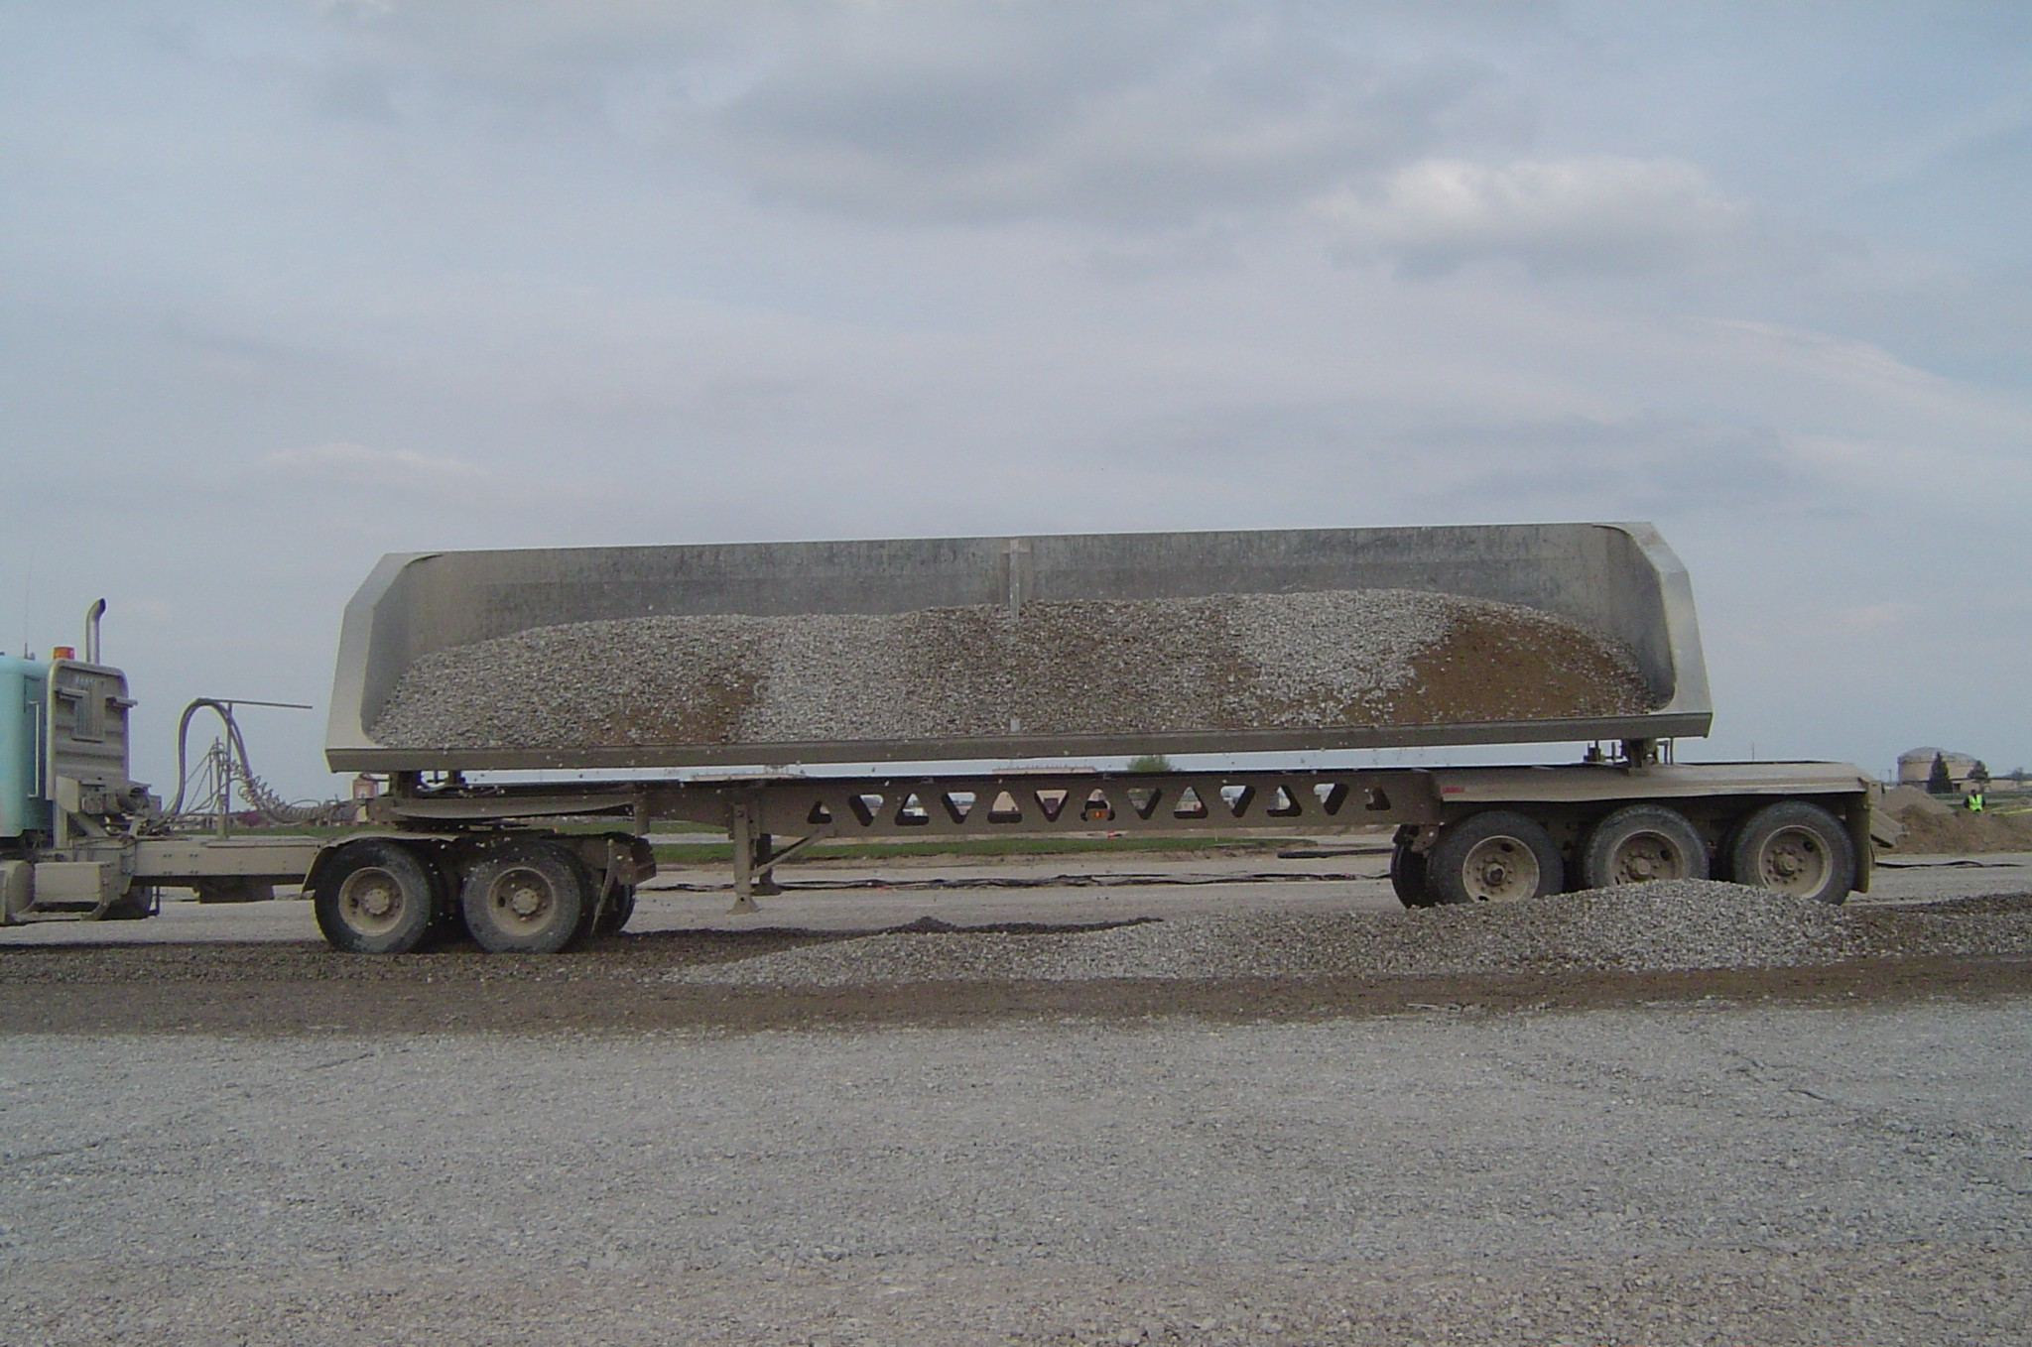
Grand Forks AFB, ND and MN border

Slide 39
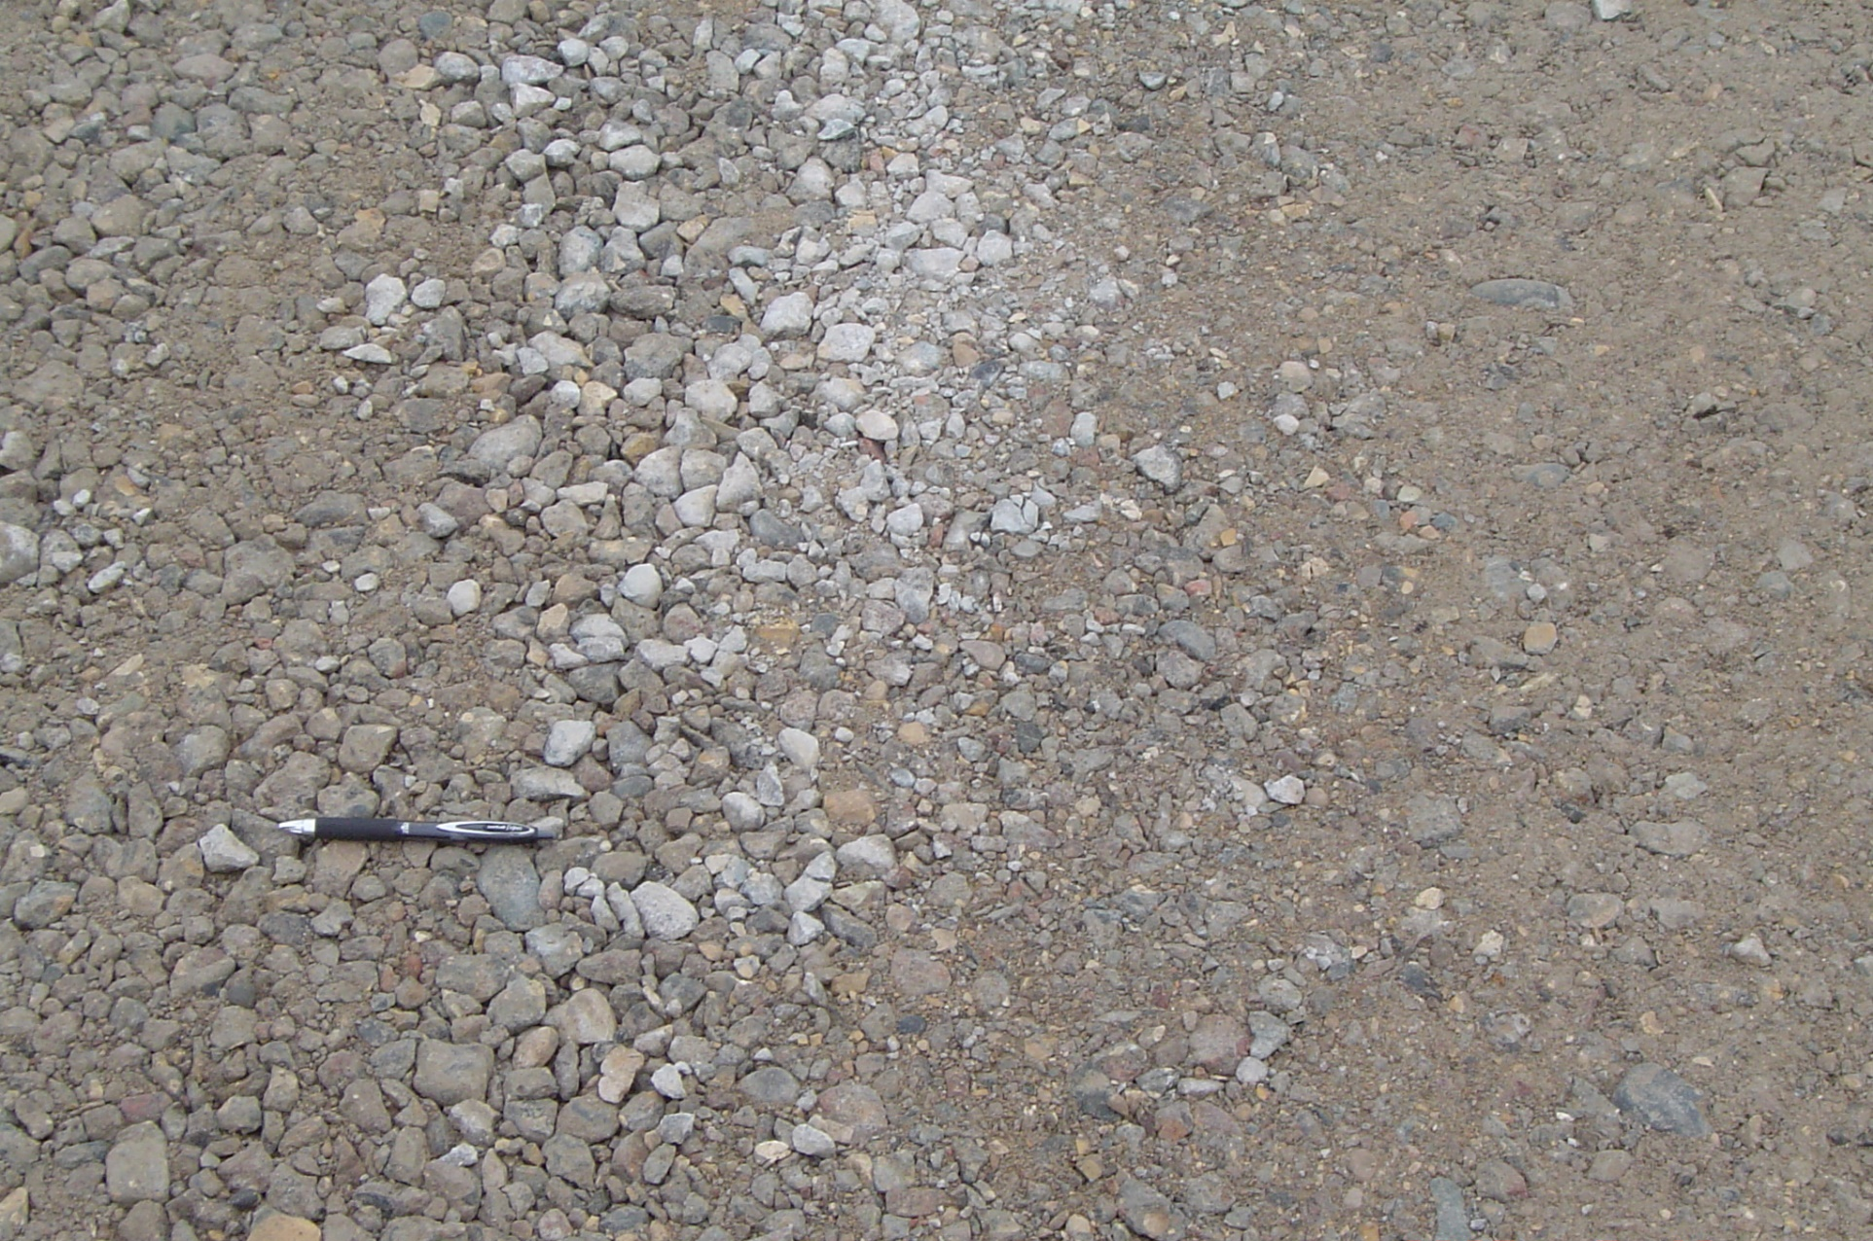
Grand Forks AFB, ND and MN border

Slide 40
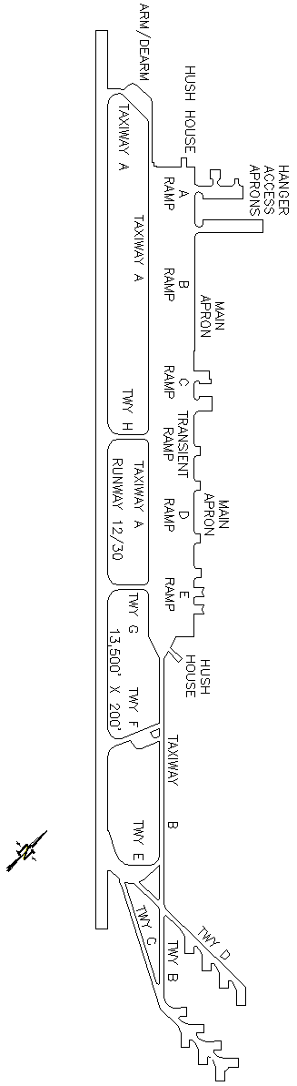
Mountain Home AFB, Idaho
Contractor option (for RW)
ASR pavement recycled
No environmental testing
Degradation concerns—did not occur
Used vibrator roller
Tested gradation before and after compaction
Success lead to additional projects
Still RCA on site for roads, etc.

Slide 41
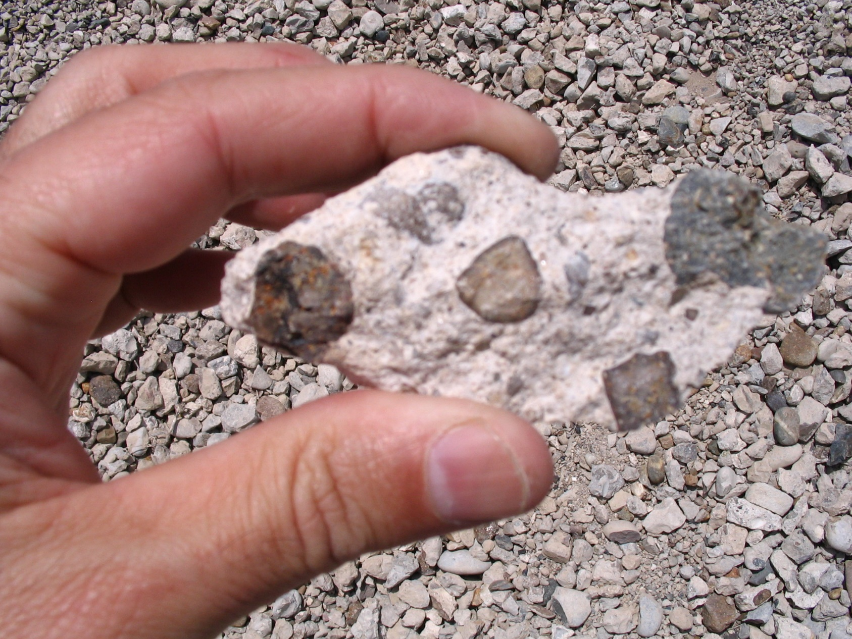
Mountain Home AFB, Idaho

Slide 42
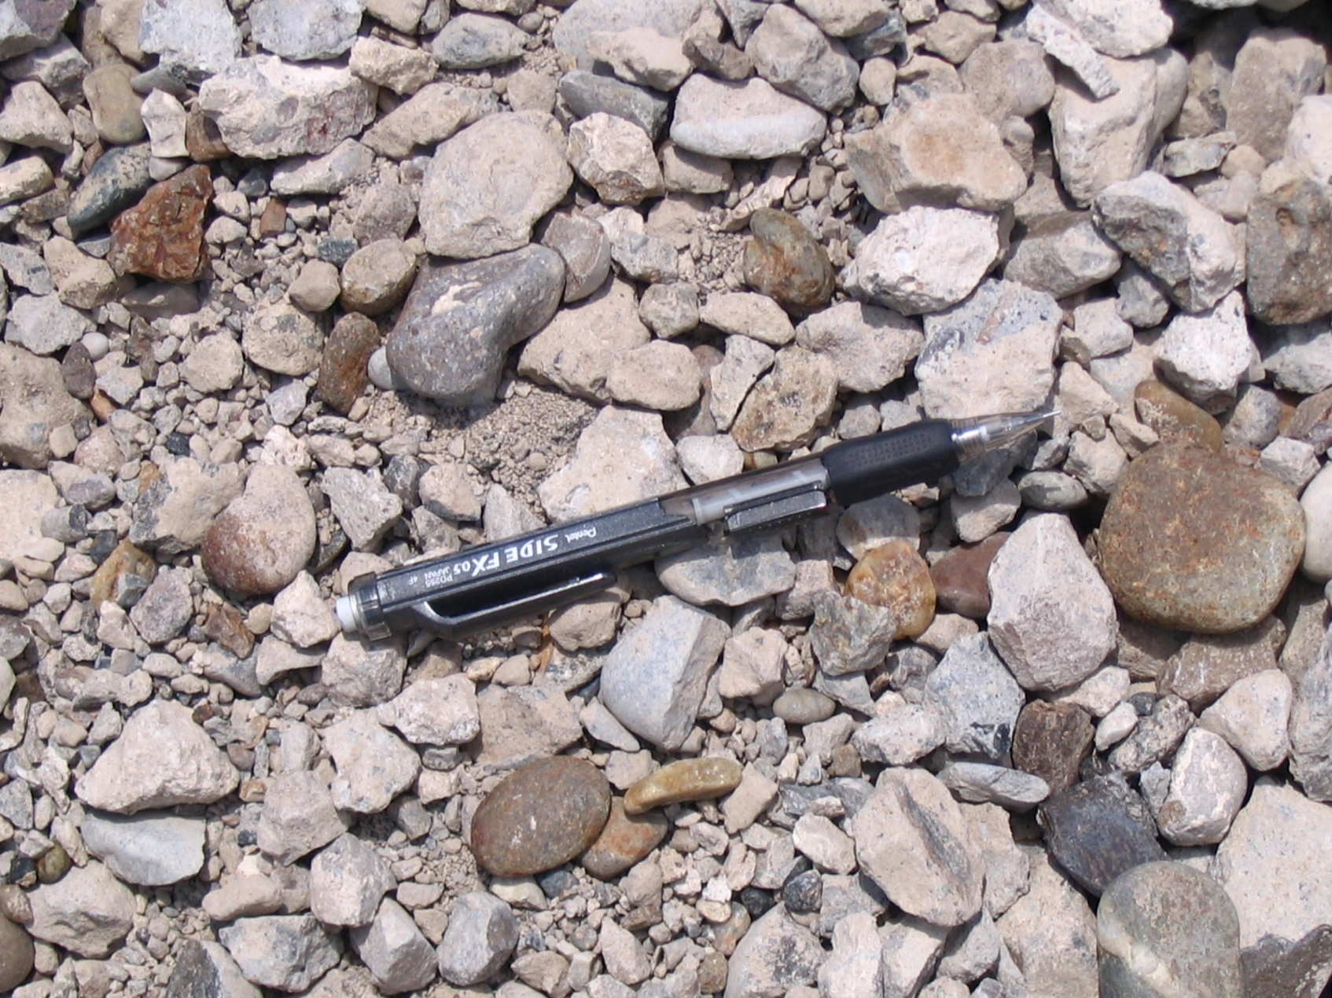
Mountain Home AFB, Idaho

Slide 43
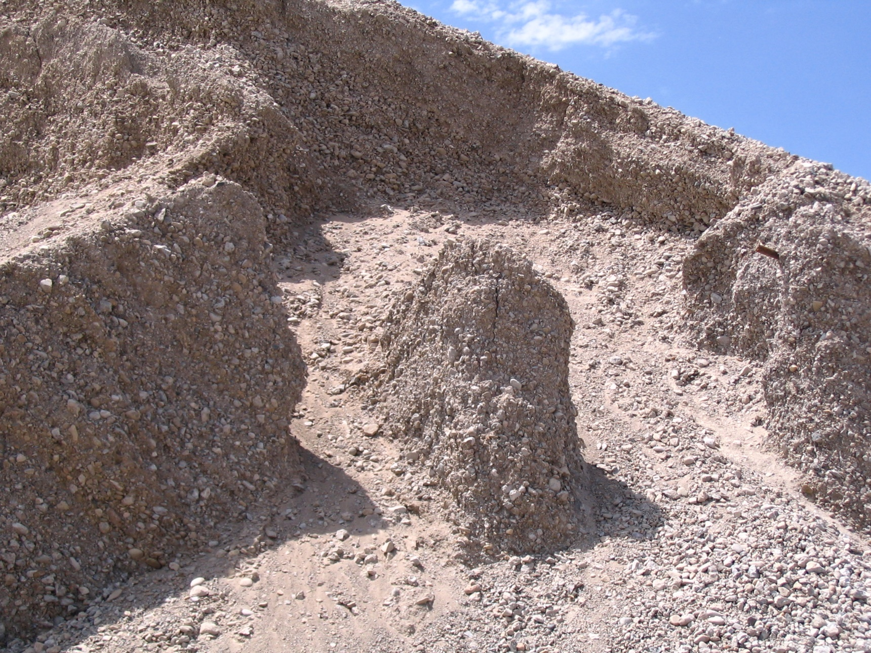
Mountain Home AFB, Idaho

Slide 44
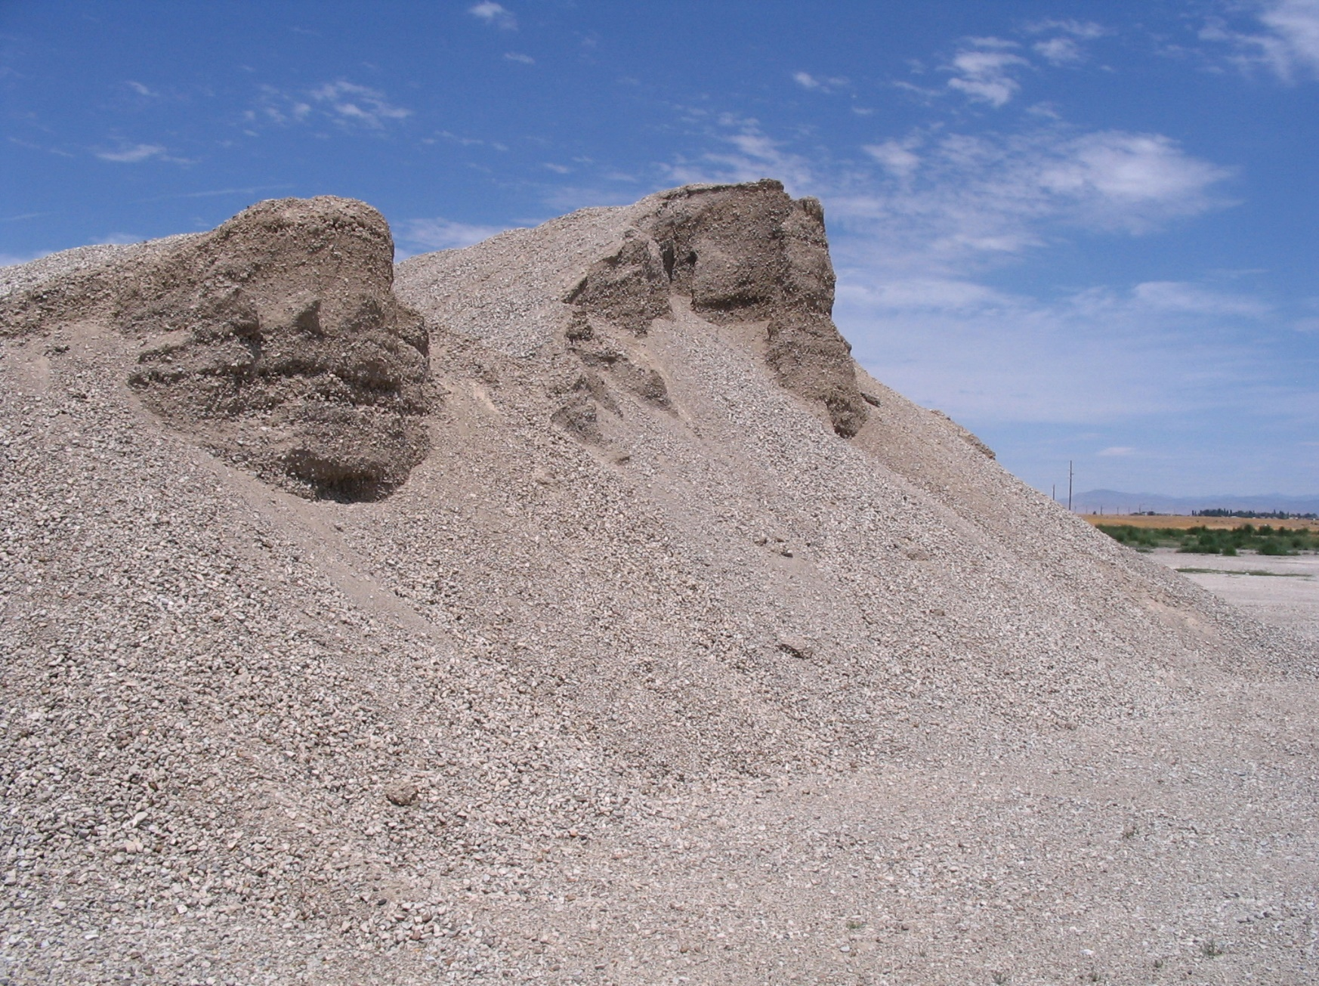
Mountain Home AFB, Idaho

Slide 45
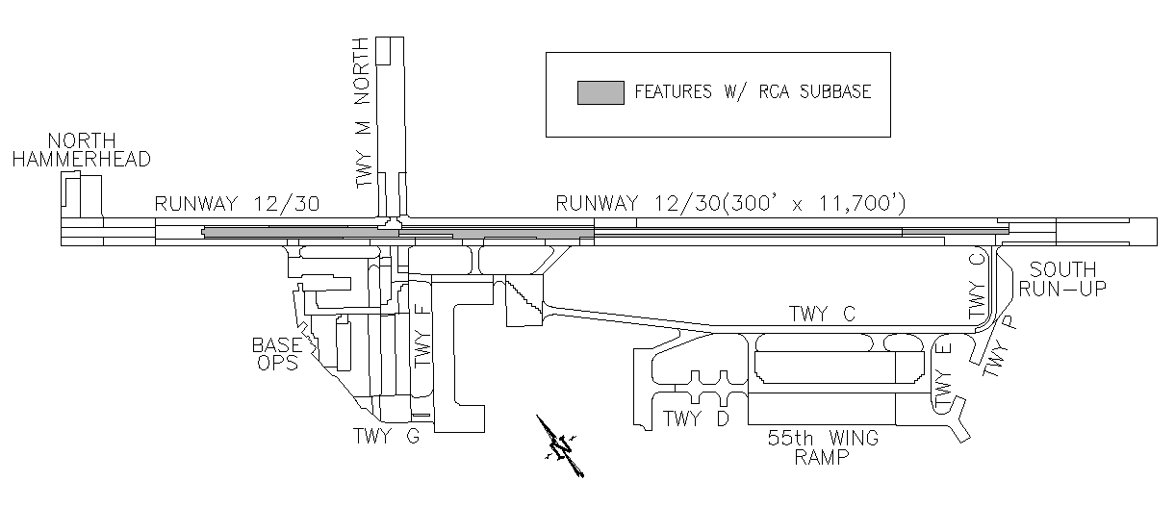
Offutt AFB, NB
Runway 12-30 – keel section
RCA – rapid drainage material
Treated as virgin aggregate for requirements
Test section used
LA abrasion: met 42 to 44 (spec was 45% loss)
Static rollers used for compaction
Exceeded virgin aggregate except LA abrasion

Slide 46
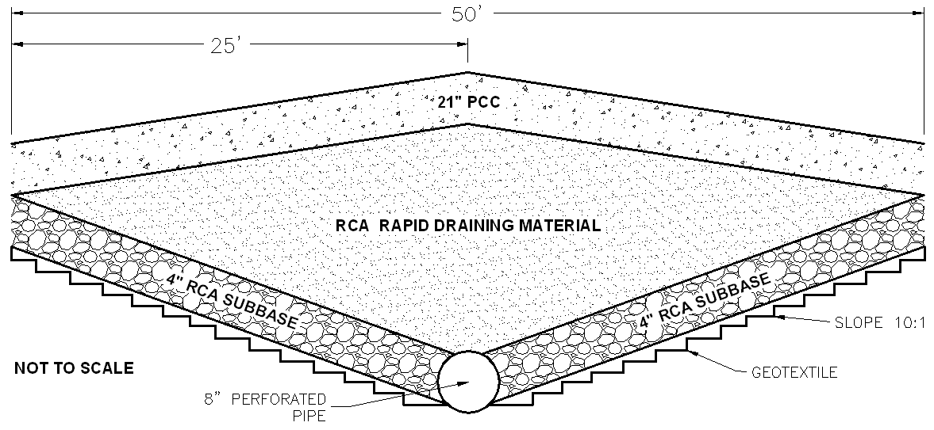
Offutt AFB, NB
Runway 12 -30 keel section replacement

Slide 47
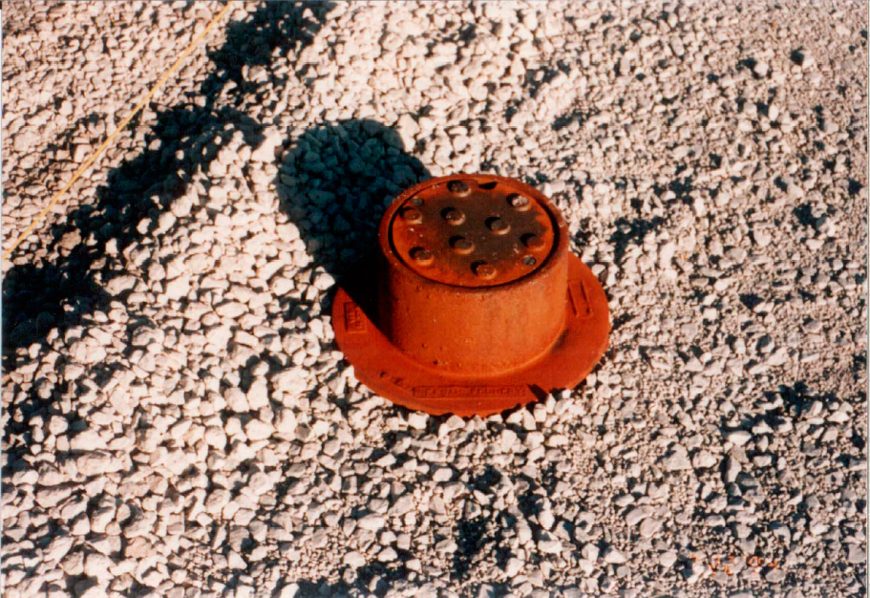
Offutt AFB, NB

Slide 48
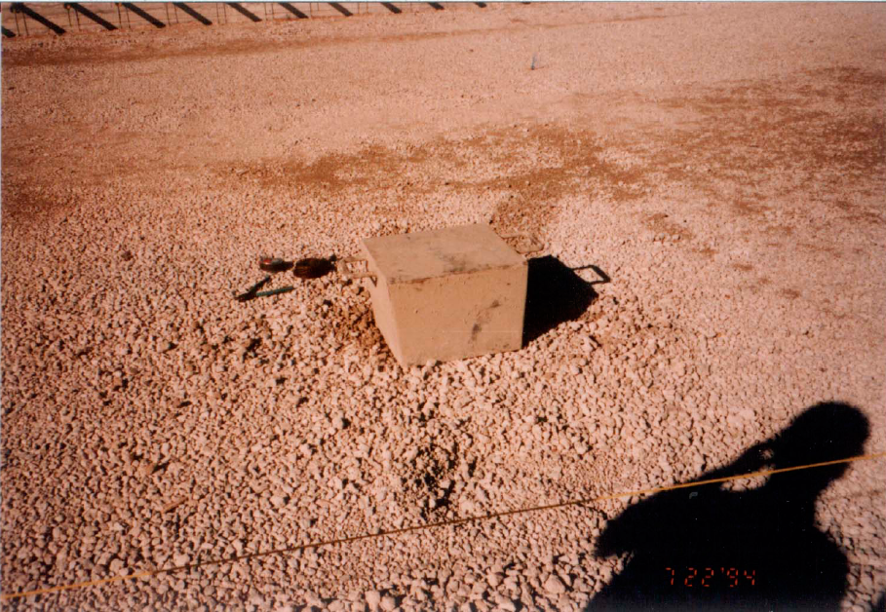
Offutt AFB, NB

Slide 49
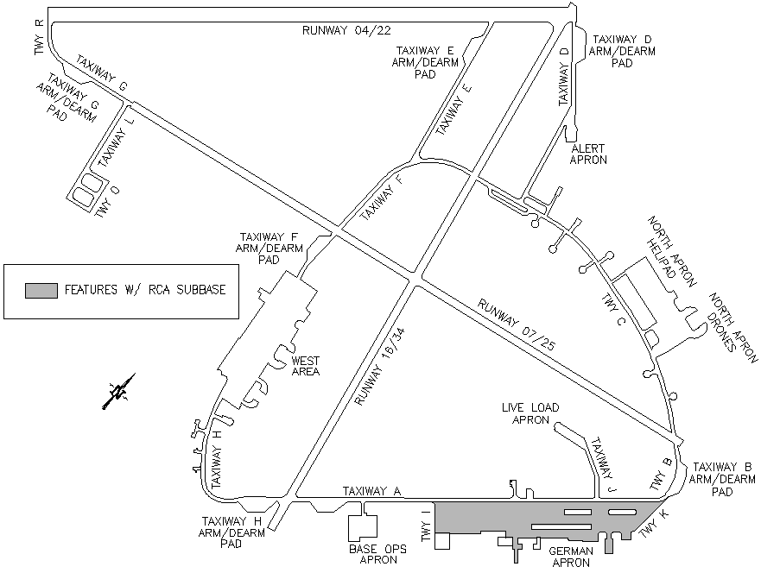
Holloman AFB, New Mexico
Apron pavement construction
2 to 5 feet of fill
Contractor proposed using PCC with no visible distress – government accepted
Sulfate resistant concrete crushed and used
Sever upheaval occurred on apron
Sulfate attack on sulfate crushed concrete?

Slide 50
Hartsfield-Jackson Atlanta International Airport
Numerous RW replacements
Wasted slabs kept in “bone yard”
RCA used in deep fill, taxiway, and roads
Must exceed all virgin aggregate requirements
LA abrasion test allowed 51 to 65%
RCA produced on site from some ASR PCC
Adequate performance
Economic saving (mostly landfill cost)

Slide 51
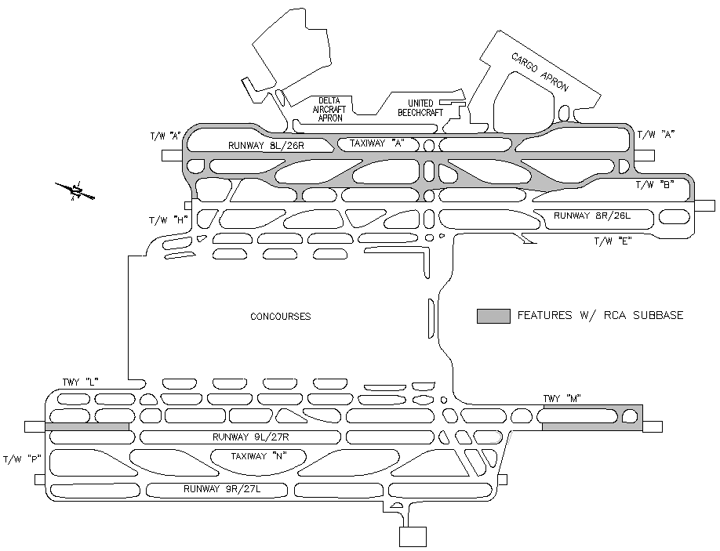
Hartsfield-Jackson Atlanta International Airport

Slide 52
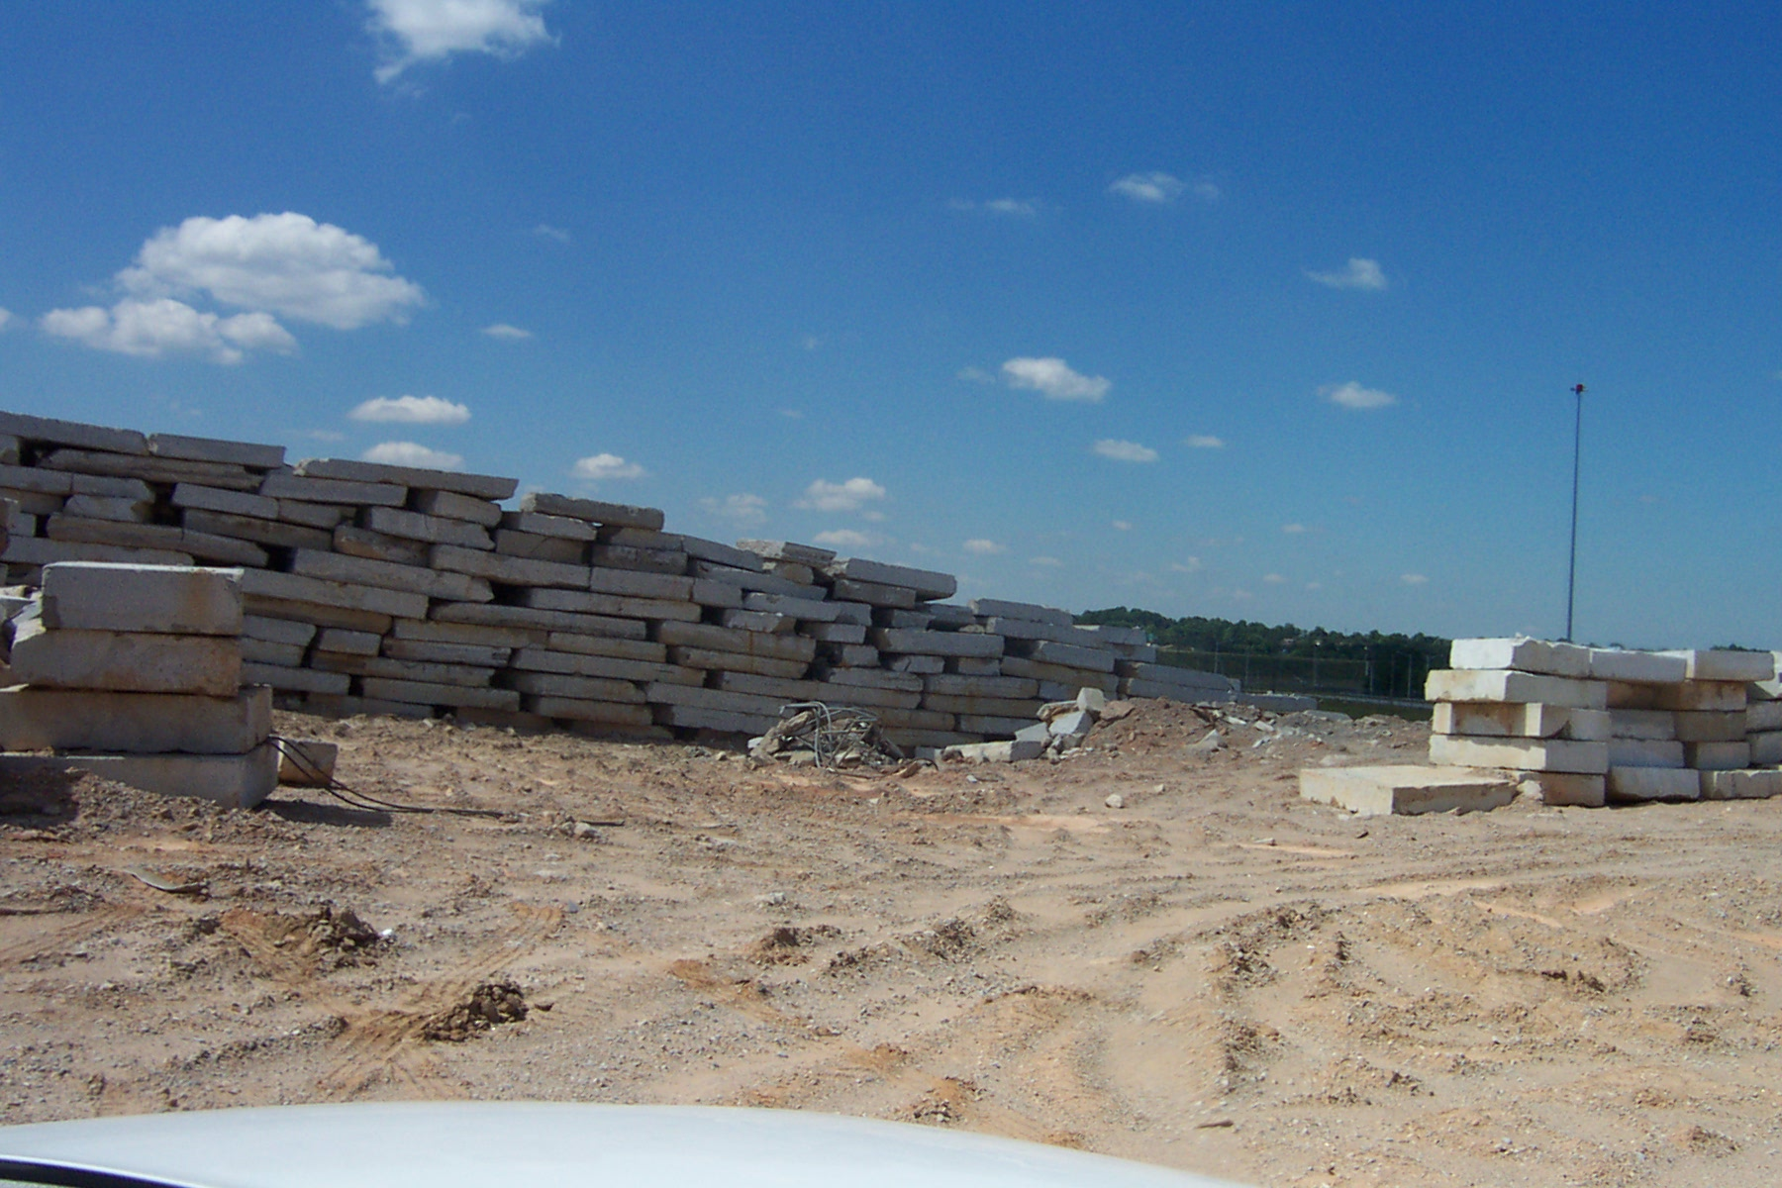
Hartsfield-Jackson Atlanta International Airport

Slide 53

Tinker AFB OK, AWACS Ramp

Slide 54
Case Studies Summary
Successfully use at commercial and military airports
Most cases—exceeded virgin aggregate requirements
Reasons cited – economic
Produced successfully for open and dense graded
Standard construction practices
    Easier compaction
    Perceived better that virgin aggregate
    Easier to handle during construction
    Stable working platform (even when wet)

Slide 55
Caution – experience is the key
High water demand: consider during planning
Segregation: must have good stockpile management
Grading Control: check before and after compaction to alleviate concerns of degradation.
Plant operations: proper crushing is key to producing quality RCA
Density control: water content is critical
Proper placement methods: asphalt paver or box spreader to minimize segregation

Slide 56
Conclusion and Recommendations
RCA can and is being used as unbound base
RCA should not be used where sulfate exposure can be expected
RCA is not a hazard to the environment
Hydration of residual cement has not been shown to be significant
RCA is typically better economically
FAA Guide specifications are available (i.e. FAA AC 150/5370-10; item P-219

Slide 57
