Slide 1

Airfield Asphalt
Mixture Optimization

Slide 2
AI To Hire New Engineer
The Asphalt Institute has begun the search for a new AI Regional Engineer covering Canada and providing direct support to AI’s Director of Engineering.
This is a new full-time AI position that focuses on supporting our Canadian members and larger user agencies in Canada (50 percent) and the advancement of Institute-level issues and objectives (50 percent).
The desired location is Lexington, Kentucky, but location is negotiable based on candidate credentials and best fit for the job. A job posting with the full job description is also available on AI's homepage under "Careers."
Feel free to notify those that may be interested. All submissions must be sent by email to cobrien@asphaltinstitute.org by Monday, October 16, 2017.
Preliminary inquiries can also be directed to Dr. Mark Buncher, Director of Engineering, mbuncher@asphaltinstitute.org, 859-288-4972.

Slide 3
Evolution of Traffic
Stress
Interstate highways - 1956
AASHO Road Test - 1958-62
  still widely used for pavement design
  legal truck load - 73,280 lbs.
Legal load limit to 80,000 lbs. - 1982
  10% load increase
  40-50% greater stress to pavement
Radial tires, higher contact pressure
FAST Act raising load limit to 120,000 lbs. (in select locations)

Slide 4
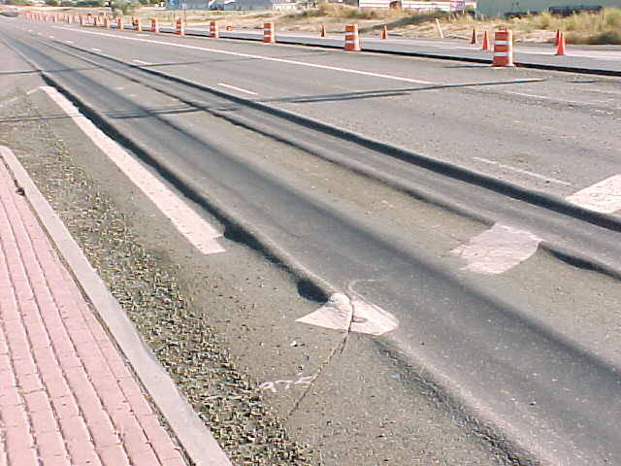
Led to Rutting in 1980’s
Courtesy of pavementinteractive.org

Slide 5
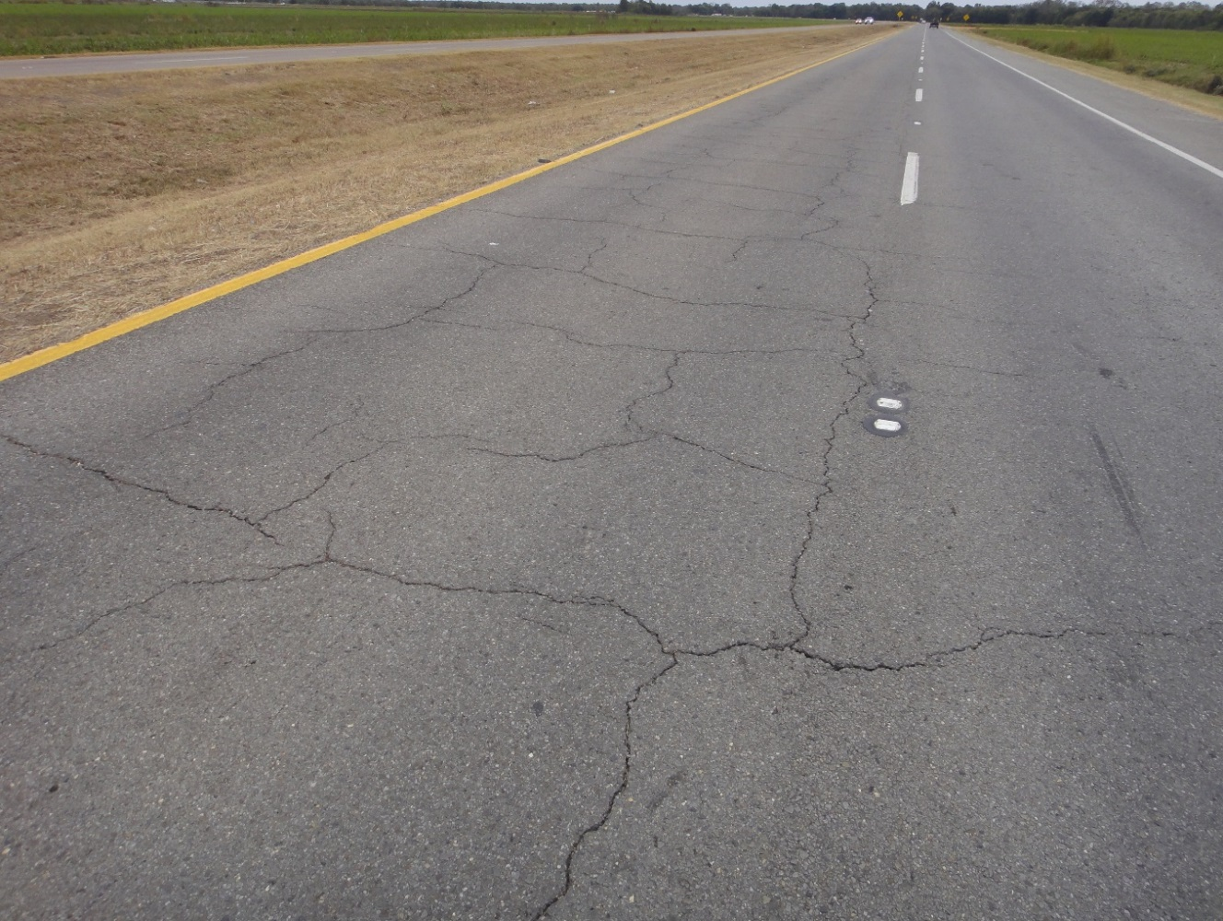
Which led to…Superpave
Fixed the rutting problem
Gyratory compaction lowered binder contents
Add in higher and higher recycled materials?

Slide 6
History of Mix Design
1890
Asphalt cement 12 to 15% / Sand 70 to 83% / Pulverized carbonite of lime 5 to 15%
1905
Clifford Richardson, New York Testing Company
1920s
Hubbard Field Method (Charles Hubbard and Frederick Field)
Sand asphalt design
Barber Asphalt Paving Company
Surface sand mix: 100% passing No. 10, 15% passing No. 200, 9 to 14% asphalt
Asphaltic concrete for lower layers, VMA terminology used, 2.2% more VMA than current day mixes or ~0.9% higher binder content
30 blow, 6” diameter with compression test (performance) asphaltic concrete design (Modified HF Method)
1927
Francis Hveem (Caltrans)
Surface area factors used to determine binder content; Hveem stabilometer and cohesionmeter used
Air voids not used initially, mixes generally drier relative to others, fatigue cracking an issue
1943
Bruce Marshall, Mississippi Highway Department
Refined Hubbard Field method, standard compaction energy with drop hammer
Initially, only used air voids and VFA, VMA added in 1962; stability and flow utilized
1993
Superpave
Level 1 (volumetric)
Level 2 and 3 (performance based, but never implemented)
BINDER CONTENT LOWER
Stability
Stability + Durability
Stability + Durability
http://asphaltmagazine.com/history-of-asphalt-mix-design-in-north-america-part-2/

Slide 7
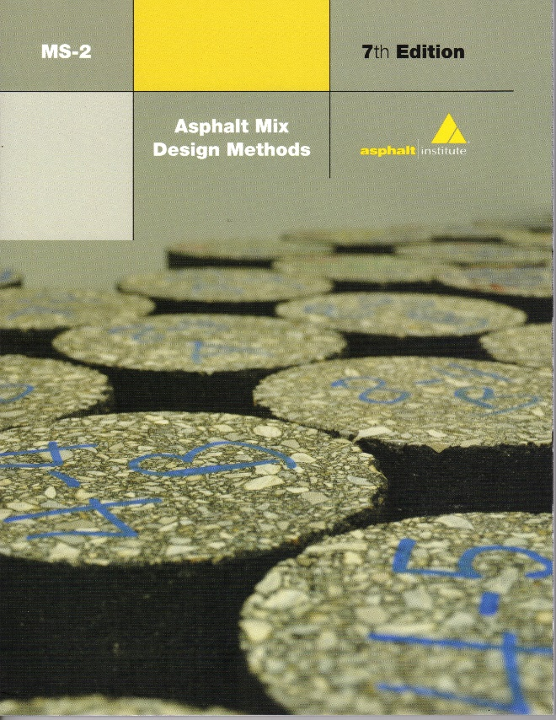
Mix Design Objective
“…to determine the combination of asphalt cement and aggregate that will give long lasting performance as part of the pavement structure…”
  Asphalt Institute MS-2, Asphalt Mix Design Methods, 7th Edition

Slide 8
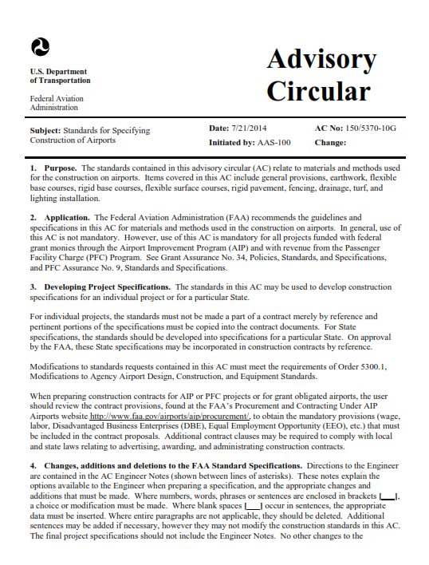
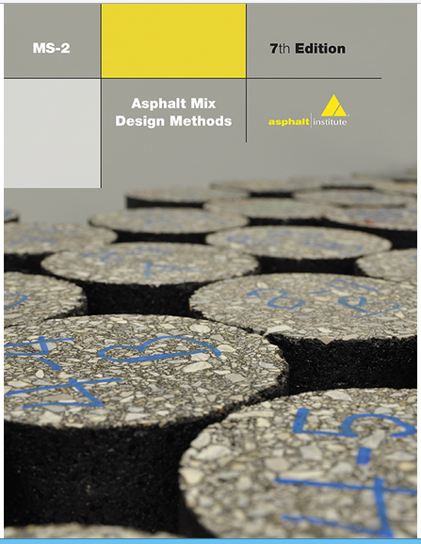
P-401: Hot-Mix Asphalt Pavements
Directly references AI MS-2 for use in developing the HMA mixture design
Marshall and Gyratory Methods of mix design
Reference: AC 150/5370-10G

Slide 9
Desirable Mixture Properties
We want:
Stability
Durability
Impermeability
Workability
Flexibility
Fatigue Resistance
Skid Resistance
We do not want :
Rutting or shoving
Cracking or raveling
Permeable pavements
Difficulty in handling
Cracking after repeated loading
Slick pavement surface

Slide 10
Marshall Criteria, P-401 Table 1
Test Property | Gross Wt ≥ 60 kips or Tire Pressures ≥ 100 psi | Gross Wt < 60 kips or Tire Pressures < 100 psi
No. of Blows | 75 | 50
Stability, lbs (min) | 2150 | 1350
Flow, 0.01 in | 10 - 16 | 10 - 18
Target Air Voids, % | 3.5 | 3.5
Reference: AC 150/5370-10G

Slide 11
Gyratory Criteria, P-401 Table 1
Test Property | Gross Wt ≥ 60 kips or Tire Pressures ≥ 100 psi | Gross Wt < 60 kips or Tire Pressures < 100 psi
No. of Gyrations | 75 | 50
Target Air Voids, % | 3.5 | 3.5
Reference: AC 150/5370-10G

Slide 12
Component Diagram
VOLUME
MASS
V_{a}
Air
Mass of Air = 0
VMA
VFA
Mass
AC
Mass
eff AC
AC
V_{mb}
V_{ba}
Total
Mass
Absorbed AC
V_{sb}
V_{se}
Aggregate
Mass
aggregate
Reference: AI MS-2

Slide 13
Minimum VMA, P-401 Table 2
Aggregate (See Table 3) | Minimum VMA
Gradation 3 | 16 %
Gradation 2 | 15 %
Gradation 1 | 14 %
Reference: AC 150/5370-10G

Slide 14
Why design to 4.0 % Air Voids?
Field performance has shown that typical mixtures designed with low air voids (maybe < 2%) are susceptible to rutting and shoving
Typical mixtures designed over about 5% air voids are susceptible to raveling, oxidation and a general lack of durability
4% air void design is an empirically derived target that allows for thermal expansion of the binder along with a cushion for future compaction

Slide 15
Why consider balanced mix design?
The bottom line
With Superpave, agencies do not have significant rutting
Agencies are experiencing more cracking issues
Nothing “magic” about the target of 4% air voids
Some mixes may perform better at other A/V contents
“Optimum” binder content is often different than “design” binder content
Perhaps we should consider designing for performance instead of “to the spec”

Slide 16
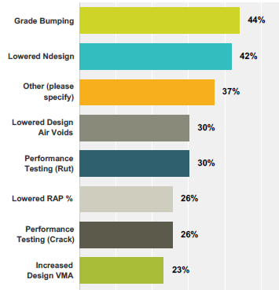
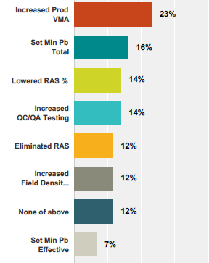

Agencies Are Searching for Solutions: Spec Changes
Survey Question: Which of the following specification changes has your DOT implemented in the last 5 years?

Slide 17

Balance the Mix Design
Improved Durability
Strength/
Stability
Rut Resistance
Shoving
Flushing Resistant
Durability
Crack Resistance
Raveling
Permeability
DON’T ATTACK ONE HALF AT THE EXPENSE OF THE OTHER HALF!!
Notes:
Mix design is a balance between strength and durability. We can design and mix that will be highly rut resistant, but it will not be durable. Or we can design a very durable mix that will be prone to rutting. The key is to balance the various constituents so as to best produce a mix that will resist rutting and yet last for years. On top of it all, we want a smooth quite ride.

Slide 18
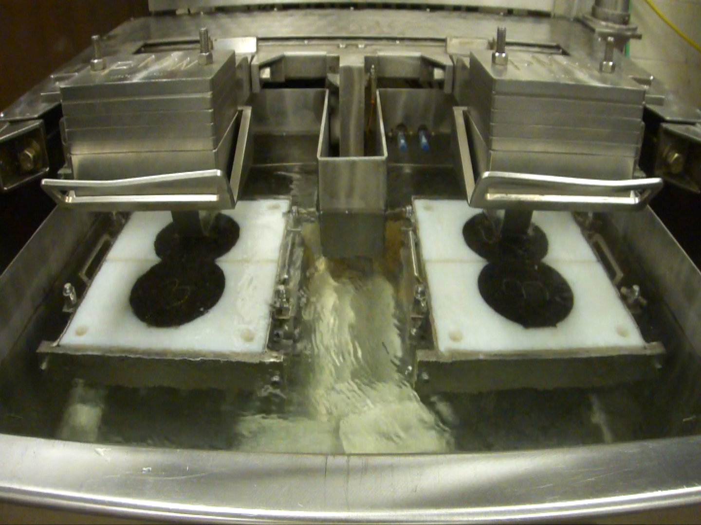
Hamburg Wheel Tracker (HWT)
Applies load on steel wheel directly on sample immersed in water at 50°C
Specimens prepared in Superpave Gyratory Compactor (SGC) to 7.0% air voids
Load on each wheel is 158 lbs.

Slide 19
Hamburg Wheel Tracker (HWT)
Also provides information regarding stripping susceptibility
Conducted under wet conditions,
  An excellent test for identifying potential stripping
  Sometimes is missed by the Tensile Strength Ratio (TSR) test
A dynamic immersion test
  Vs. static immersion mode of the TSR
  Different mechanism for measuring stripping potential
  Water is “pumped” through the
  samples by the wheel force
  Stripping is usually identified
  as the onset of a stripping slope

Slide 20
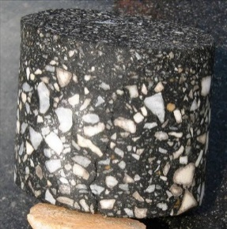
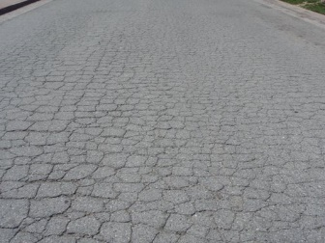

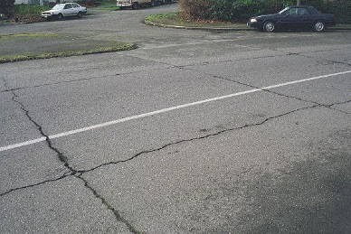
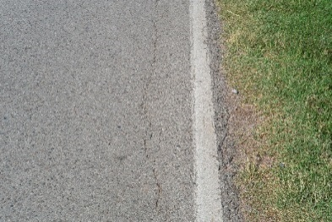
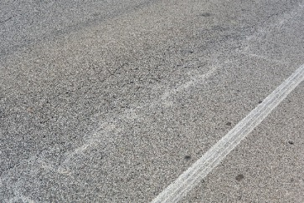
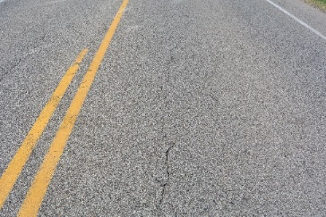
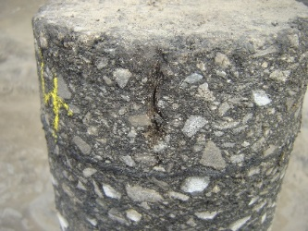
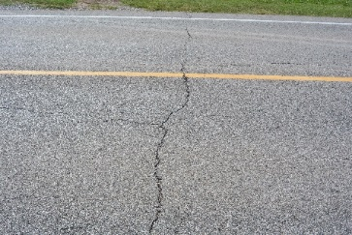
Cracking Performance Tests
  Much more complicated
  How many different kinds of cracking are there?
Bottom-up Cracking
Alligator Cracking
Block Cracking
Reflective Cracking
Edge Cracking
Fatigue Cracking
Longitudinal Cracking
Top-down Cracking
Transverse / Thermal Cracking

Slide 21

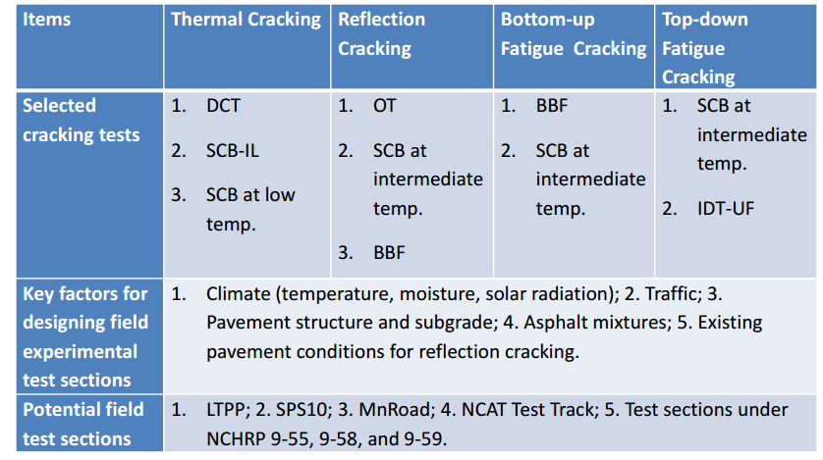
NCHRP Project 9-57 Outcomes

Slide 22
Balanced Mix Design Approach
General Procedure
  Design and test mix for Rutting
  Test mix for Cracking and/or Durability
  Performance Testing
States that are using this approach
  Texas
  Louisiana
  New Jersey
  Illinois
  California
  Wisconsin

Slide 23
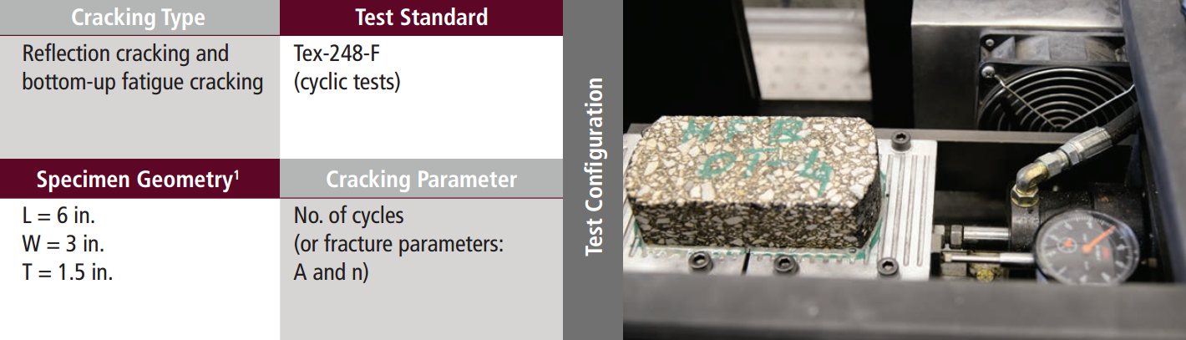
Texas Overlay Tester
Early adopter of the HWT
Needed a performance test for reflective cracking

Slide 24
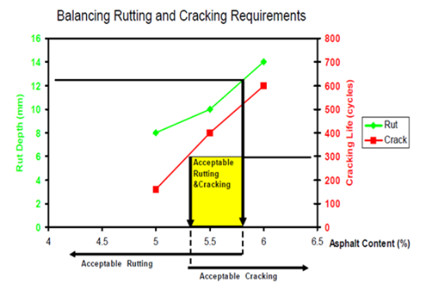
Balanced Mix Design Approach
Volumetric Design w/ Performance Verification
Texas DOT
  Volumetric design conducted
  HWTT AASHTO T 324
  Overlay Tester (OT) Tex-248-F
  Three asphalt binder contents are used: optimum, optimum +0.5%, and optimum -0.5%.
  The HWTT specimens are short-term conditioned.
  The OT specimens are long-term conditioned.
Within this acceptable range (5.3 to 5.8 percent), the mixture at the selected asphalt content must meet the Superpave volumetric criteria.

Slide 25
Case Study: NJDOT/Rutgers
Most NJ mixes below (dry) of the balanced area
Plant QC air voids requirements need to be re-evaluated to account for the added binder
Changes in production volumetrics are likely required to move the mixes in the right direction

Slide 26
Balanced Mix Design – New Jersey
Balanced Mixture Design Concept: Performance-based design
Mixes are designed to optimize performance
  Not around a target air void content
Performance criteria (limits) already determined
Take an existing mix design
  Start at a “dry” binder content
  Add binder at 0.5% increments – measure rutting and cracking
  Determine range where rutting and cracking are optimized
  Conduct volumetric work
      After establishing a binder content that results in passing rutting and cracking tests, establish resulting volumetric parameters for field control

Slide 27
Future Balanced Design Concept
Courtesy of Tom Bennert
Notes:
Important to point out that the min Pb is governed by the OLT and max by the APA. Should be prepared to respond wide Pb range of balanced performance.

Slide 28
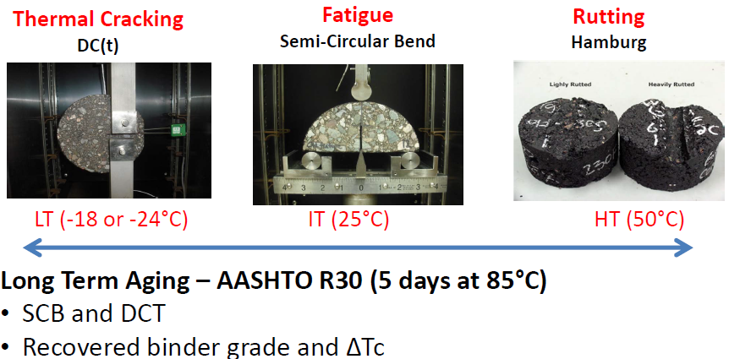
Use of Performance Testing in Design - Wisconsin
From: Erv. Dukatz, Mathy Construction, TRB 2015

Slide 29
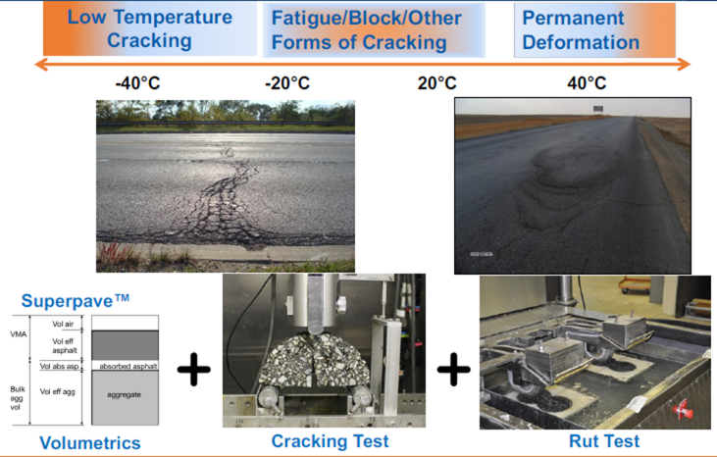
Performance Testing in Design - Illinois
From: Imad Al-Qadi, University of Illinois

Slide 30
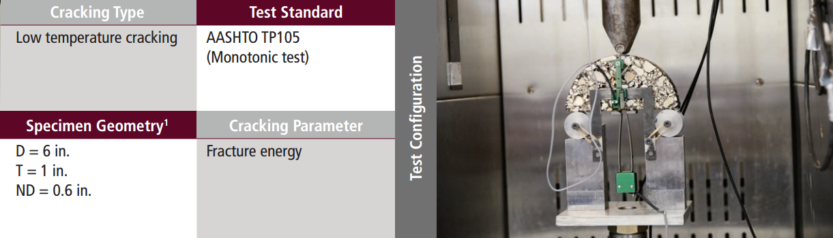
SCB Low Temperature Test

Slide 31
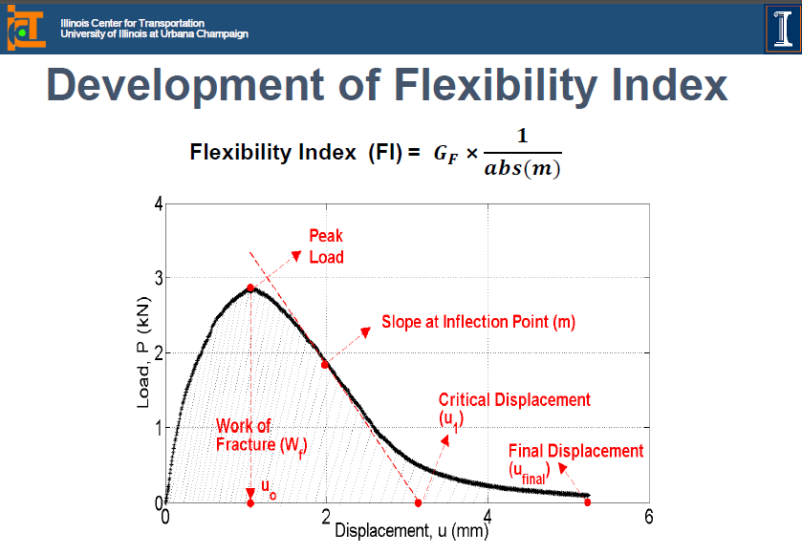
SCB Low Temperature Test

Slide 32
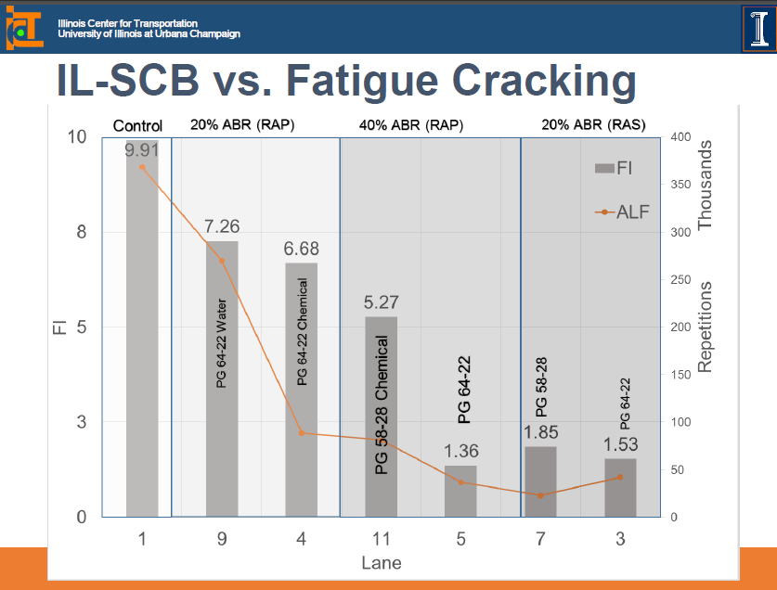

Slide 33
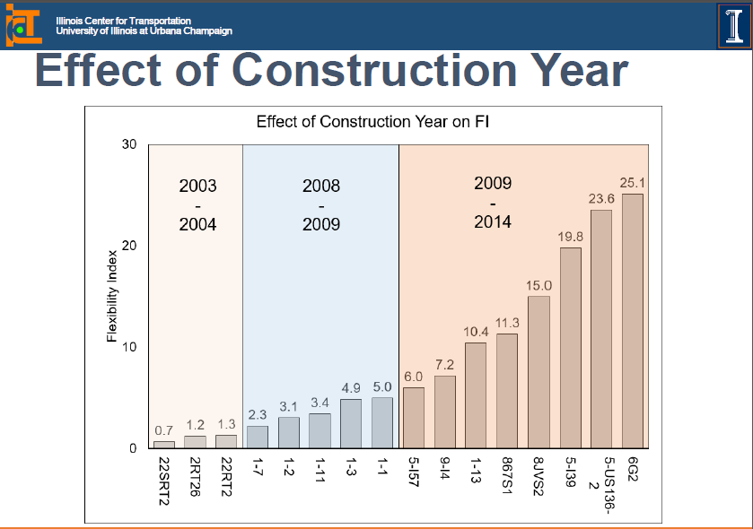

Slide 34
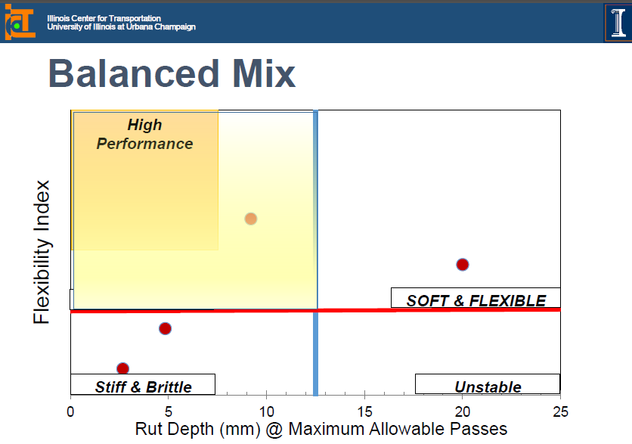

Slide 35

FHWA Technical Brief - Draft
Technical Brief being developed to provide a current summary of the Balance Mix Design Task Force efforts.
Target publication of end 2016 (not available yet).
DRAFT

Slide 36
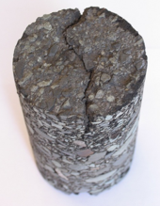
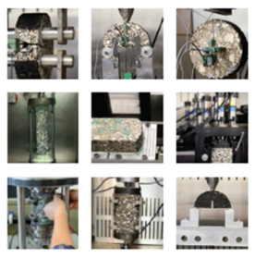
Task Force Development
      At the request of the National Pavement Implementation Executive Task Group (PIETG) the
        Balanced Mix Design Task Force formed at the
        September 2015 FHWA Mixture and Construction ETG meeting
      Focus Areas
        Define Balanced Mix Design
        Determine the current “state of practice” of BMD
        Present approaches/concepts for immediate use
        Recommend future needs (potential research) to advance BMD approaches
        Disseminate information

Slide 37
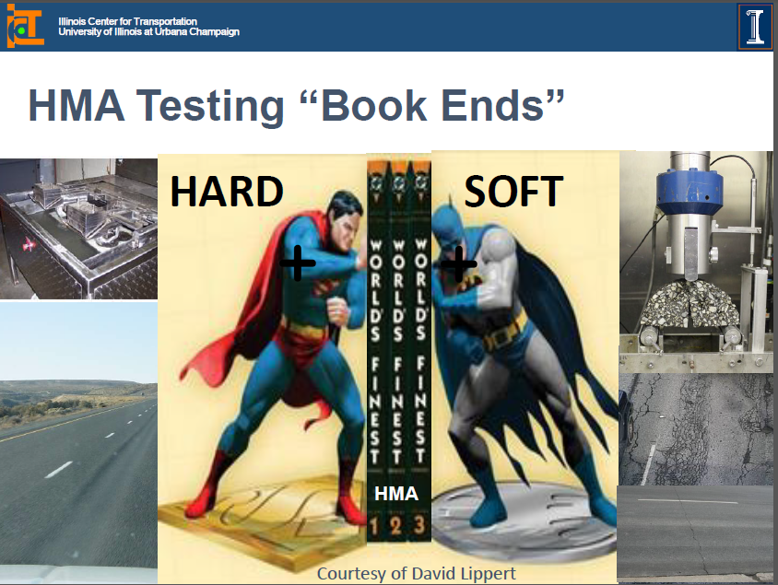

Slide 38
AI To Hire New Engineer
The Asphalt Institute has begun the search for a new AI Regional Engineer covering Canada and providing direct support to AI’s Director of Engineering.
This is a new full-time AI position that focuses on supporting our Canadian members and larger user agencies in Canada (50 percent) and the advancement of Institute-level issues and objectives (50 percent).
The desired location is Lexington, Kentucky, but location is negotiable based on candidate credentials and best fit for the job. A job posting with the full job description is also available on AI's homepage under "Careers."
Feel free to notify those that may be interested. All submissions must be sent by email to cobrien@asphaltinstitute.org by Monday, October 16, 2017.
Preliminary inquiries can also be directed to Dr. Mark Buncher, Director of Engineering, mbuncher@asphaltinstitute.org,
859-288-4972.

