Slide 1

Performance Engineered Concrete Mixture Specifications Understanding the
Parameters that Influence Critical
Performance
Dr Peter Taylor, PE (IL)

Slide 2

The Challenge
  Contractors want
    Workability
    Uniformity
  Owners want
    Durability
    FOD free
  Everyone wants
    Local materials
    Competitive

Slide 3
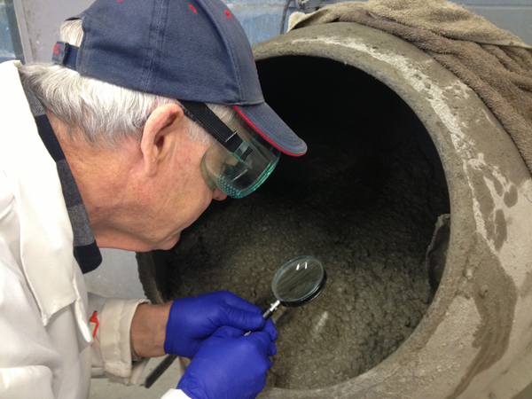
Performance Engineered Mixtures
What is it?
A program to
  Understand what makes concrete “good”
  Specify the critical properties and test for them
  Prepare the mixtures to meet those specifications

Slide 4
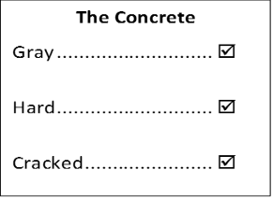

What is it?
Performance – choosing what we need
Engineered – delivering what is needed
Mixtures – focus on the mixture, for now

Slide 5




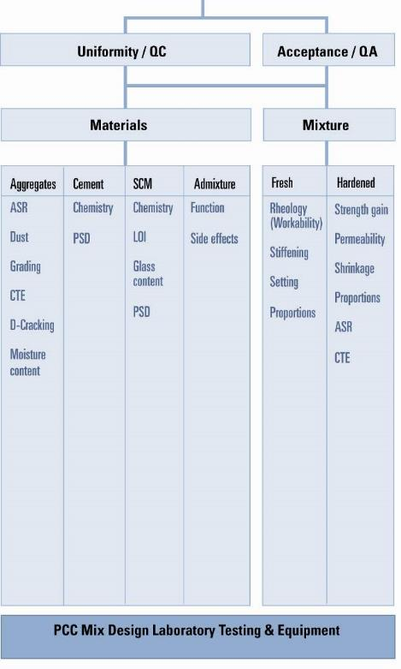
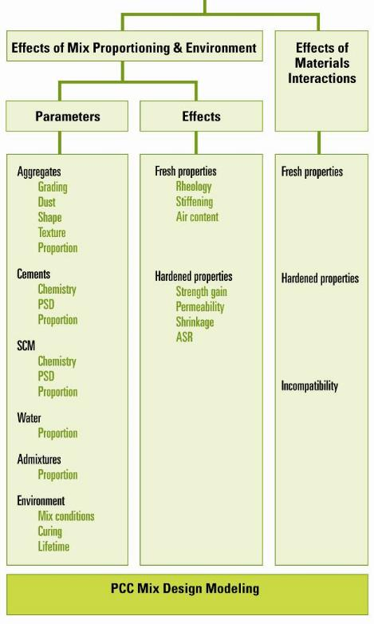

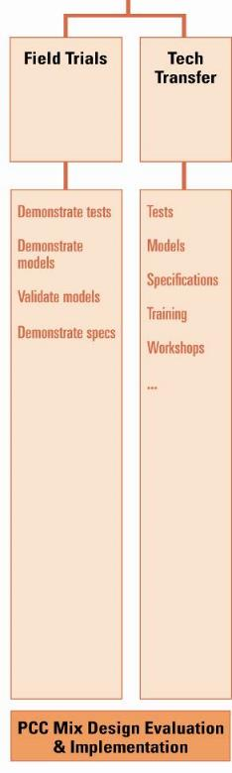
Extract from a slide used at NC2 in 2008

Slide 6
The Team
FHWA - Gina Ahlstrom, Mike Praul
Consultants – Tom VanDam, Cecil Jones, Tom Cackler
Researchers – Jason Weiss, Tyler Ley

Slide 7
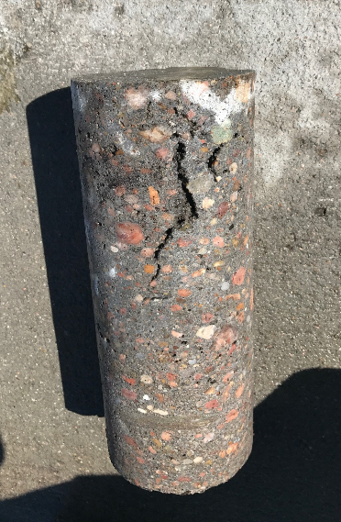
Why bother?
Current approaches
  May not measure critical parameters
  Are often built around previous failures – thereby introducing unintended consequences
  Limit innovation
Need to deliver mixtures
that meet needs, reliably

Slide 8
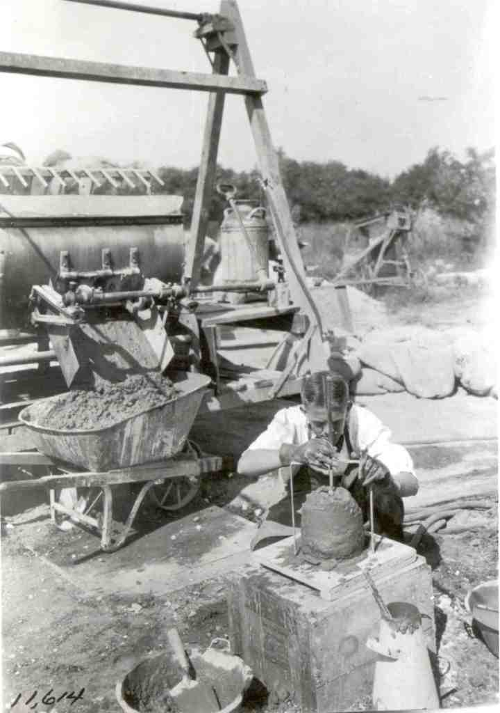
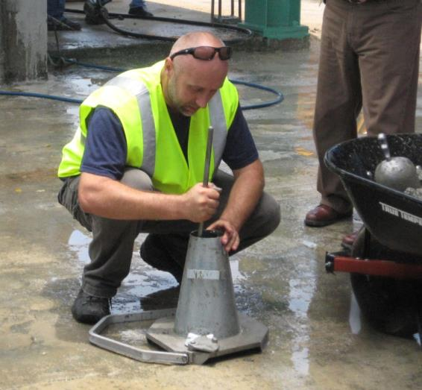
Field Testing
Almost 100 years ago
Today
What has changed?

Slide 9




But I have been doing it this way for 30 years…

Slide 10
Why bother?
Iowa Highway Research Board funded project
Collecting data on overlay performance in the whole IA system
This plot represents 12 foot slabs showing Pavement Condition Index (PCI) vs age
Typical of all data collected

Slide 11
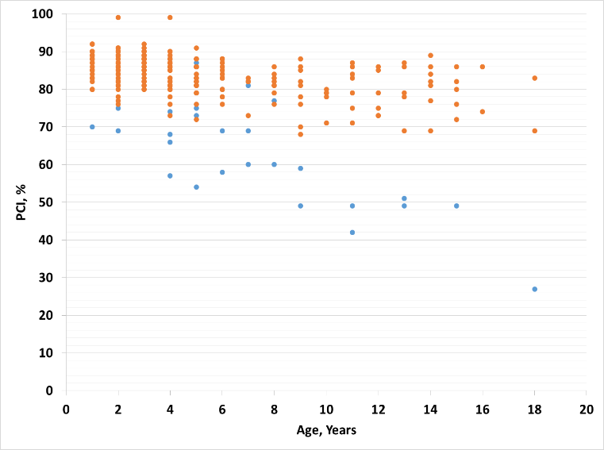
Why bother?
Clear bifurcating data set
  Orange = normal
  Blue = premature distress
    30/257 data points
    Joints
    Foundation
    system
    Design

Slide 12
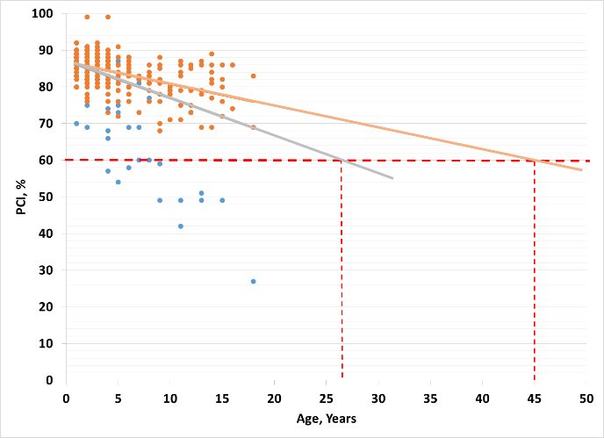
Why bother?
Modelling system performance insists we use all data = gray line
  27 years before 60% Pavement Condition Index
If we could improve our practices to eliminate the premature failure
  45 years before
  60% PCI
Adds ~20 years

Slide 13
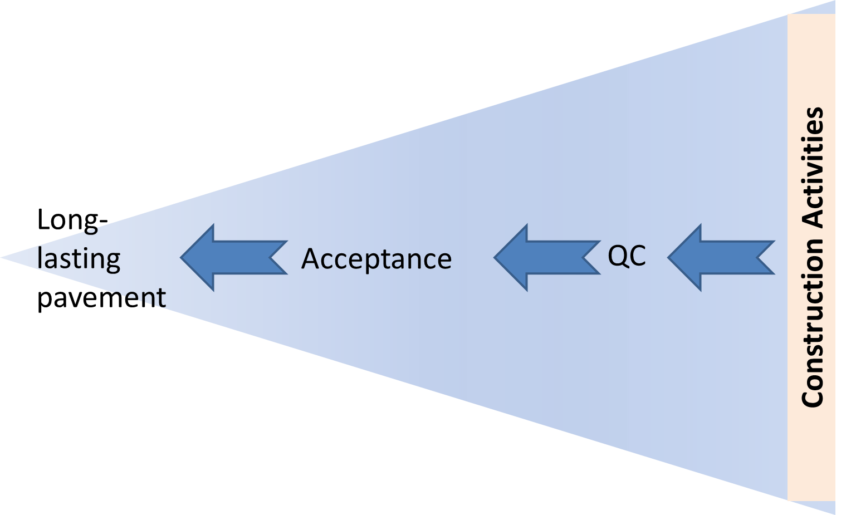
Quality

Slide 14

A Better Specification
  Require the things that matter
    Transport properties (everywhere)
    Aggregate stability (everywhere)
    Strength (everywhere)
    Cold weather resistance (cold locations)
    Shrinkage (dry locations)
    Workability (everywhere)

Slide 15
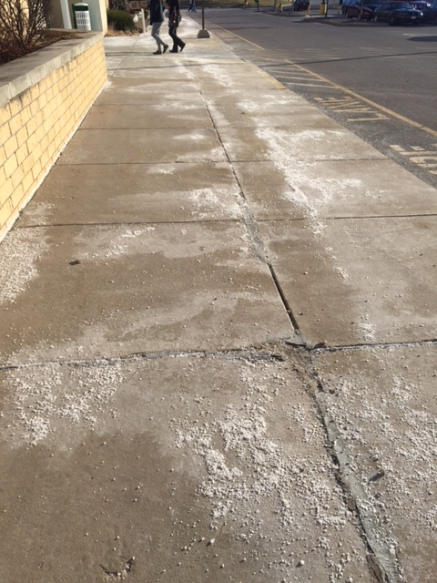
Critical Properties
Transport properties (permeability)
  All deterioration mechanisms involve fluid movement
  Keep water out = longer life
  Measurement has been difficult
    Boiled water
    RCPT

Slide 16
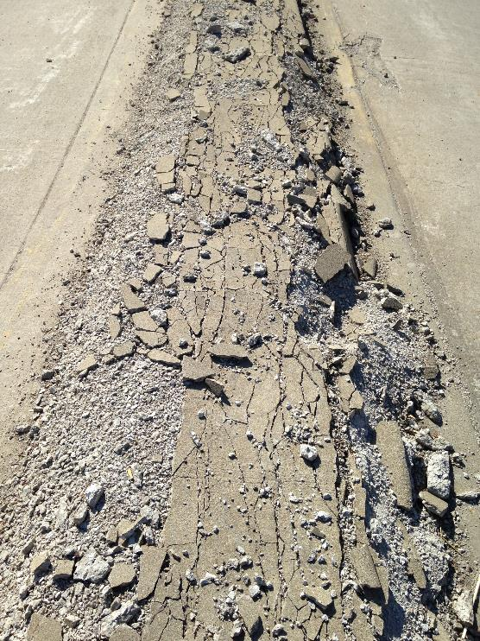
Critical Properties
Aggregate Stability
  If aggregates expand = damage
    Alkali aggregate reaction
    D-Cracking

Slide 17
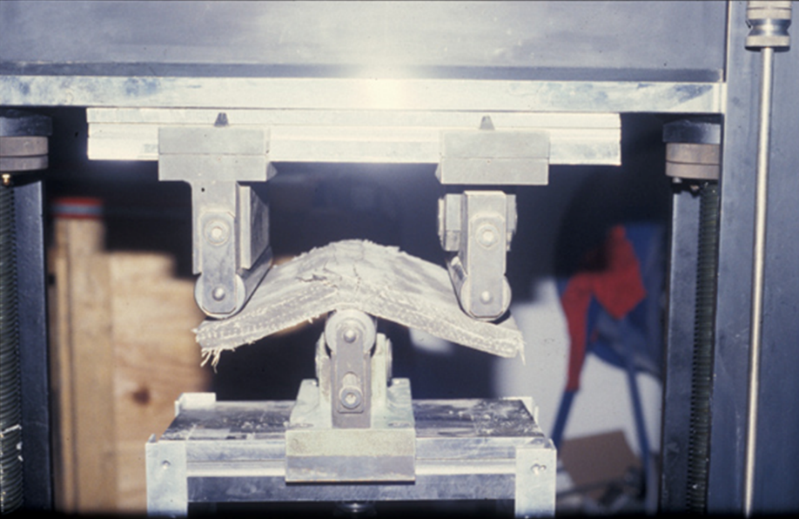
Critical Properties
Strength
  Strong enough
  (But not much more)
  It comes along for the ride
  Beware of shrinkage, high heat

Slide 18
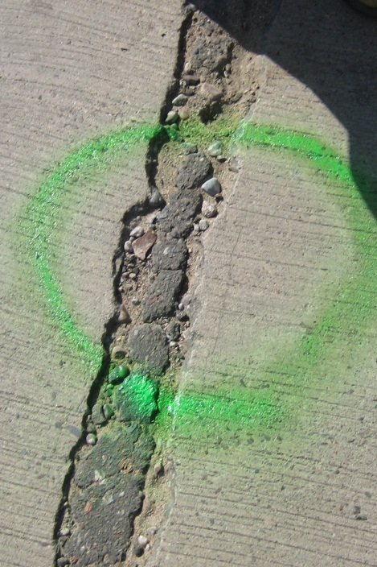
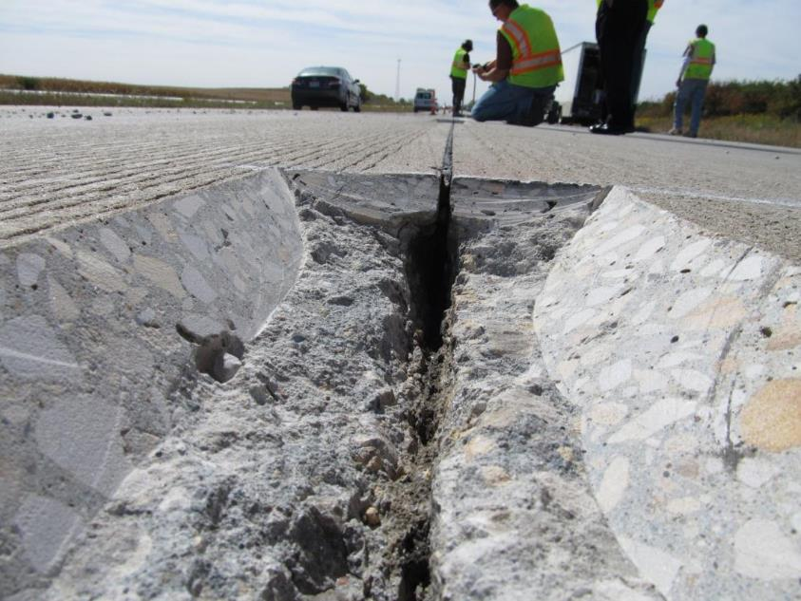
Critical Properties
Cold Weather
  Freeze-thaw
    Entrained air
  De-icing salts
    Sufficient SCM

Slide 19
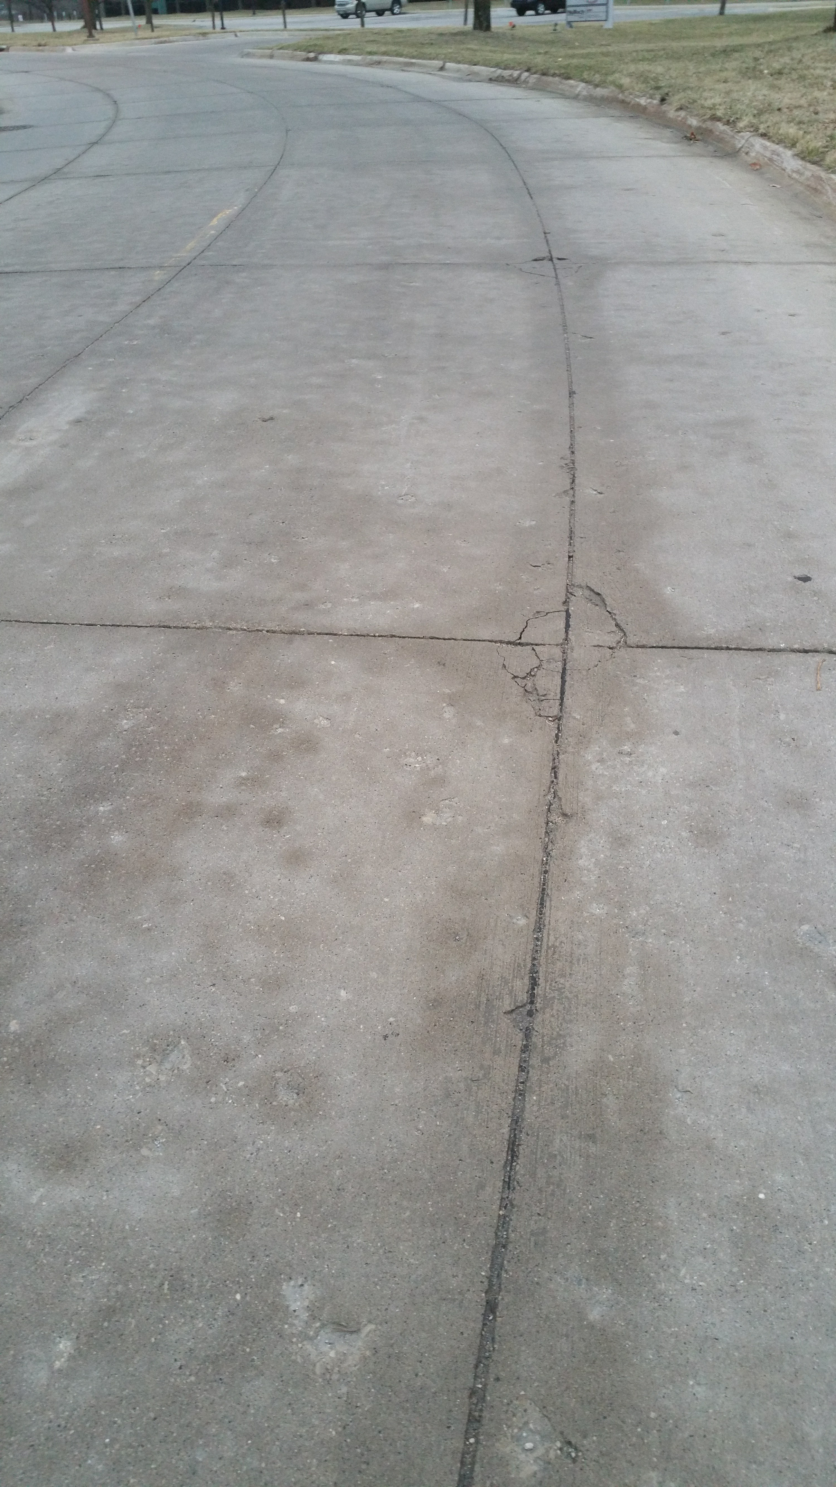
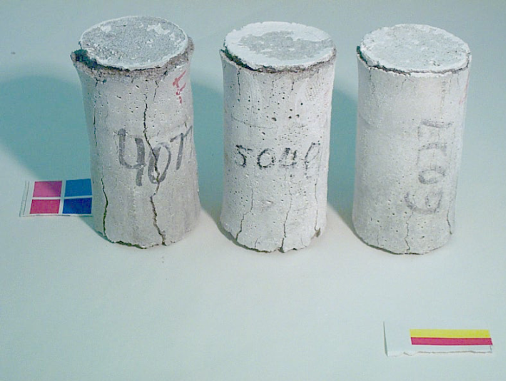
Salts can cause chemical attack
Calcium oxychloride is formed
  Calcium from cement
  Chlorides from salts
  Expands 31%
  At 40°F
Sutter
CaCl₂ @ 40°F
Notes:
There are signs of chemical attack in some cases. The oxychloride later decomposes and disappears. This from Larry Sutter’s work for SD. Have to have the right temperature.

Slide 20
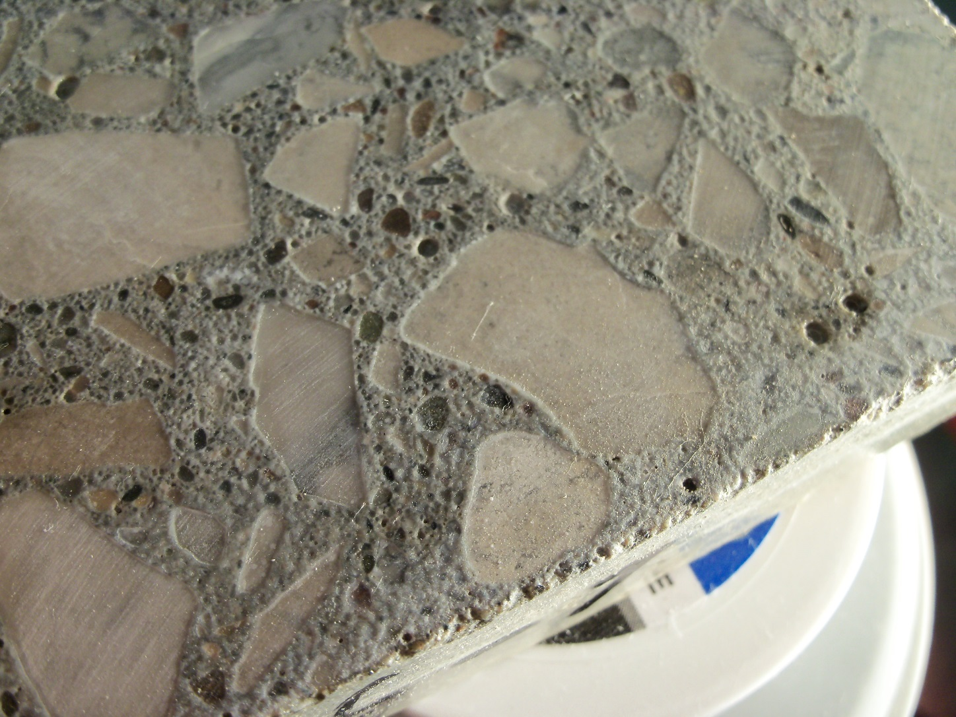
Salts can cause chemical attack
Calcium oxychloride
MgCl₂ @ 40°F
Notes:
There are signs of chemical attack in some cases. The oxychloride later decomposes and disappears. This from Larry Sutter’s work for SD. Have to have the right temperature.

Slide 21
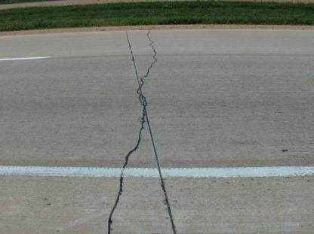
Critical Properties
Shrinkage
  Random cracking
  Warping

Slide 22
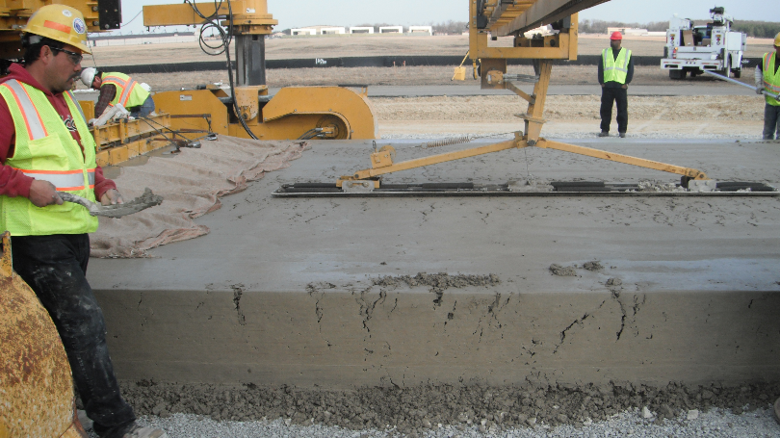
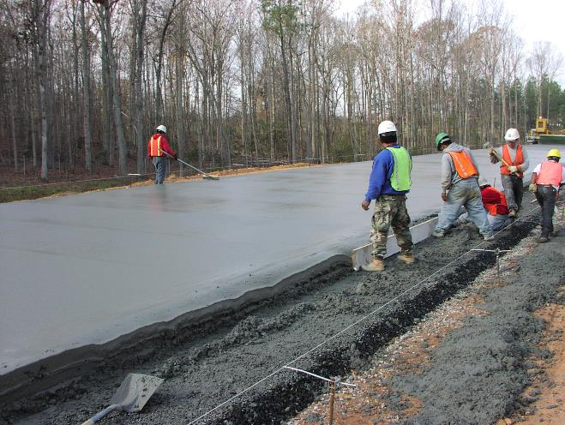
Critical Properties
Workability
  Not too wet
  Not too dry

Slide 23

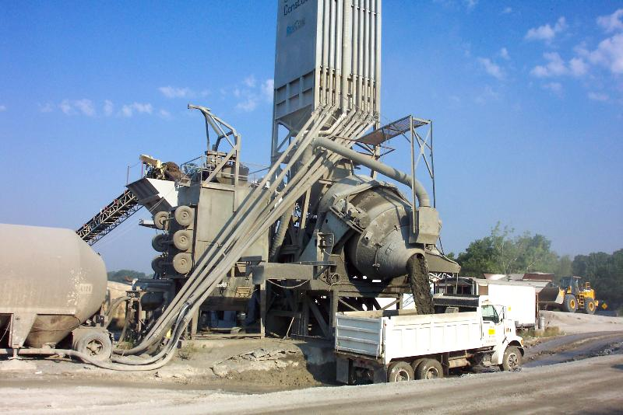
A Better Specification
  Measure the right things at the right time
    Prequalification
    Process control
    Acceptance

Slide 24

A Better Specification
  A buffet of approaches
    Prescriptive: w/cm, paste volume
    Performance: Formation factor

Slide 25
A Better Specification
  AASHTO PP84 published in March
    Guide Specification
    “Deemed to satisfy”
    Avoids bonus discussion – that is local
    Provisional = meaning we can
    modify as we learn things

Slide 26
Transport Properties/Permeability (6.6)

Slide 27
Aggregate Stability (6.7)

Slide 28
Concrete Strength (6.3)

Slide 29
Hardened Cement Paste Freeze-Thaw Durability (6.5)

Slide 30
Reducing Unwanted Cracking Due to Shrinkage (6.4)

Slide 31
Workability (6.8)

Slide 32

Time for a break

Slide 33
Quality

Slide 34
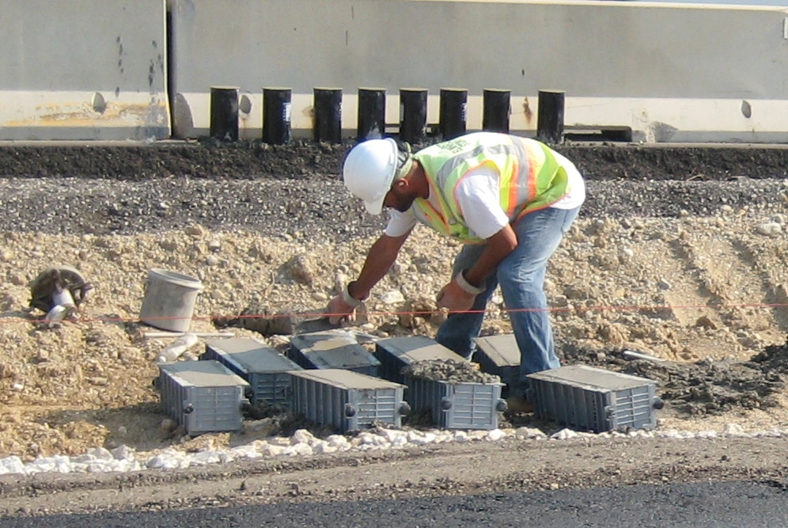
Acceptance Testing
Should be
  Fast
  Reliable
  Meaningful
  Affordable

Slide 35

Test Methods
Tests for those critical properties
    VKelly
    Box
    Resistivity / Formation
    factor
    Bucket / Sorptivity
    Dual ring
    SAM

Slide 36
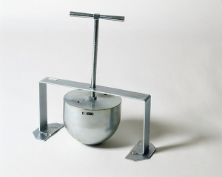
VKelly
Kelly ball test
  Developed in the 1950s in US
  Standardized in California DOT test
  Comparable to slump test

Slide 37
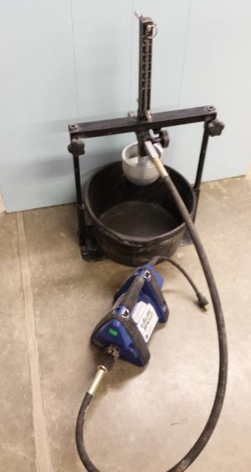
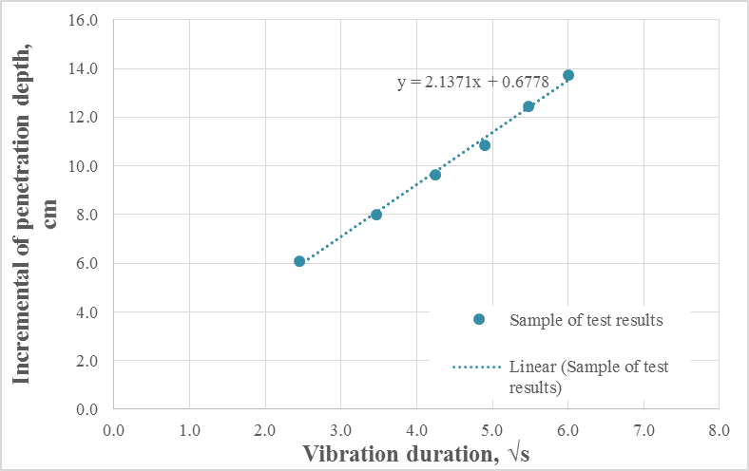
VKelly
Measure initial slump (initial penetration)
Start vibrator for 36 seconds at 8000 vpm
Record depth every 6 seconds
Repeat
Plot on root time
Calculate slope = VKelly Index

Slide 38
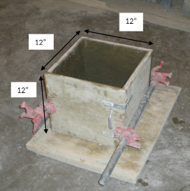
Box Test
A test that examines:
  Response to vibration
  Filling ability of the grout (avoid internal voids)
  Ability of the concrete to
  hold an edge
Ley

Slide 39
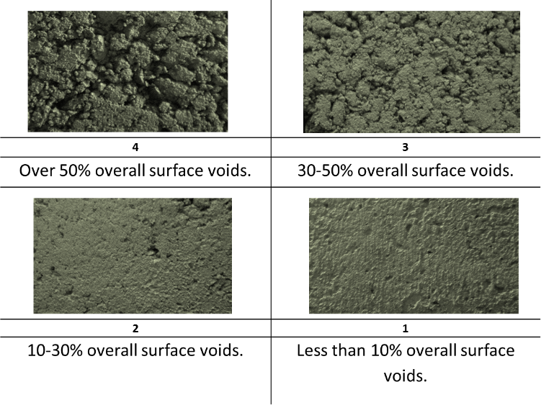
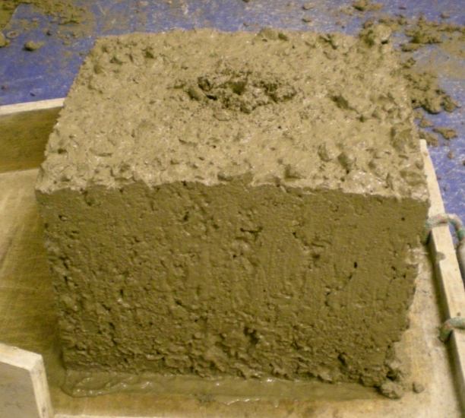
Box Test
The edges of the box are then removed and inspected for honey combing and edge slump
Ley

Slide 40
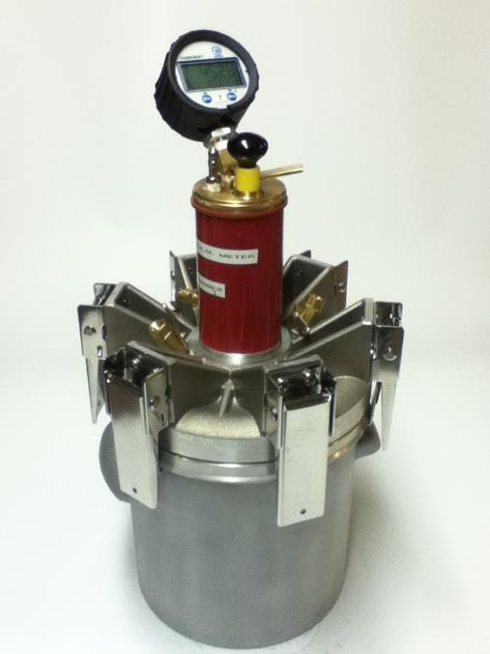
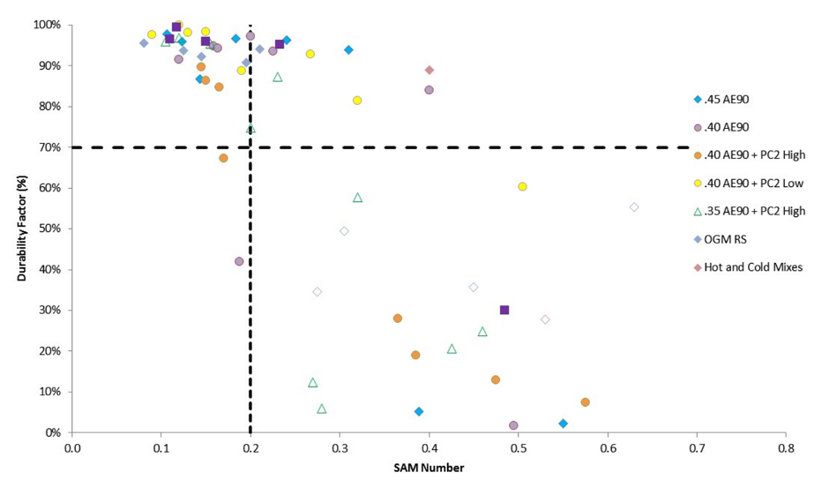
Super Air Meter
Reports air content and SAM number
SAM number correlates well with freeze thaw testing
Ley

Slide 41
Cold Weather Resistance
Freeze Thaw (Time to Saturation)
Weiss

Slide 42

Cold Weather Resistance
Resistance to Salts
  Expansive calcium oxychloride formation
    From MgCl2 and CaCl2
  Measure with – Low temperature differential scanning calorimetry (LT-DSC)
Sutter

Slide 43
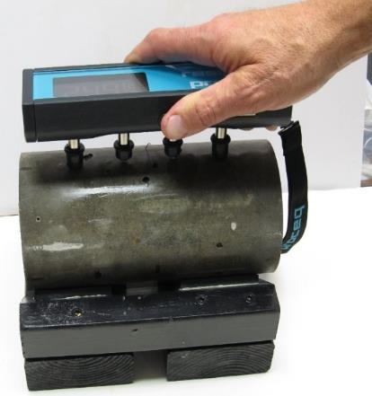
Formation Factor
Resistivity
  Then calculate Formation Factor based on
    Moisture
    Temperature
    Geometry
    Curing conditions
    Ionic concentration of the
    pore solution
    F = Resistivity (bulk)
    Resistivity (solution)
Weiss

Slide 44
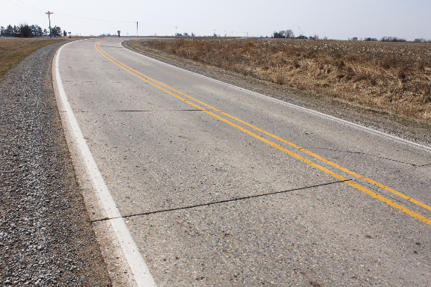
Shrinkage
Cracking risk
Warping

Slide 45
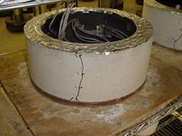
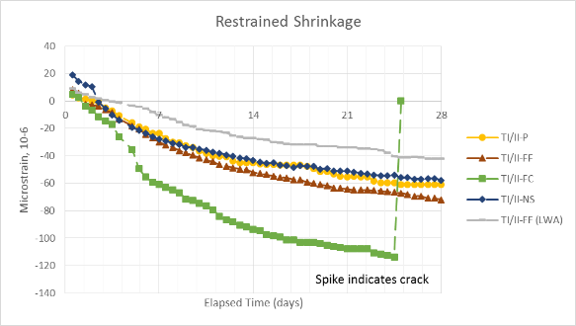
Ring Test
Assesses cracking risk
Starts immediately

Slide 46

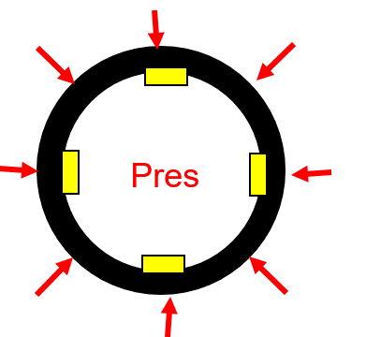
Dual Ring Test
Invar ring
Strain gauge
This ring can measure both expansion and contraction.
As the concrete shrinks the ring can measure the strains that occur.
We force a temperature gradient in the concrete and make it crack and compare that to 60% of the split tension capacity after 7 days.
Concrete
Plan View
Weiss

Slide 47
Quality

Slide 48

Construction
QC should include
  Unit weight
  Calorimetry
  Maturity
  Strength development
  Air void stability
  And a response…
Risk management

Slide 49
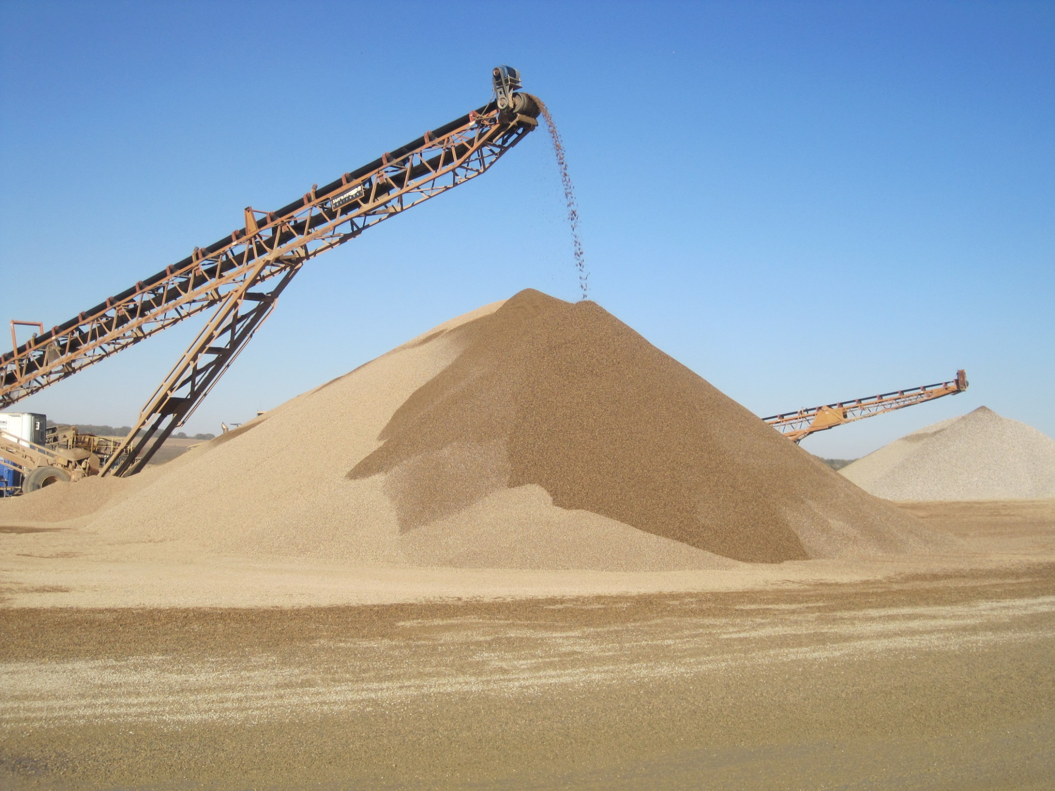
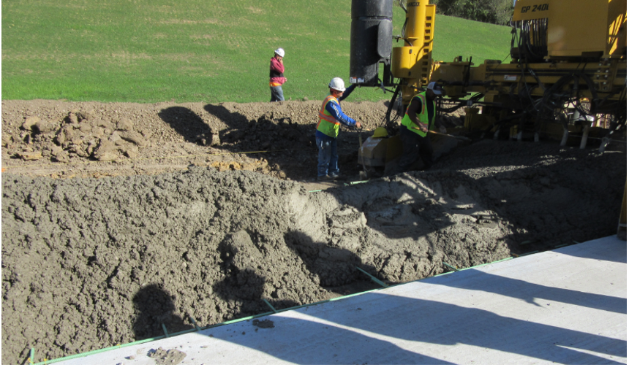
Uniformity
Deliver the same mixture in every truck

Slide 50
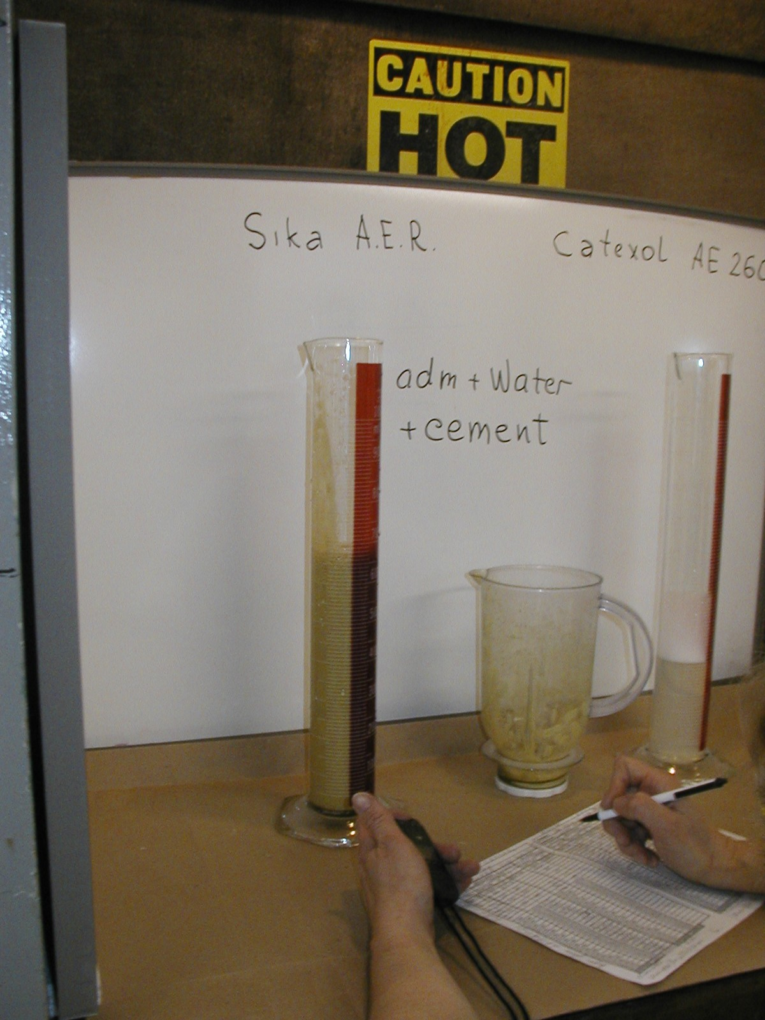
Foam Drainage
Air void systems can change with working / pumping
Depends on system chemistry

Slide 51

Calorimetry
  Calorimetry tells us about the chemistry of the system (Uniformity)

Slide 52
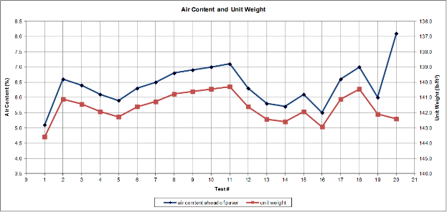
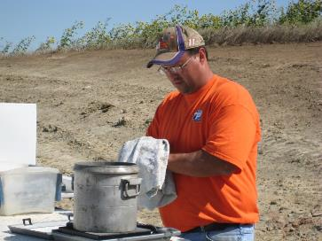
Unit weight
Uniformity
  Affected by air and water

Slide 53

Maturity
Maturity readings
  Sensors in the pavement determine in-place maturity and thereby strength for opening
Notes:
the maturity of the pavement from data loggers instrumented in the field on 9/22 and 9/24. From this figure it can be seen that, for the specific site conditions on 9/22 and 9/24, the pavement reached a 5800 ºChrs maturity value (equivalent to a flexural strength of 550psi) in 152 hours (6.3 Days). So using the concept of maturity, the pavement can be opened to construction traffic at least 3 days in advance of the current minimum opening requirement of 10 days. This is because the strength gain of the pavement is faster than the beams due to the greater mass of concrete (higher heat of hydration) and greater exposure to the environment (The environment could increase or decrease the strength gain compared to lab cured specimens depending on the temperature and moisture conditions). It measures the actual in place pavement under actual field conditions. Test specimens cured at standard conditions represent the concrete strength under laboratory conditions which are different than what the pavement experiences. So the concept of maturity can be used to open pavements for construction traffic sooner, which in turn can help reduce costs, speed up the construction operations and also helps in safety related issues.
Maturity meters currently available in the market automate the process shown in these figures. They are very easy to use and relatively inexpensive. By using the maturity concept to open pavements to traffic sooner, CALTRANs can benefit significantly in terms of time and money savings.

Slide 54
Quality

Slide 55
Better Mixtures
History
  Structural concrete 1:2:4
  Other concrete 1:3:6
  Waterproof concrete Add salt
  No chemicals
  No SCMs
  Precision was ugly
  Bulking made it worse

Slide 56

Proportioning Approaches
Present
ACI 211
  Last revised in 1991
  Linear
Developed
  Before water reducers
  Before supplementary cementitious materials
Primarily focused on structural concrete
  100 mm (4”) slump
  30 MPa (~4000 psi)

Slide 57
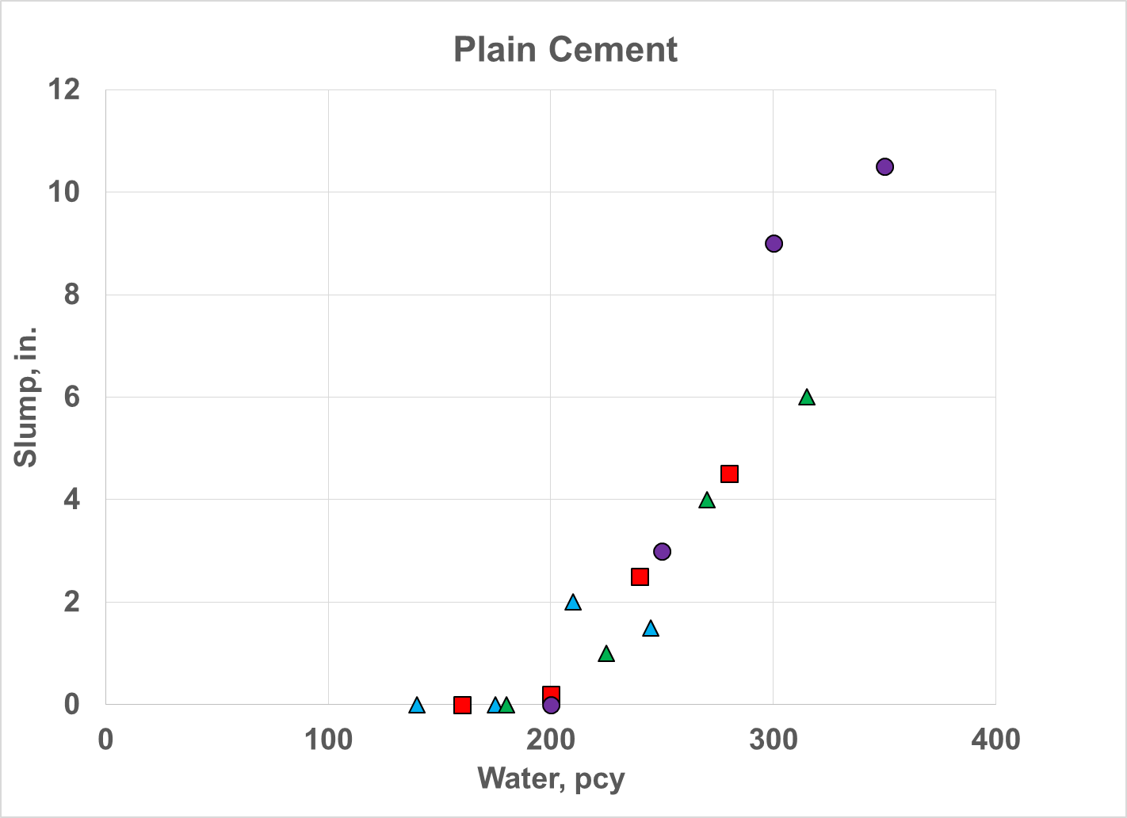
Workability

Slide 58
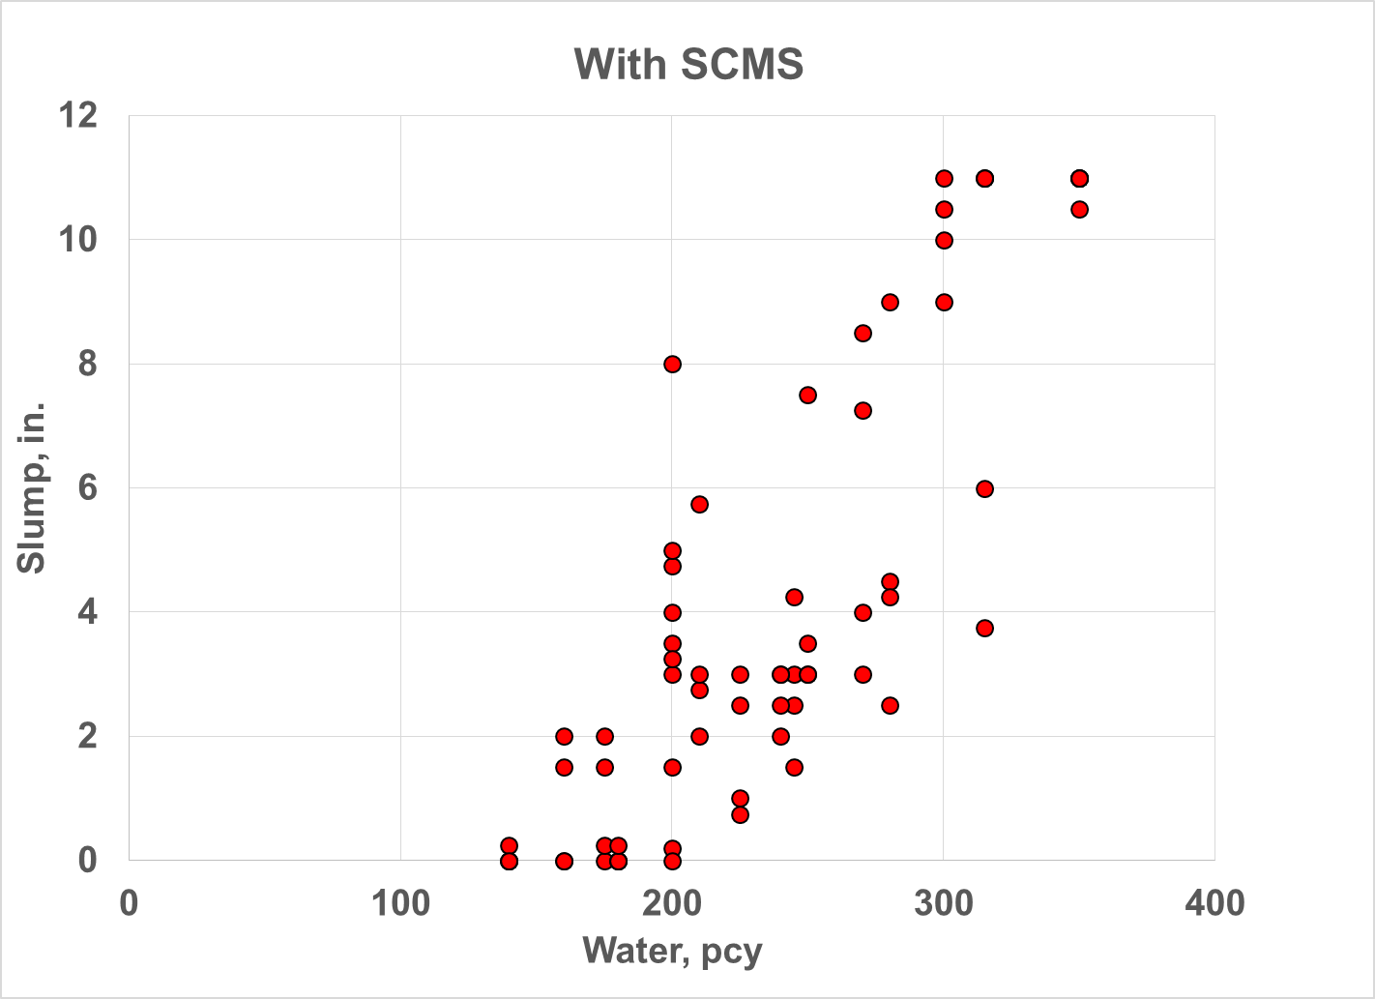
Workability

Slide 59
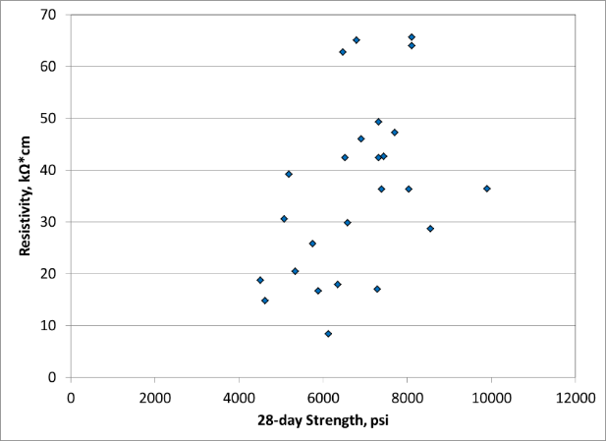
Preconceptions
More cement = more strength
Strength is everything
Slump indicates quality
Gradations of individual fractions are critical

Slide 60

Proposed Mixture Proportioning Procedure
Aggregate system
Paste Quantity
Paste Quality
Koehler

Slide 61
How do we proportion to achieve design goals?
Notes:
This chart indicates which of the three mixture parameters affects what critical property. The yellow stripe is where the specification should reside. All else should be left to the contractor to match available materials with their equipment while still meeting spec requirements.

Slide 62

Doing the Sums
  The wonders of
  a spreadsheet and a solver function…
Measure V_{a}

Slide 63

Does it Work?
West Des Moines spec
    5% minimum air behind the paver
    0.42 w/cm target
    35% fly ash
    Cracking risk
      MN recommended 400 pcy cement
      Blankets

Slide 64


What do we get?
Concrete that delivers what is needed
  Efficiently w.r.t.
    Cost
    Environmental impact
  Reliably
  More riding, less waiting

Slide 65

What next?
Understanding and education
Validate tests in the field
Parallel testing
New tests
Pooled fund to
pay for it

Slide 66
Implementation

Slide 67
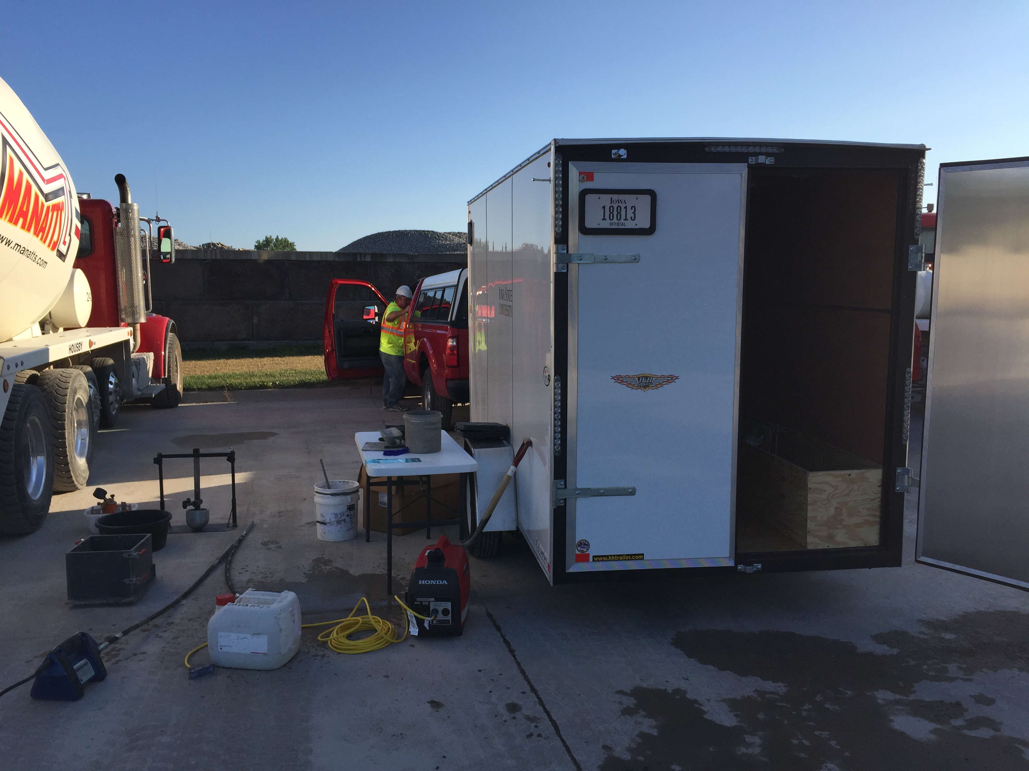
Implementation

Slide 68

Closing
The framework is in place
The details need work

