Slide 1

Sustainable Airfield Asphalt Construction Practices

Slide 2

Coop Agreements
Intelligent Compaction
Longitudinal Joints
Tack Coats
Improved Durability

Slide 3

Don’t We Already Know How To Build a Longitudinal Joint?
Notes:
This was my first reaction when approached by FHWA about starting this project, but I quickly discovered that not only was there many approaches to specifying a LJ, there were aspects of building a LJ that even experts didn’t agree on. This made the project very interesting.
It also became apparent that, even with all the LJ studies that have been done, LJs often fail pre-maturely. For this reason, it’s my opinion that LJs are our industry’s black eye, or said in a more positive manner, offer us the greatest opportunity to improve overall asphalt pavement performance. Too often LJs are the weakest link in the chain, failing before any other aspect of the asphalt pavement.
This was illustrated clearly when Carlos Rosenberger, one of the lead project members, took the following set of pics when driving from his home in eastern PA to an asphalt alliance meeting in CT, where the purpose was to ironically talk about what we can do as an industry to improve our market.

Slide 4
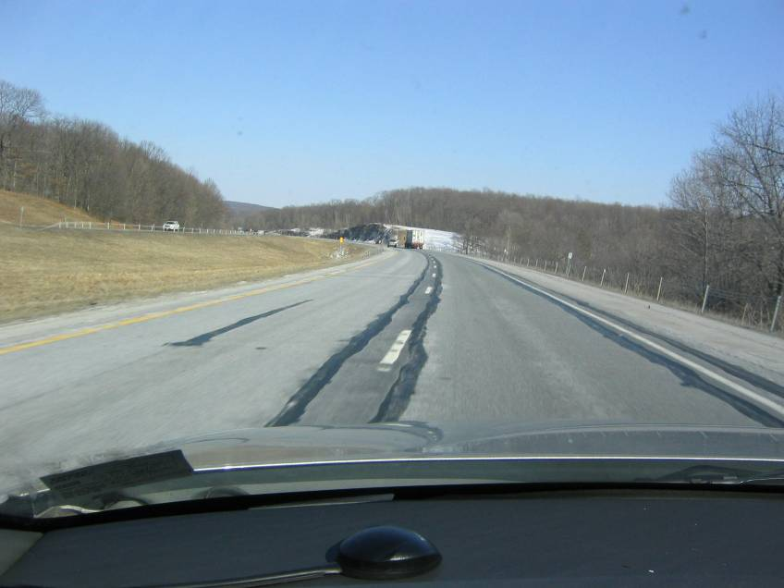


    Photo: Carlos Rosenberger
Notes:
Now into NY
DOT had to go in mill out the deterioration joint. Note they seal both sides.

Slide 5
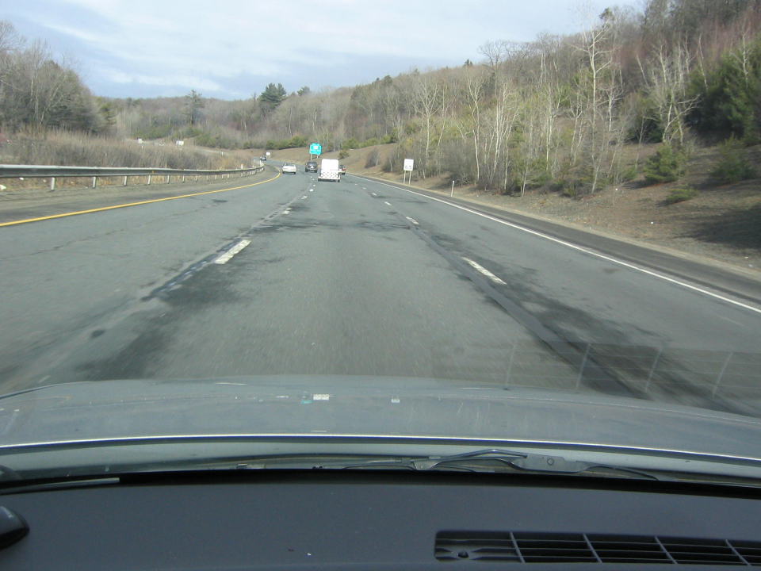

I-84 in CT
    Photo: Carlos Rosenberger
Notes:
Finally in CT
Both LJs deteriorating

Slide 6
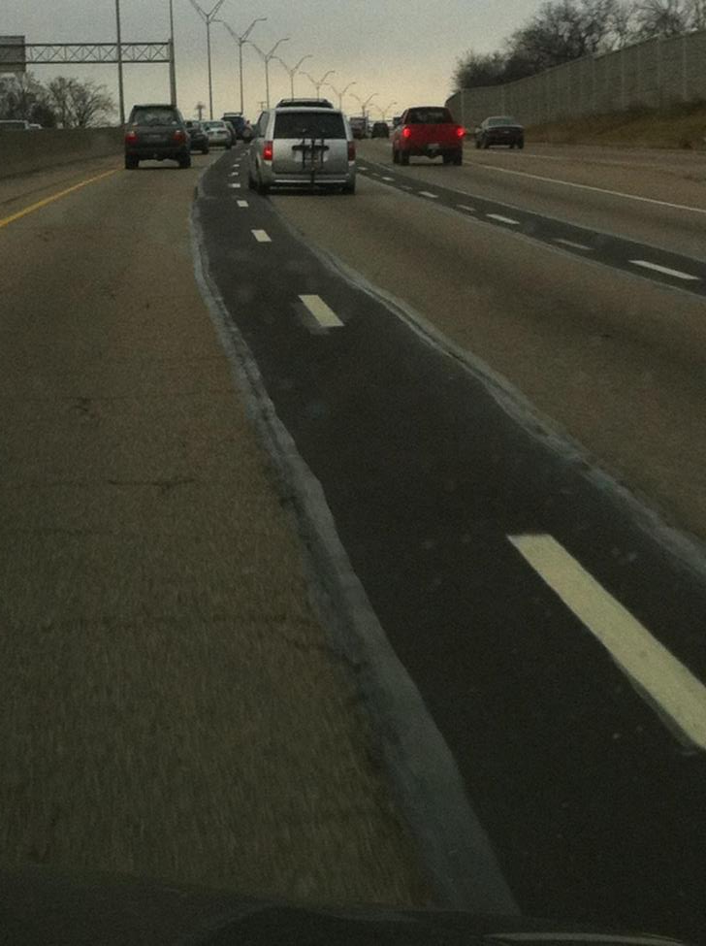
I-71 in Columbus, OH
Notes:
Note that both longitudinal joints failed before the mat and were milled and filled.

Slide 7
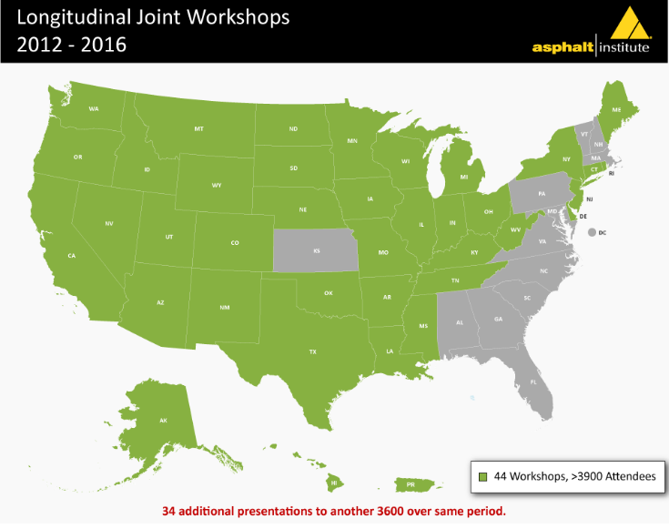

Slide 8
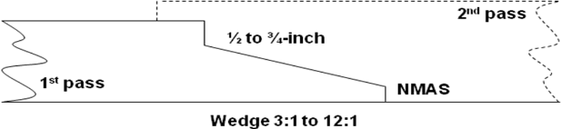
Different Types of Longitudinal Joints
Butt (Vertical) Joint
Milled or Cutback Joint
Notched Wedge Joint
Notes:
(This slide was moved up)
We need to define butt (vertical edge) joint versus notched wedge joint. More on these later.
The notched wedge was originally developed for the opportunity for higher tonnage (not required to pull second lane up before opening joint to traffic) and for safety (FHWA requires closing up any lift 2 inches or greater before opening for traffic). Some States decrease that requirement of 2 or greater, to 1.5” or greater, or 1.75” or greater.
Schematic of butt and notched wedge joints.
Wedge Joints: Geometry requirements (slope of the wedge and depth of the notches) vary across the state DOTs, and can also vary depending on the thickness of the mat being placed. We recommend there is a notch, especially on top, and also on the bottom of the mat.
Butt Joints: We are distinguishing between paver constructed “butt joints” and milled/cutback “butt joints” because the proper overlap is different. For paver constructed butt joints, the proper overlap is 1”+.5”, while for milled or cutback joints, the proper overlap is 0.5”. Some locations may not refer to a milled or cutback joint as a butt joint.

Slide 9
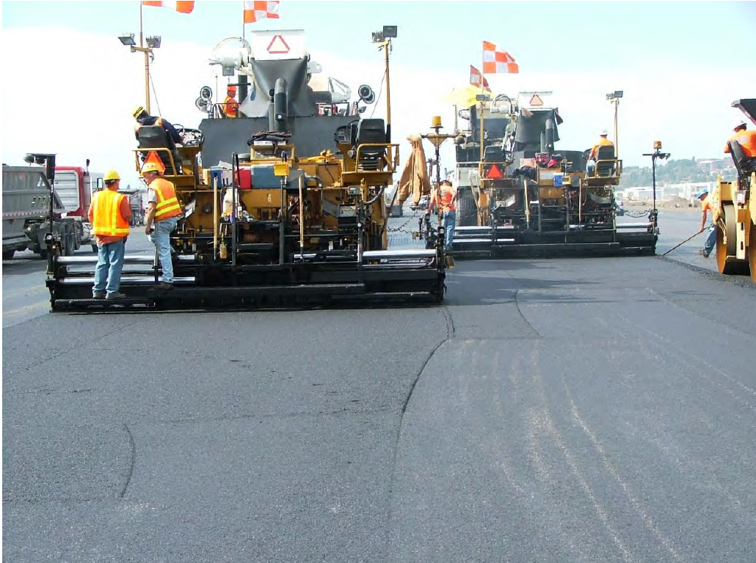
The Best Longitudinal Joint:
Echelon Paving
Notes:
The next ten slides or so will cover different types of longitudinal joints; hot, notched-wedge, butt.
Everyone does agree that the best longitudinal joint is a hot, rather than a cold, joint. That can be accomplished using pavers in echelon or paving with a paver capable of paving several lanes, and possibly a shoulder with one pass. (This is I-295, southbound, in New Jersey. Three lanes being placed in tandem.) There is one problem, the opportunities to pave several lanes at one time and maintain an acceptable traffic flow do not happen very often. Consequently, most of the time we are left with paving one lane at a time and have the resulting cold joint.

Slide 10
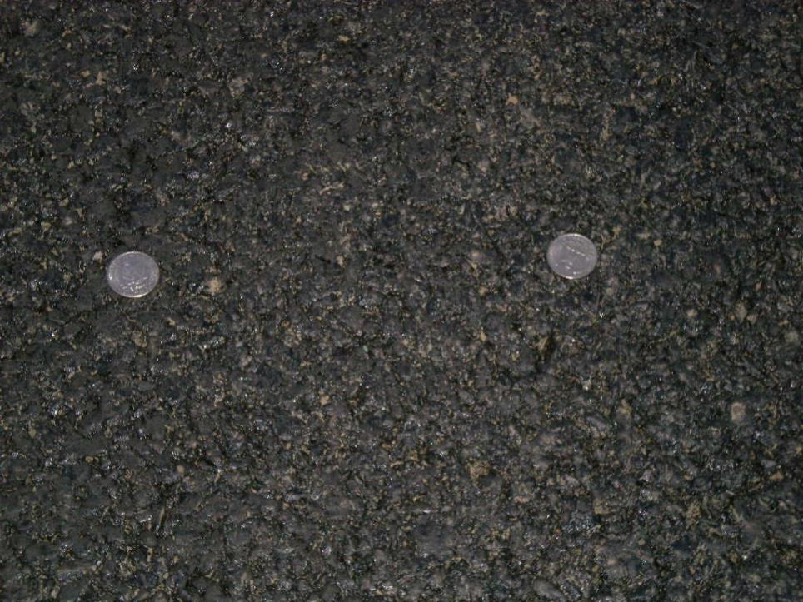
Echelon Paving Longitudinal Joint
Joint passes between the quarters
Notes:
This is an intermediate mix placed with echelon paving. The joint passes between the $0.25s but unable to tell where it is

Slide 11
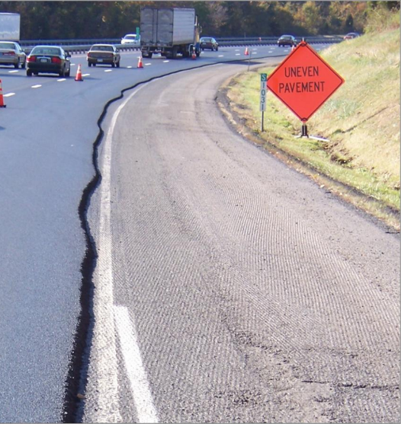
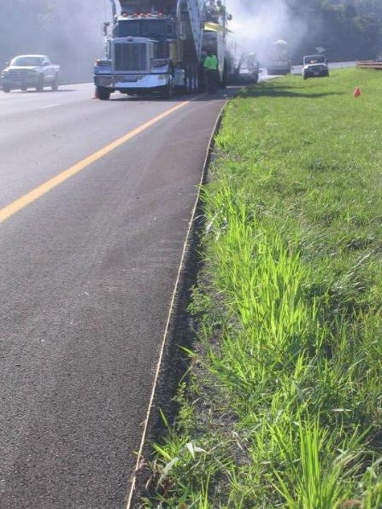
First Pass Must be Straight
Notes:
The first pass must be straight. A straight first pass allows the paver operator to consistently and uniformly overlap the existing lane. The examples show here are a stringline and a stringline that has been skip painted. (Circumstances may negate the need for a stringline, one example being urban paving where there is a curb that can be used as a reference.) It is equally important the paver operator have a clearly visible reference that can be used in conjunction with the stringline. Several of the Shedon Hayes winners commented on the importance of a straight firs pass and one sends a survey team out to set the line.

Slide 12
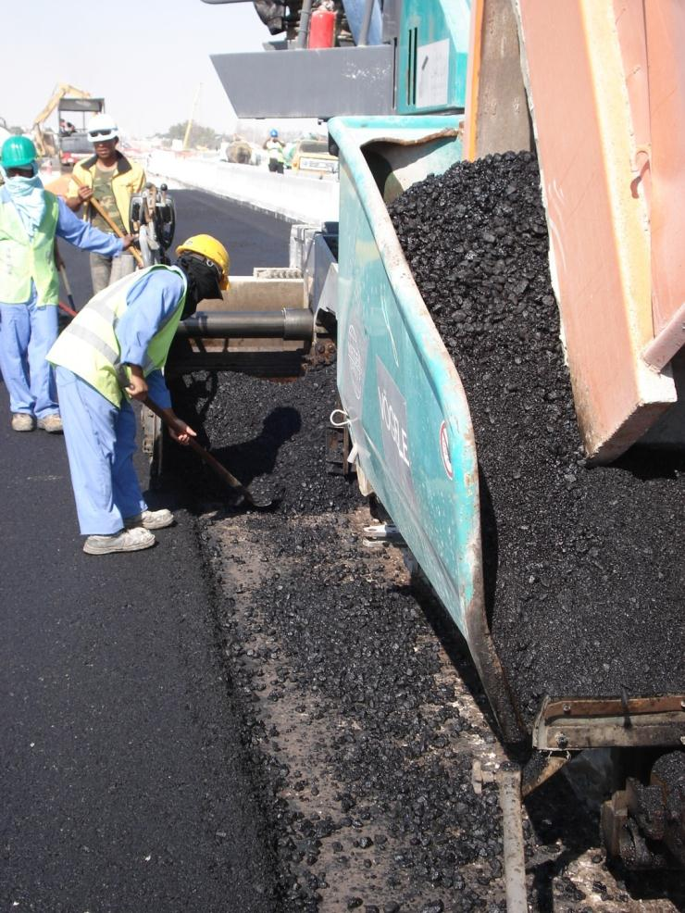
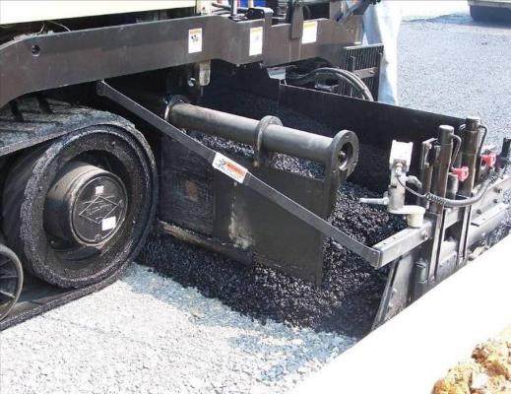
Avoid Segregation at the Joint
Don’t delivery segregated
mix to the joint area
Use auger & tunnel extensions
Extend auger and tunnel within 12 to 18 inches of the end gate
Notes:
There should be a uniform head of material across the entire screed and the auger should carry the material to within 12 to 18-inches of the end gate. Augers that fail to carry the material to the end gate are a source of segregation and the resulting low density, high permeability found in many longitudinal joints

Slide 13
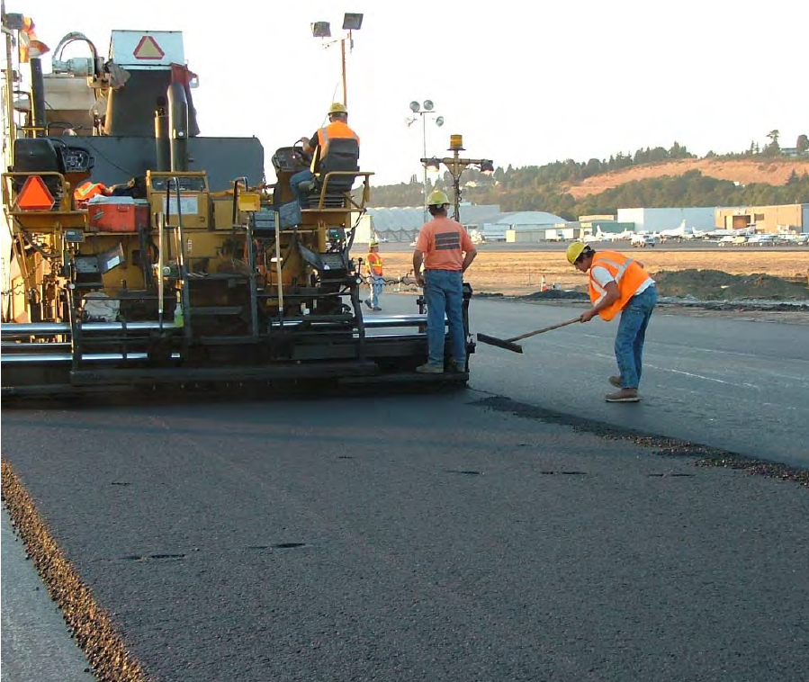
Do NOT Rake Away From the Joint
Notes:
All too common event; overlapped material being broadcast across the mat. The result is a joint starved for material and a non-uniform (segregated) mat.

Slide 14

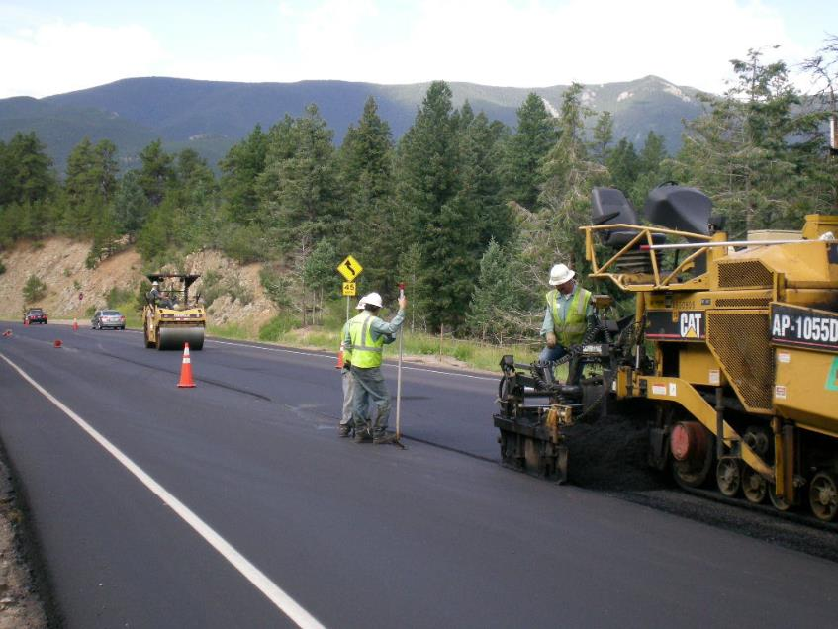
Lute the Longitudinal Joint
This lute person is
doing a great job
Notes:
In a break from the traditional method of luting the material back to the joint; the consensus is the material should not be luted back. Not luting the joint provides the highest probability of good joint performance. It also increases the safety of the paving operation as the lute person no longer has to contend with luting the joint and having the lute handle out in the passing traffic.
(Note : Only use the following sentence only if not using slide with title: “Bump the Joint”. If the material could always be properly luted back it would may well be the recommended method, but too often the material is luted across the mat; the result is a joint starved for material and one destined for premature failure.)

Slide 15
Rolling Unsupported Edge?
Option 2
1st Pass 4”-6” inside
Option 1
Hang over 4-6”
4”- 6”
Roller
Roller
6”
2nd Pass hang over 4”-6”
Roller
4”- 6”
Notes:
Here was one of the areas where opinions were split almost 50 / 50 among experts interviewed.
Two methods used to compact unsupported edge:
Option 1 (preferred by this project): roller hangs over unsupported edge about 4-6” on first pass.
Option 2: roller stays inside unsupported edge 4 to 6 inches on first pass. On second pass, roller hangs over unsupported edge 4 to 6 inches.
Cautions:
Option 1 may break down edge for lifts thicker than 2”. If this occurs, use Option 2.
If cracks are noticed near unsupported edge using Option 2, then use Option 1, or move roller farther inside the edge on first pass using Option 2.

Slide 16
What We Don’t Want
Rolling Unsupported Edge
With First Roller Pass
Rolling Unsupported Edge
(First Paver Pass)
(If milled or cutback joint, then 0.5-inch)
Edge of drum inside unsupported edge
can cause cracking near the edge
If edge of drum is located just inside the unsupported edge, a stress crack can occur here.
Notes:
The concern for staying back from the unsupported edge is a stress crack developing along the edge of the roller drum.
Might be interesting for those that use this method to go back to previous projects to see if stress cracks develop.
May be mix dependent.

Slide 17
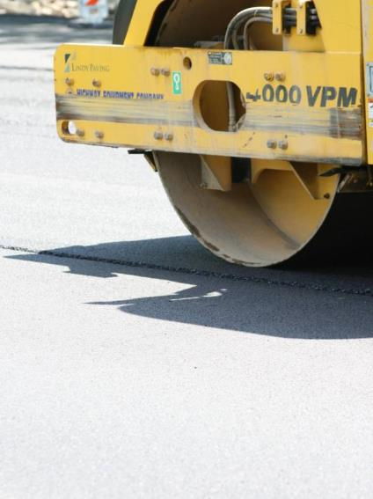
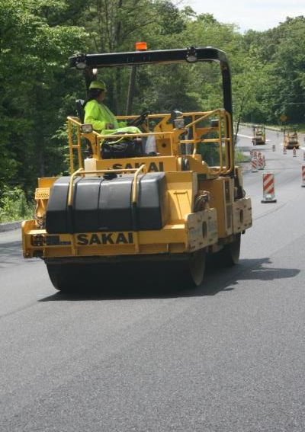
Rolling the Confined Edge:
1st pass all on hot mat with roller edge off
joint approx 6-12 inches
2nd pass overlaps on cold mat 3-6 inches
Notes:
Recommended method of compacting the supported edge is to stay off the joint on the first pass overlapping onto the cold lane on the succeeding pass.
This method allows the material right at the joint to be confined on both sides prior to rolling. By confining both sides, the full weight of the roller will force the mix down into the joint to achieve the best density available.
This method also minimizes any bridging effect of the roller being supported by the cold lane.
This recommended rolling pattern is opposite of what we recommend for the unconfined joint (staying off joint versus overlapping joint).

Slide 18
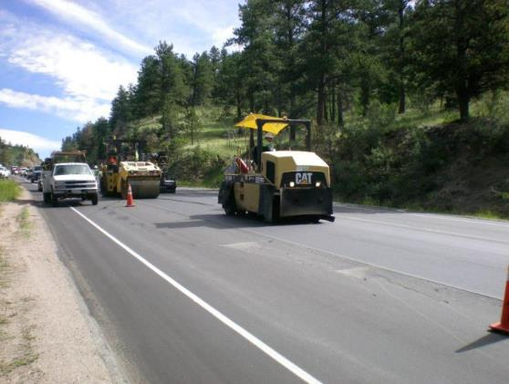
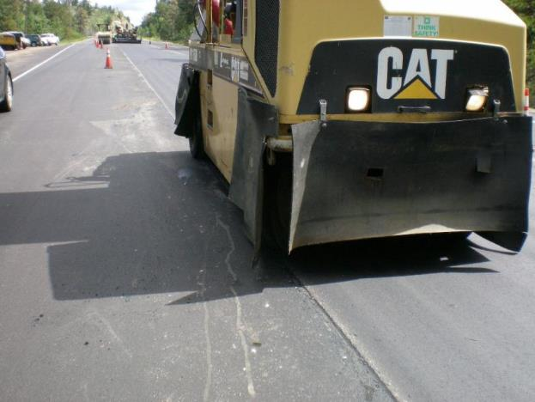
Notes:
Two pics of same roller on same job.
Upper left photo: Note the rubber tire roller is doing intermediate rolling, and a drum roller is behind doing the finish rolling.

Slide 19
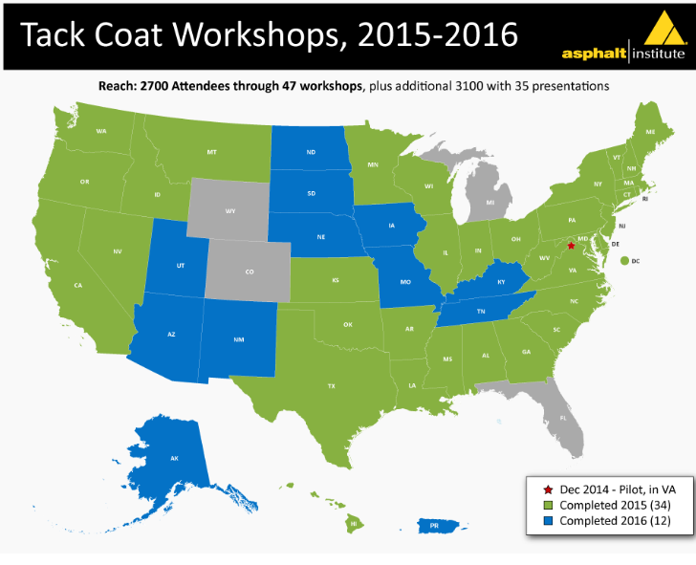
Notes:
10 states selected for field demonstration projects and workshops.
15 states selected for workshops only.

Slide 20

Importance of Tack Coats
Promotes the bond between pavement layers
  Prevents slippage between pavement layers
  All layers working together
  Vital for structural performance of the pavement
  Seals all transverse & longitudinal vertical surfaces
Notes:
Let the participant’s list the reasons Tack coats are important. Instructor can fill in the gaps.
The most important purpose is to promote layer bonding. The presenter, NEEDS to emphasize that this is the key reason for tack coats.

Slide 21
Notes:
Ask the participants what is happening in the photo, what might be the cause or consequence, what to do if this does happen, and so forth. Let them answer and instructor can fill in the details
Picture from Yellowstone NP of a maintenance overlay being installed by a Park Service crew. Note the lack of tack and how far back the rollers are.

Slide 22
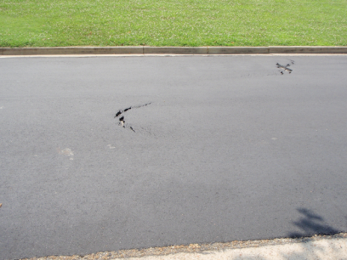
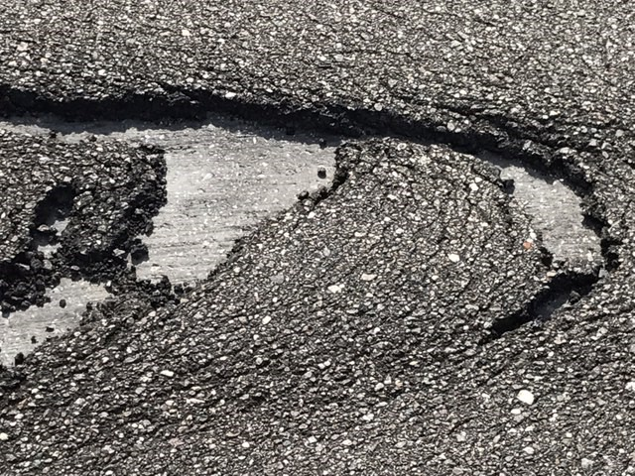
What is going on and why?
Notes:
Good spot for the instructor to ask what is going on and why, and then he could use that to ‘sell’ how proper tack coat application would have helped in the situation.
Crescent shaped slippage cracks often rapidly appear on poorly or unbonded areas. These slippage cracks typically appear in areas of extreme stress such as braking areas, high speed curves or areas where sharp turning movements occur. This type of cracking is usually limited to local areas of high stress. It is possible for these types of cracks to develop due to excessive tack application, but the typical reason is no or low tack or properly applied tack that has been tracked off the job by mix trucks backing into the paver over uncured tack. A proper mill and patch operation for repairing these areas is necessary to alleviate the distress on a properly designed pavement.
Traffic direction question to students—for both pictures the traffic is from left to right.

Slide 23
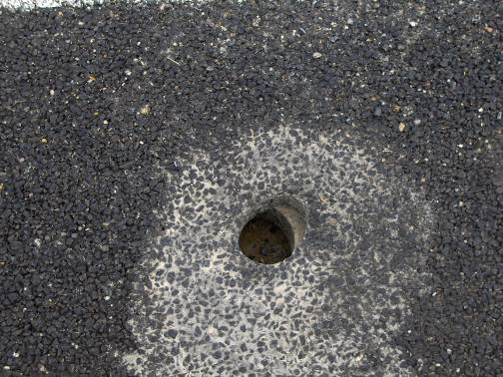
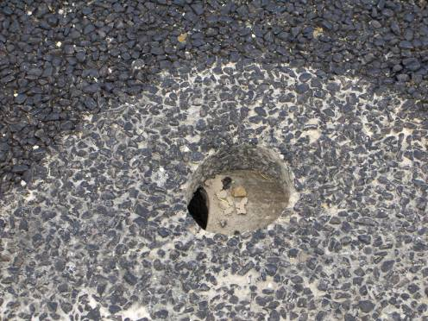
What is going on and why?
Days later!
Courtesy of Road ScienceTM
Notes:
Dramatic example of layer slippage in the Salt Lake City area.
Yes pavements can move around a lot!!

Slide 24
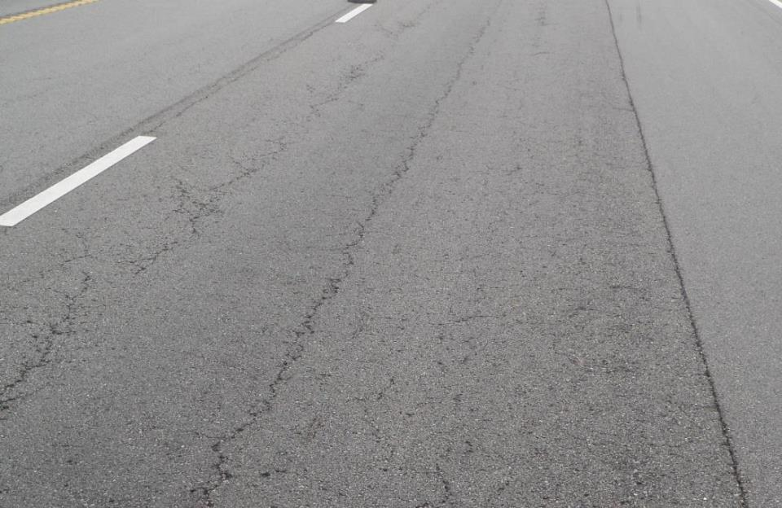
8–10 years est. Interstate Pavement
Courtesy of MoDOT
Notes:
This and the next slide show pictures from a presentation given to the NCAUPG February 2014 meeting by Jason Blomberg, MoDOT. The entire presentation was on why MoDOT was revising their tack coat spec.
Pavement showing fatigue relatively early in its life. Other distresses are seen, but it is the fatigue that has our and their attention as it was determined to relate to poor bonding.

Slide 25

What The Worth It To Apply A Tack Coat?
Cost of Tack Coat
New or Reconstruction
  About 0.1-0.2% of Project Total
  About 1.0-1.5% of Pavement Total Cost
Mill and Overlay
  About 1.0-2.0% of Project Total
  About 1.0-2.5% of Pavement Total Cost
30-100% of Original
Pavement Costs
Notes:
Information as calculated from recent (2013) bid tabs from various states. Intended to emphasize that tack coats are a relatively small part of a project’s overall cost whether it is full-depth construction or a mill and overlay.
So is it worth it to apply a tack – let’s take a look at real world bid tab costs evaluated by AI Engineer Dave Johnson, depending on the type of project, it will vary.
On a major reconstruction or new project many items other than pavement items will be included in the project costs. When looked at from the total project cost – tack is insignificant in cost. It is a larger portion of the pavement cost, but barely a blip on the screen of the overall project bill.
On strictly overlay or mill and fill type projects where pavement makes up the majority of the project cost, the cost of Tack is higher, in the 1-2% range.

Slide 26
Common Tack Coat Questions
What is the Optimal Application Rate?
  Surface Type
  Surface Condition
Workshop Recommended Ranges
Surface Type | Residual Rate (gsy) | Appx. Bar Rate Undiluted* (gsy) | Appx. Bar Rate Diluted 1:1* (gsy)
New Asphalt | 0.020 – 0.045 | 0.030 – 0.065 | 0.060 – 0.130
Existing Asphalt | 0.040 – 0.070 | 0.060 – 0.105 | 0.120 – 0.210
Milled Surface | 0.040 – 0.080 | 0.060 – 0.120 | 0.120 – 0.240
Portland Cement Concrete | 0.030 – 0.050 | 0.045 – 0.075 | 0.090 – 0.150
*Assume emulsion is 33% water and 67% asphalt.
Notes:
Field tack rates are often not changed to meet the conditions in the field – a plan quantity and rate are placed in the contract and used without modification in the field. Virtually any 2 lift rehabilitation project should have two different rates applied in the field. A higher dose on the lower lift – and a reduced rate on the top lift. The ability for field personnel to designate the optimal rate is highly recommended.

Slide 27
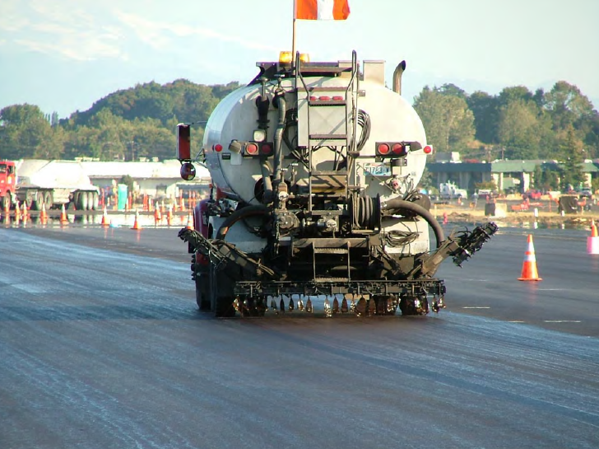
Common Tack Coat Question
When to Re-Tack?
  Pour appliation
  Pick-up on tires
  Contamination
If in doubt …
Re-Tack
Notes:
This picture shows some areas of lighter tack application. It would be wise for this crew to re-tack the light areas at the very least.

Slide 28
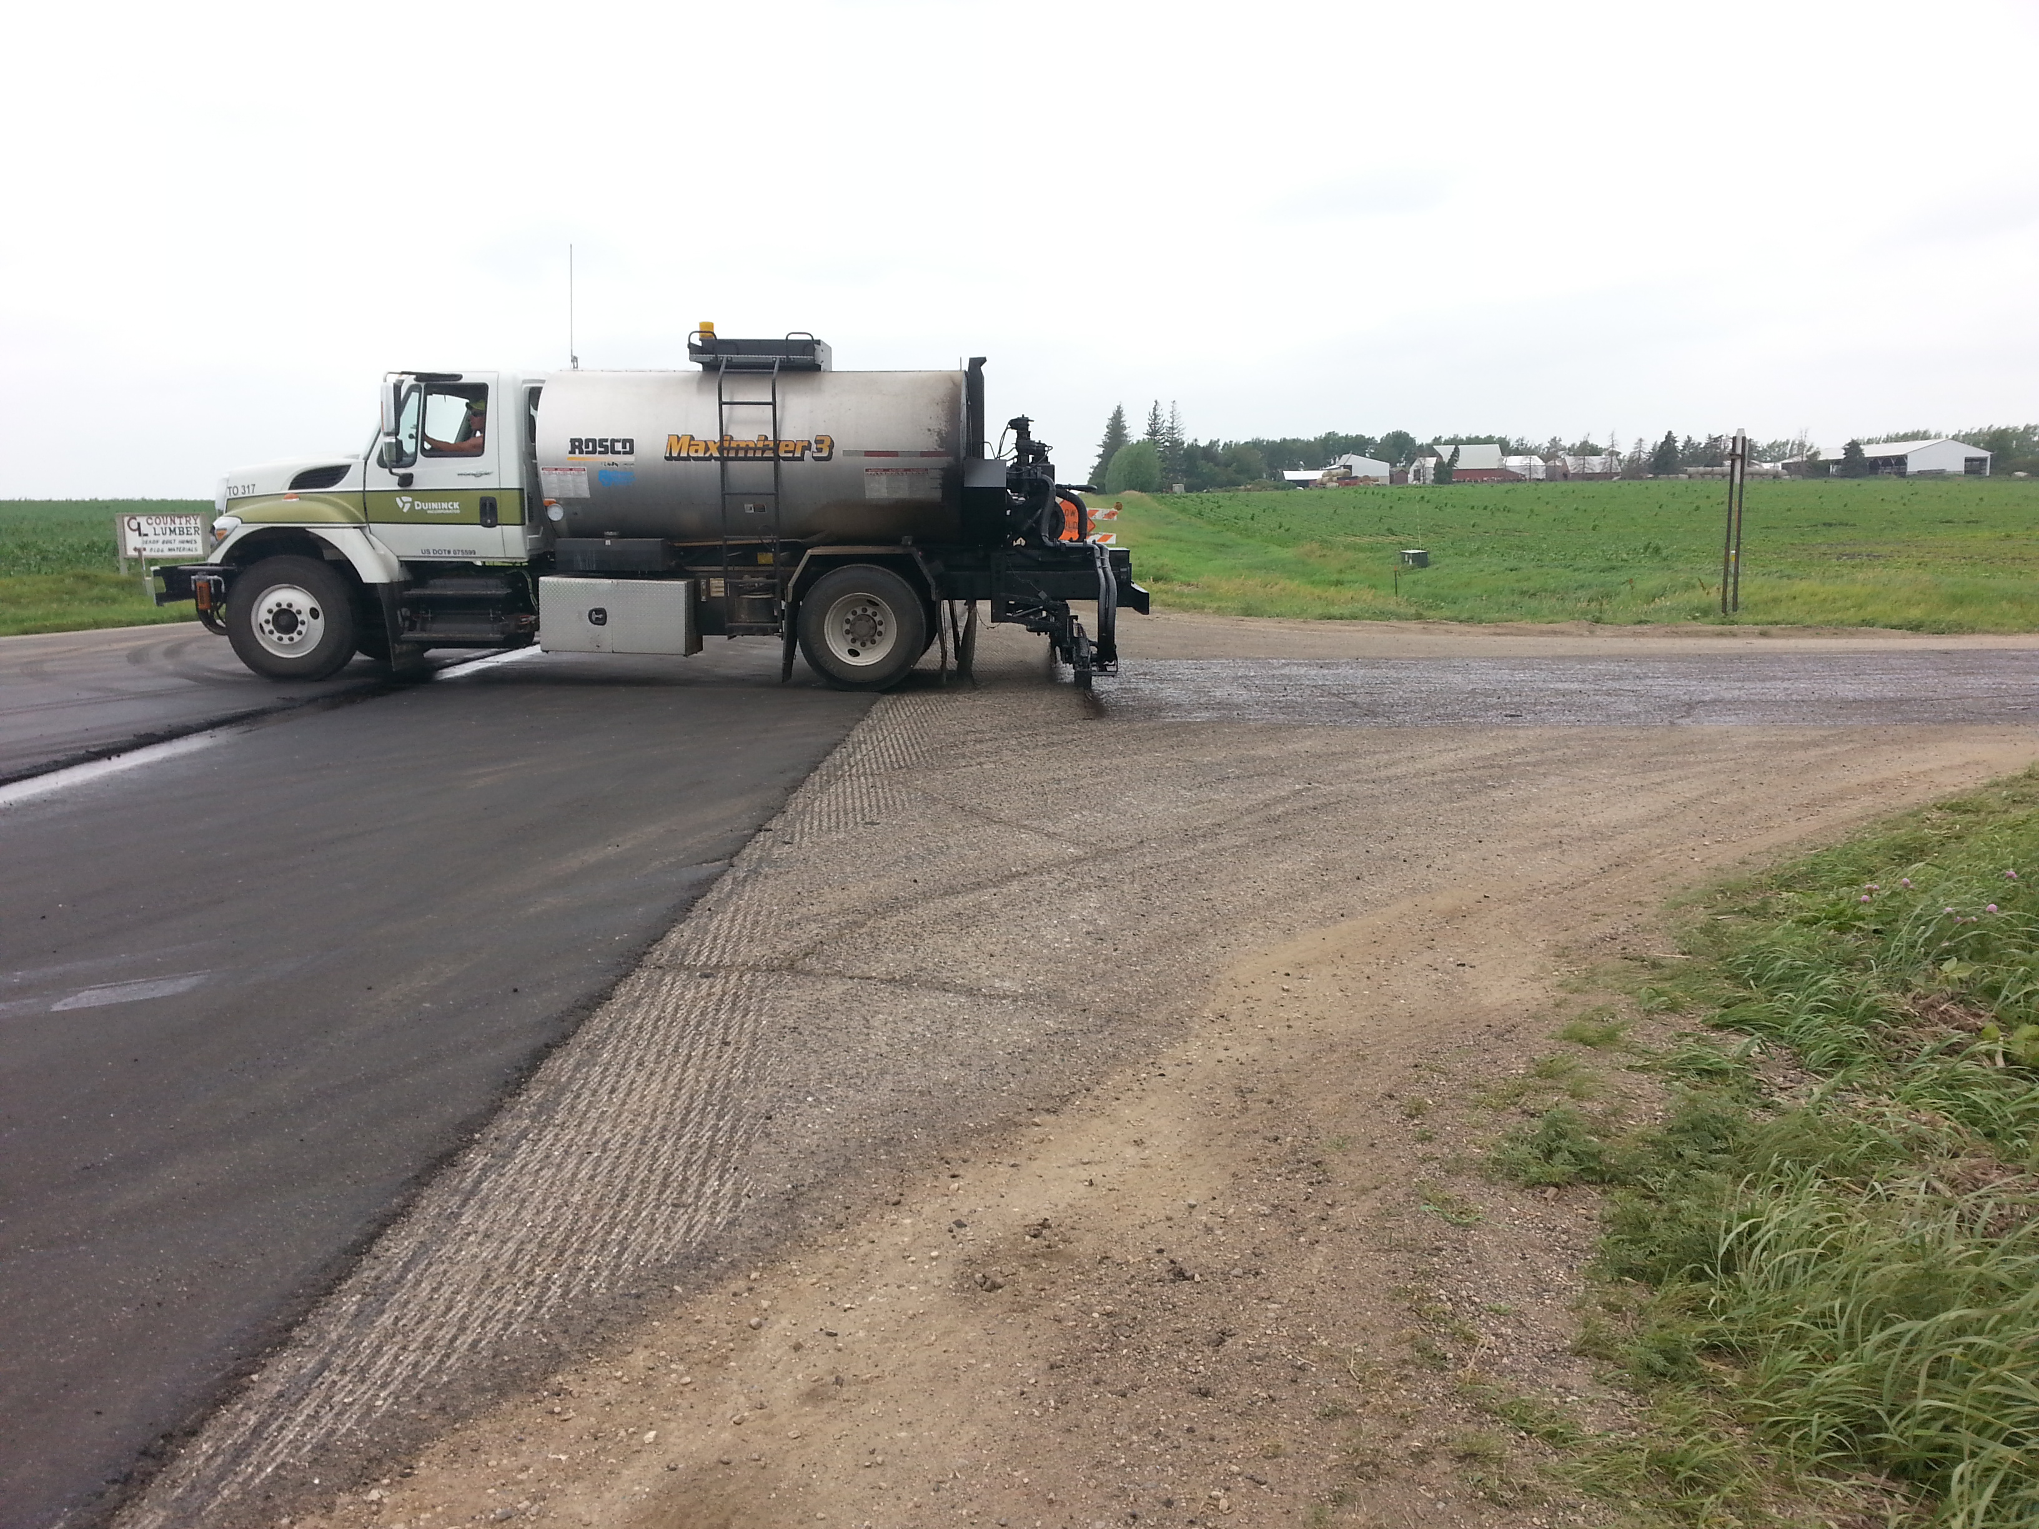
Light Application
Dirty Surface
Longitudinal Joint Tacked
Notes:
Another picture for the audience to critique this operation.
Longitudinal joint is tacked which is good practice. However, the entire lift is not. Perhaps it too will be tacked before placement of the next lift.
Additional cleaning of the milled surface appears to be needed as dirt has been tracked on to this surface.
While we don’t have the best perspective, it appears that the application rate is rather light.

Slide 29
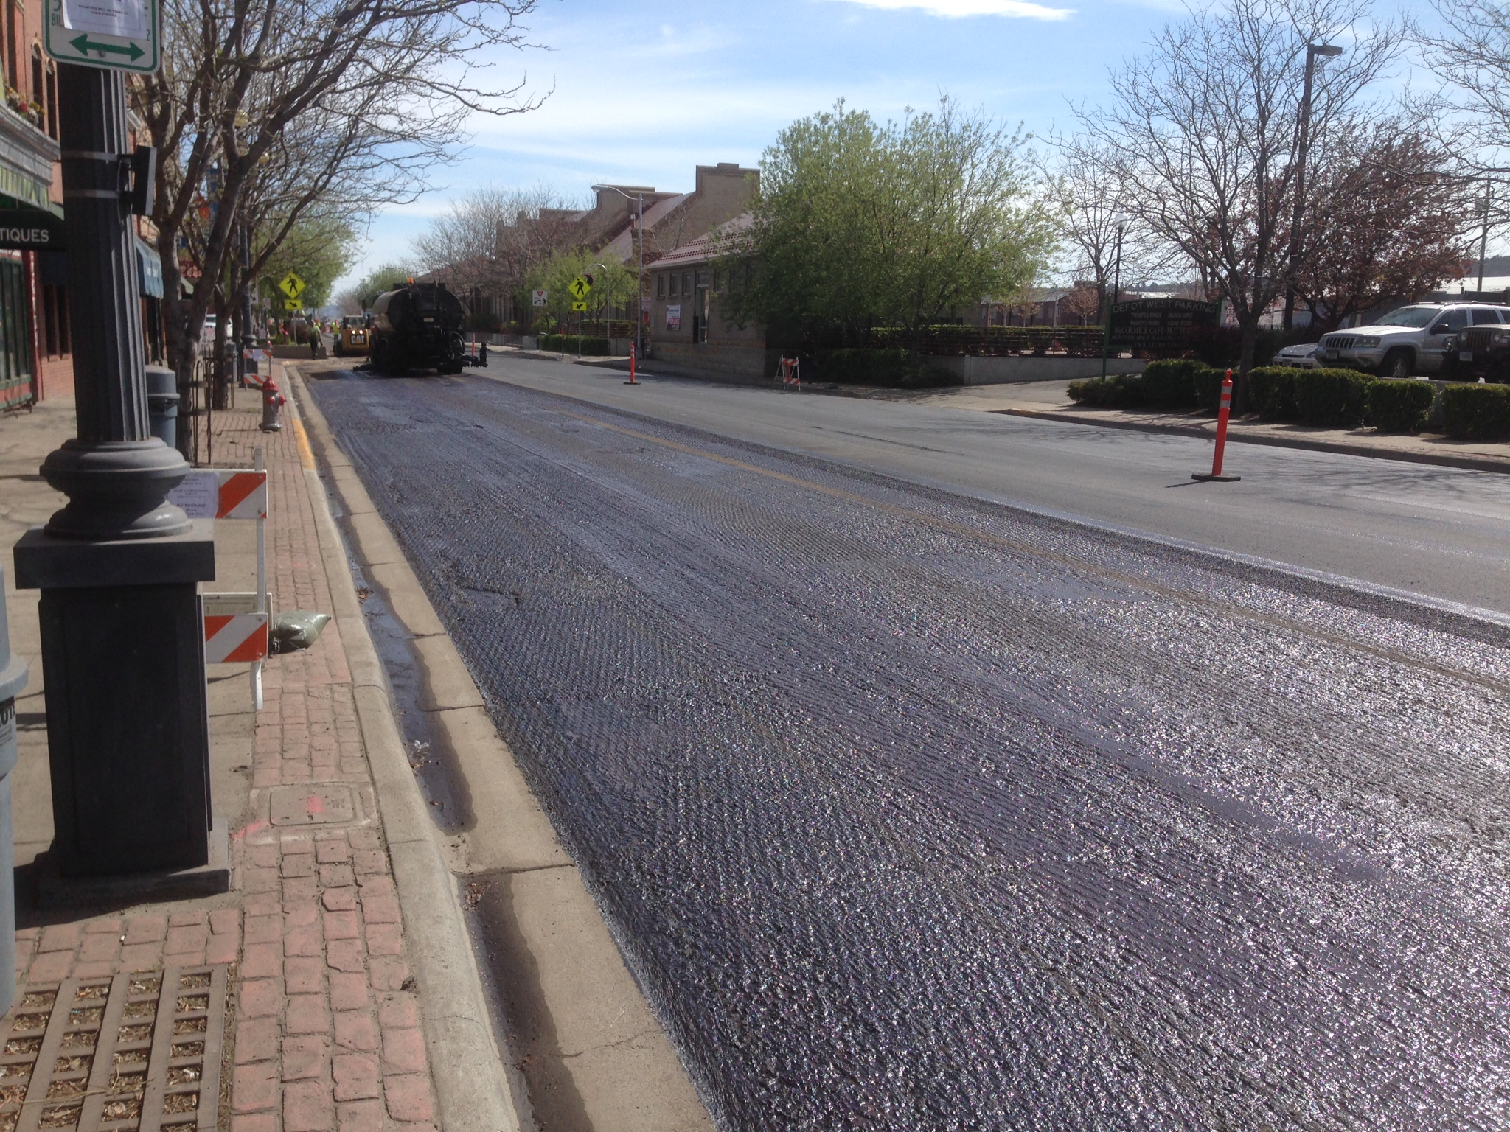
Missed Line
Generally Uniform
Application

Slide 30
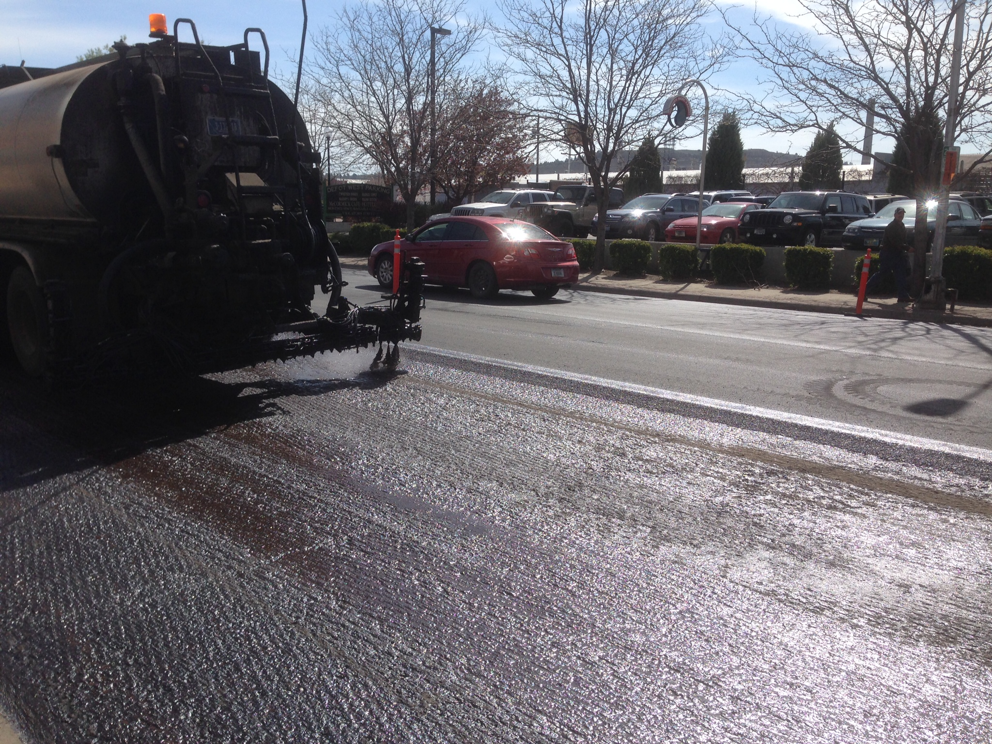
Filling it in

Slide 31
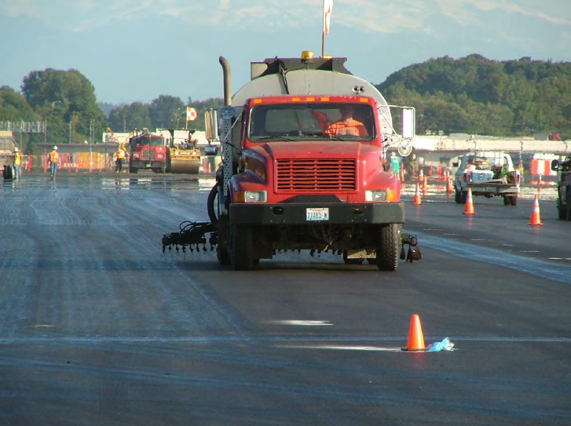
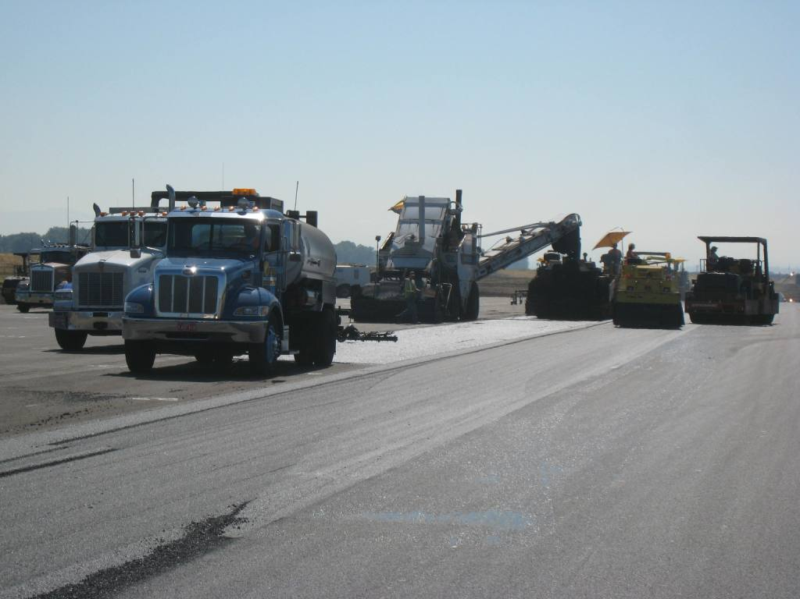
Notes:
Ask the participants what is happening in the photo, what might be the cause or consequence, what to do if this does happen, and so forth. Let them answer and instructor can fill in the details
Picture from Yellowstone NP of a maintenance overlay being installed by a Park Service crew. Note the lack of tack and how far back the rollers are.

Slide 32
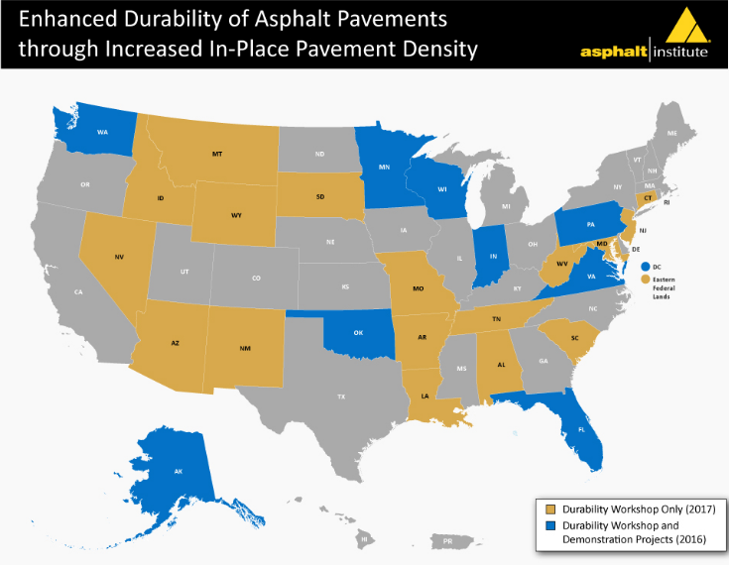
Notes:
10 states selected for field demonstration projects and workshops.
15 states selected for workshops only.

Slide 33
NCAT Report 16-02 (2016)
“A 1% decrease in air voids was estimated to improve:
Fatigue performance between 8.2 and 43.8%
The rutting resistance by 7.3 to 66.3%
Extend the service life by conservatively 10%.”

Slide 34
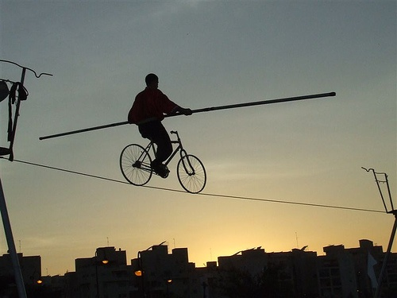
Balance the Mix Design
Improved Durability
Strength/
Stability
Rut Resistance
Shoving
Flushing Resistant
Durability
Crack Resistance
Raveling
Permeability
DON’T ATTACK ONE HALF AT THE EXPENSE OF THE OTHER HALF!!
Notes:
Mix design is a balance between strength and durability. We can design and mix that will be highly rut resistant, but it will not be durable. Or we can design a very durable mix that will be prone to rutting. The key is to balance the various constituents so as to best produce a mix that will resist rutting and yet last for years. On top of it all, we want a smooth quite ride.

Slide 35
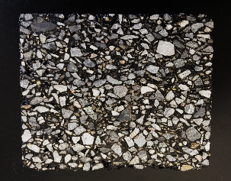
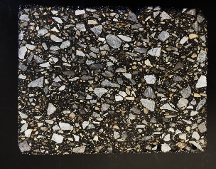
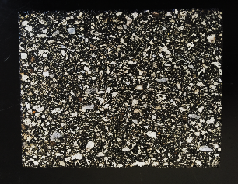
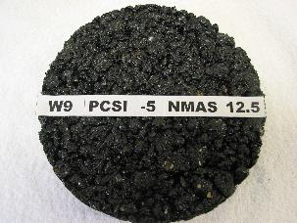
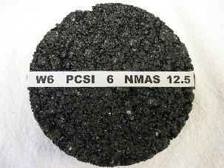
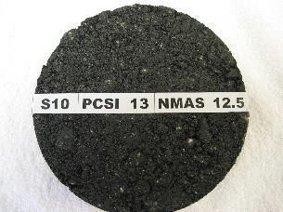
Choosing a Gradation
Finer Gradations
More Compactable
More Workable
Less Permeable
  Requires better aggregate
  Higher binder contents
Courtesy of NCAT
Notes:
Finer gradations are more compactible, more workable, and less permeable.
Those are qualities that make for longer-lasting, more crack resistant pavements.

Slide 36

Lift Thickness’ Effect on Compaction
Aggregates need room to densify
Too thin vs. NMAS leads to:
  Roller bridging
  Aggregate lockup
  Aggregate breakage
  Compaction Difficulties
NCHRP Report 531 (2004)
  Fine Graded Mix—Min Thickness = 3 X NMAS
  Coarse Graded Mix—Min Thickness = 4 X NMAS
  SMA Mix—Minimum Thickness = 4 X NMAS

Slide 37
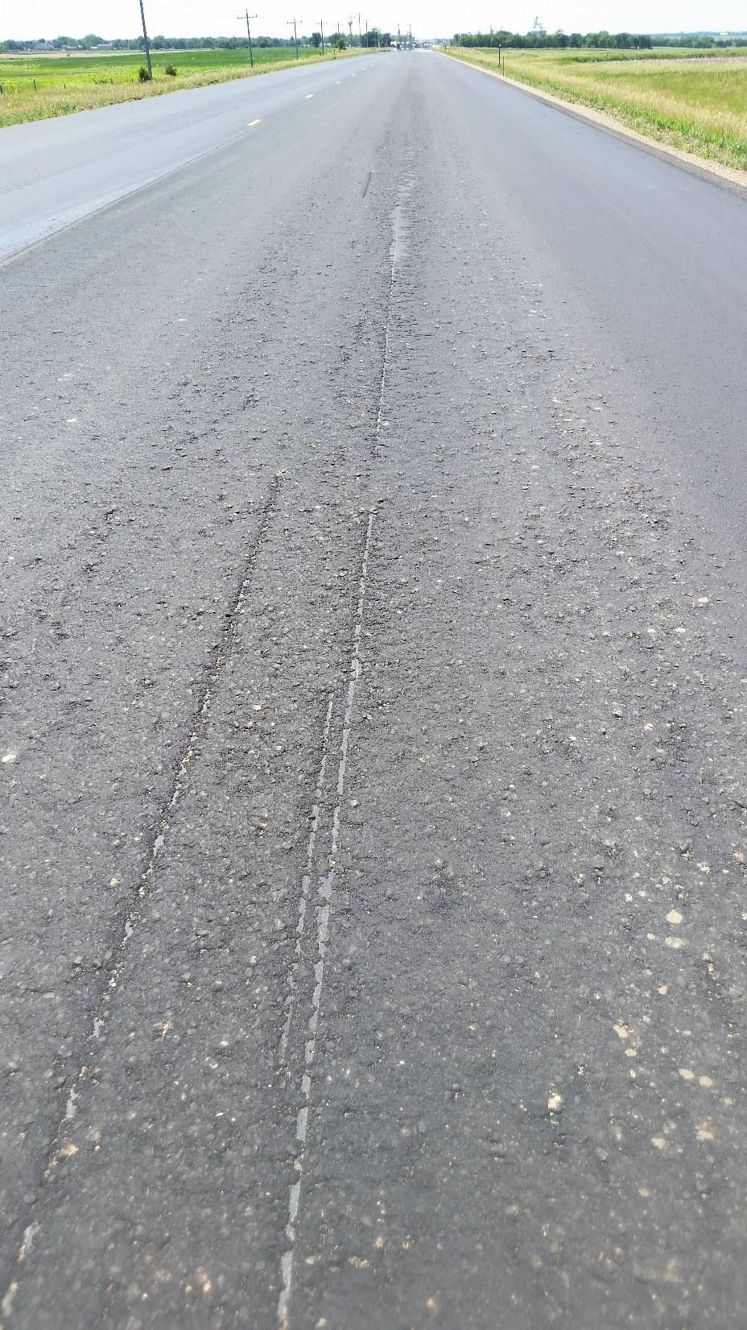
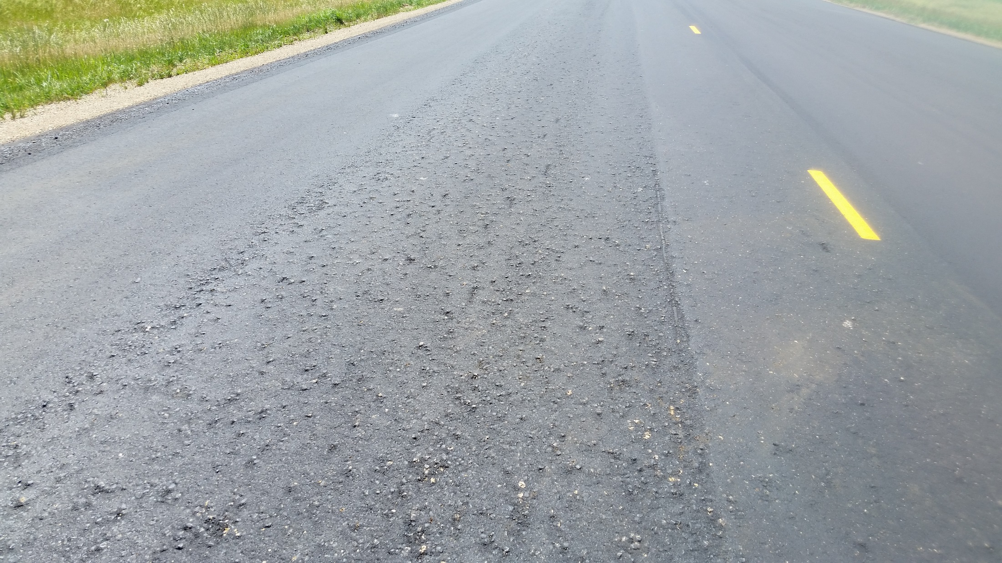
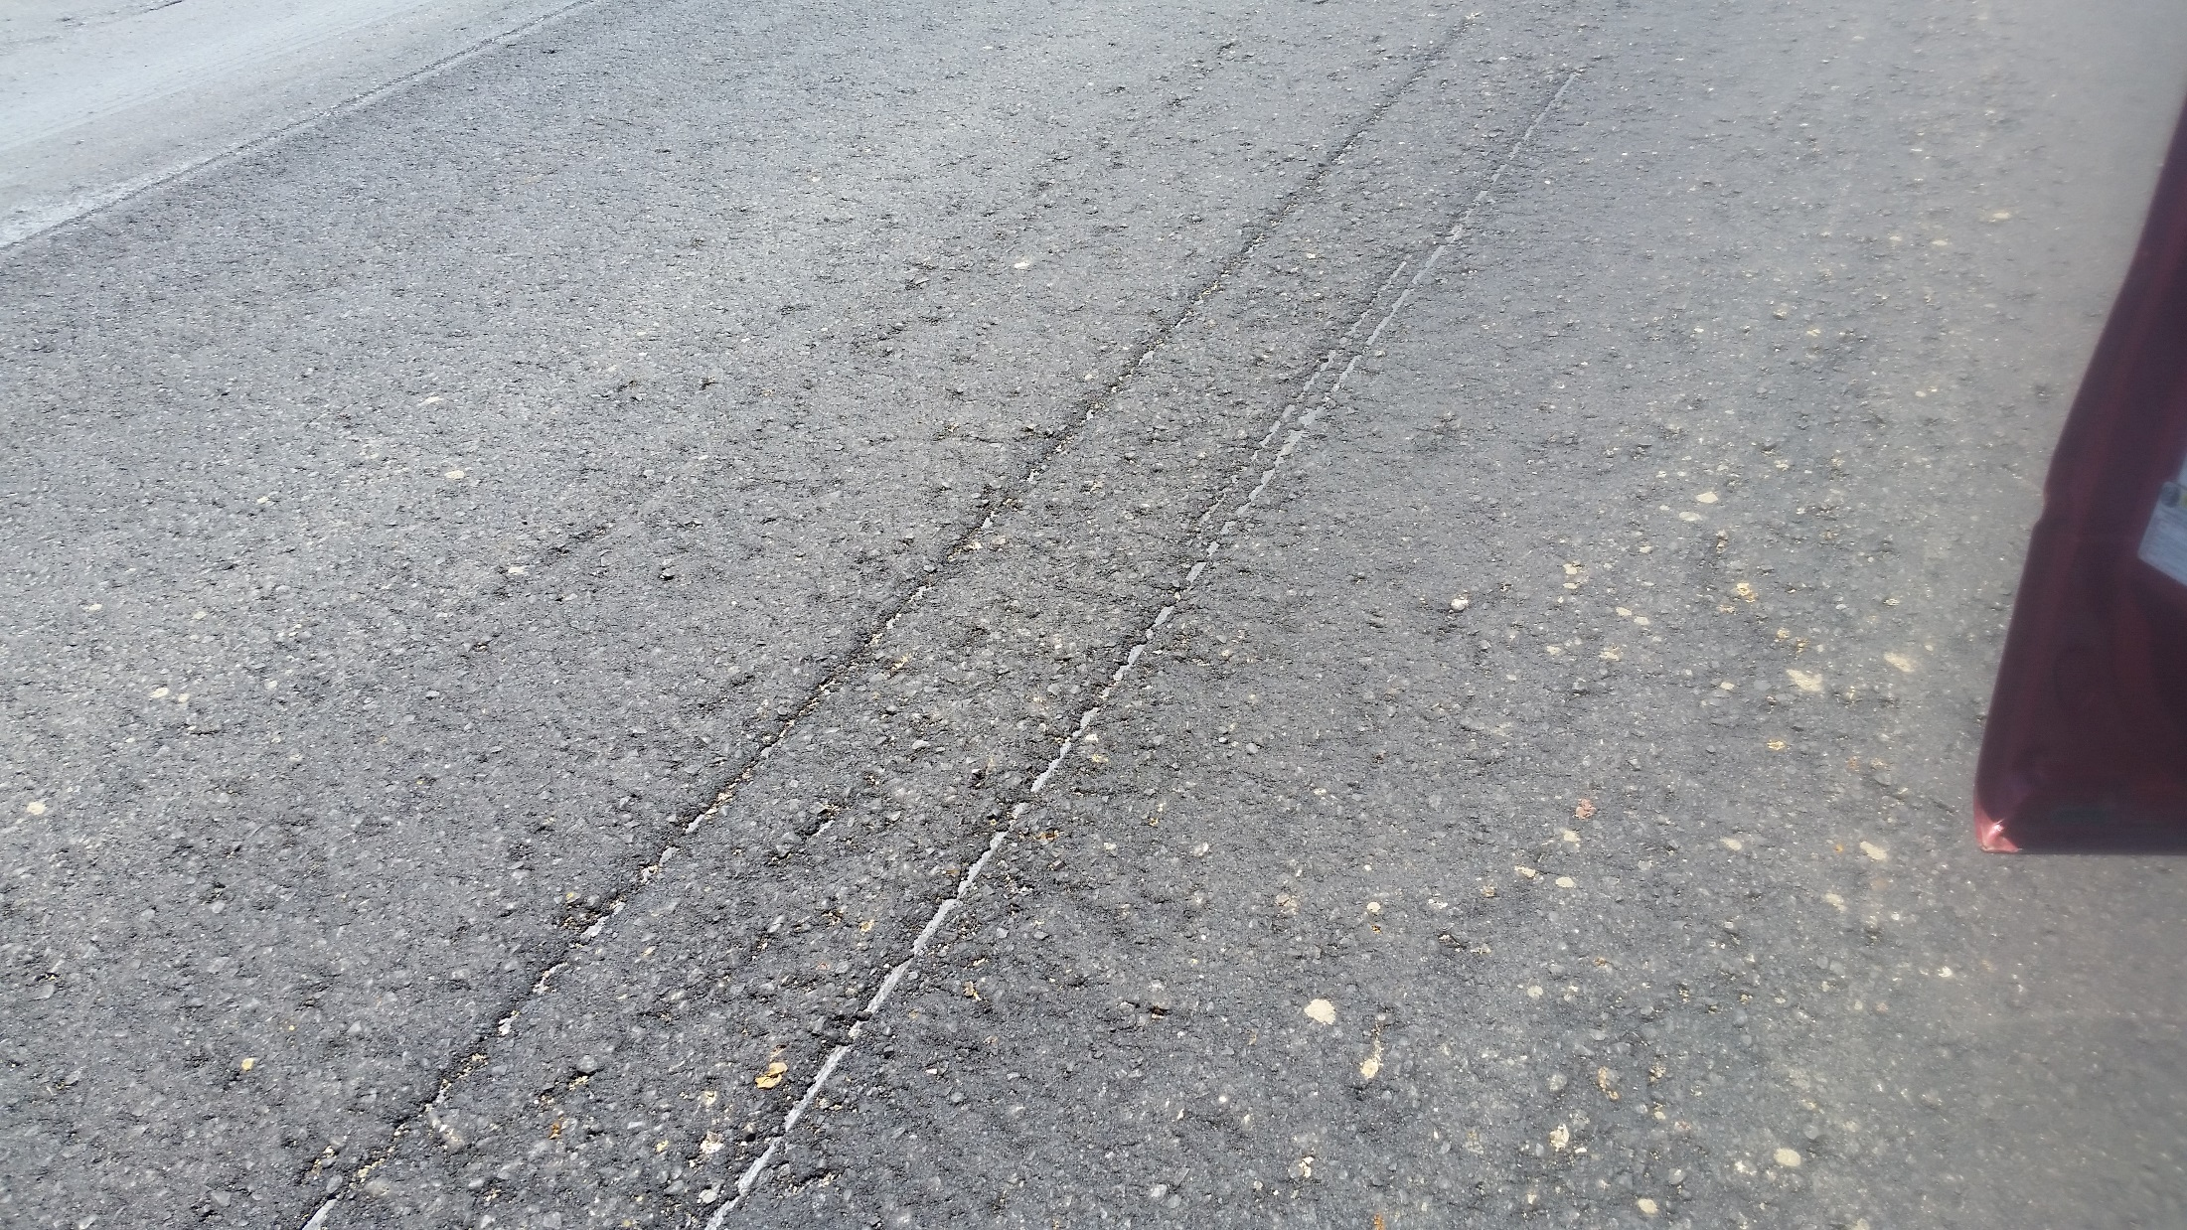
Asphalt Mixtures

Slide 38
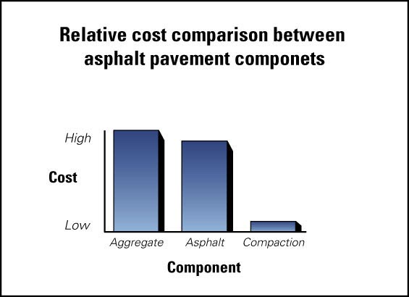
Cost of Compaction
Least expensive part of the paving process
Aggregates and binders are expensive in comparison
Compaction adds little to the cost of a ton of asphalt
Notes:
While this cost data is now dated, the upshot still applies, compaction adds relatively little to the cost of a ton of asphalt concrete.

Slide 39
Material Cooling
Thicker = More Time for Compaction
Free tools for estimating compaction time
  PaveCool—single lift (generation 1)
    PC
    iOs App
    Google App
  MultiCool—multiple lifts (generation 2)
    PC
    Google App
    Mobile Web

Slide 40
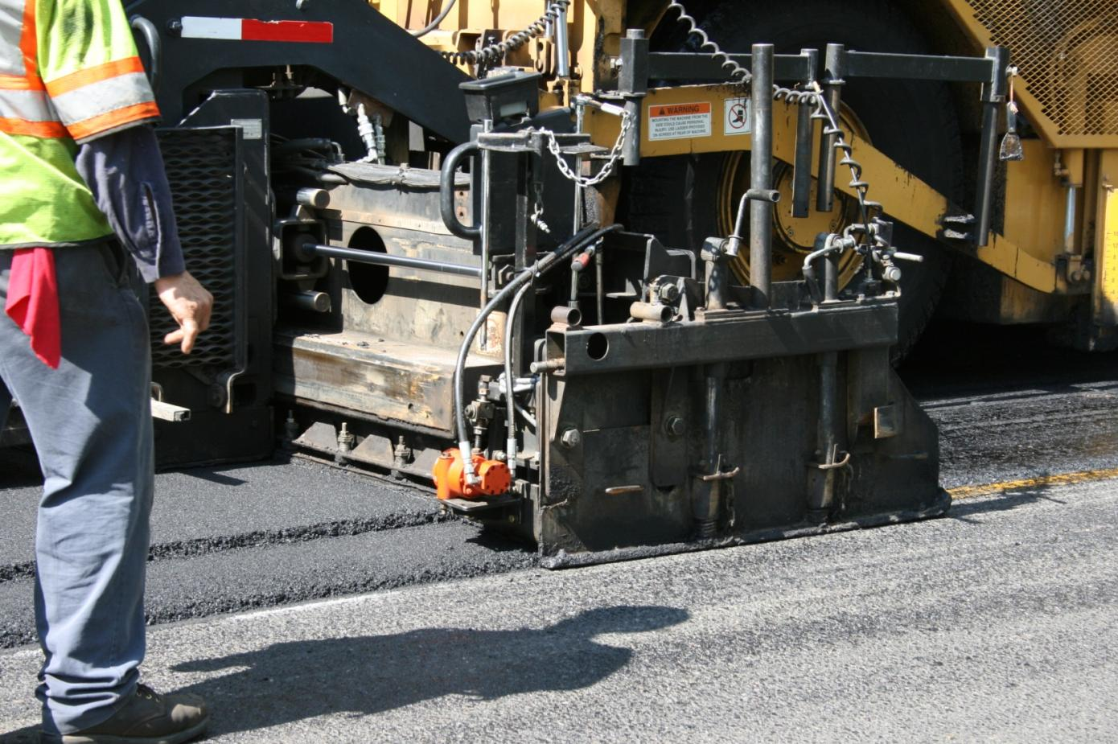
Vibratory Screed Should Always be “ON”
Note: screed operator walking along side
Notes:
Like the paver automatics, the vibratory screed should always be on to allow for good material flow under the screed and for pre-compaction.
If paver running on automatics, screed operator doesn’t need to ride screed all the time.

Slide 41
Paver Speed and Output
Assume:
  2-Inch Compacted Mat
  12-Foot Pull
  140 lbs/ft³ Compacted Unit Weight
Notes:
We want the paver to run nonstop all day at the same speed.
The chosen speed needs to match the output of the hot plant, the delivery capabilities of the trucking, and the compaction capabilities of the rollers.

Slide 42
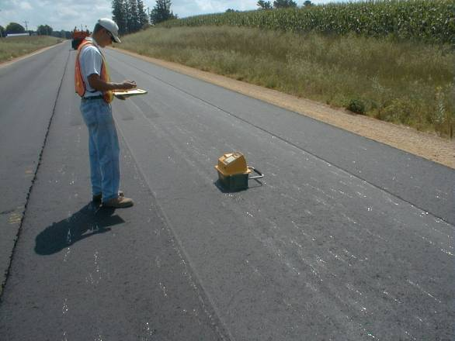
Establishing Rolling Pattern
Goal: 93.5% G_{mm}
Select: 3 Passes
(Intermediate will get the rest of the density)
Notes:
Here is what performing a test strip at the beginning of the project would look like. An inspector with a nuclear density gauge is determining the density of the mat after each pass. In this case, the inspector is building a compaction curve for the breakdown roller. The compaction curve is a plot of Density on the vertical axis against number of passes on the horizontal axis. As you can see, the density is increasing after each roller pass until pass # 4 where there is no significant increase in density from pass #3. Since we want to avoid “breaking” the mix (actually getting a reduction in density), the inspector decides to select 3 passes for the breakdown roller. The same procedure would then be followed to establish the correct number of passes for the other phases of compaction.
OK, now we have established that we want to perform three passes with the breakdown roller for this project. That means that we want to get a uniform coverage of three passes with the first roller everywhere on the mat.

Slide 43
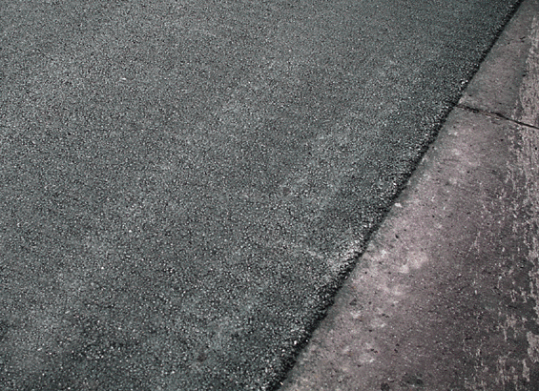
Vibratory Rollers - Amplitude
Amplitude too high
Travel speed too fast
Vibrating cool mat
  Roll closer to paver
Damaged gutter
  Roll along interface

Slide 44
Drum Impacts per Foot
Frequency | 2 MPH | 3 MPH | 4 MPH | 5 MPH
2000 vpm | 11.36 | 7.58 | 5.68 | 4.55
2200 vpm | 12.50 | 8.33 | 6.25 | 5.00
2400 vpm | 13.64 | 9.09 | 6.82 | 5.45
2600 vpm | 14.77 | 9.84 | 7.39 | 5.91
2800 vpm | 15.91 | 10.61 | 7.95 | 6.36
3000 vpm | 17.05 | 11.36 | 8.52 | 6.82
3200 vpm | 18.18 | 12.12 | 9.09 | 7.27
3400 vpm | 19.32 | 12.88 | 9.66 | 7.72
3600 vpm | 20.45 | 13.64 | 10.22 | 8.18
3800 vpm | 21.59 | 14.39 | 10.80 | 8.63
4000 vpm | 22.72 | 15.16 | 11.36 | 9.10

Slide 45
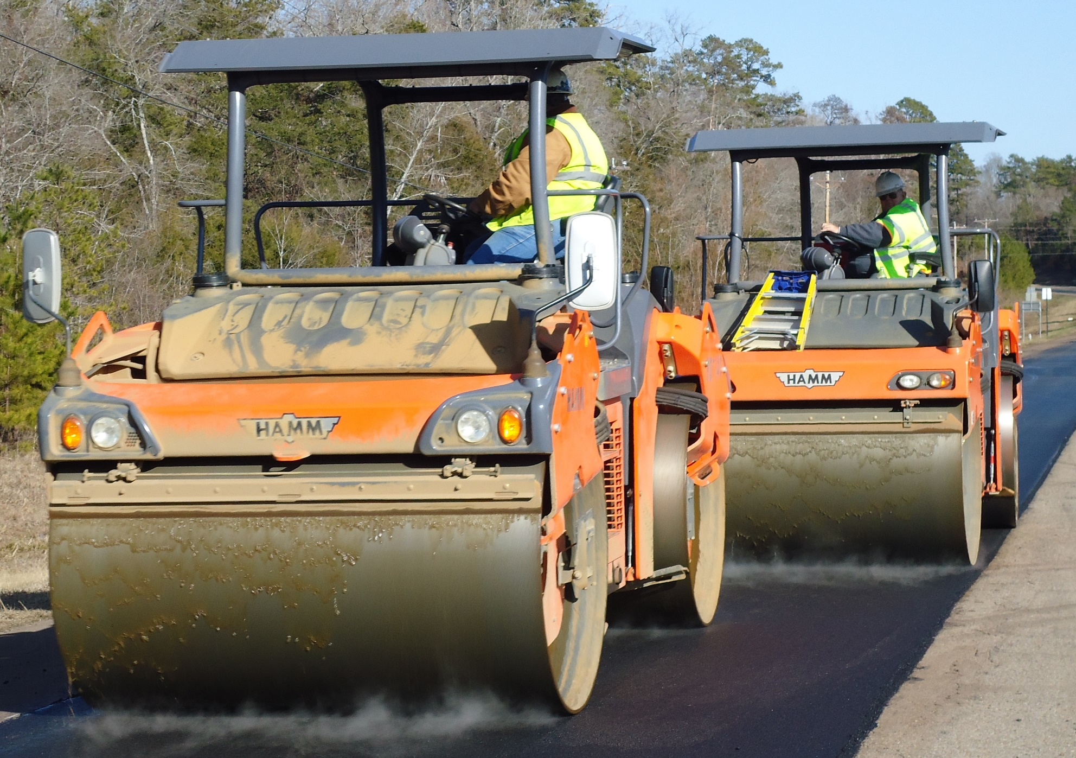
Additional Vibratory Rollers
Notes:
The photo shows two vibratory rollers working in tandem during the breakdown phase of compaction typically right behind the paver. Using two or more rollers like this puts the maximum compactive effort on the mat before it has a chance to cool off. This is becoming more and more commonplace especially on high production projects and on hard-to-compact asphalt mixtures. Tandem breakdown rolling is also a great way to address a scenario where there is a limited amount of time to complete compaction. Notice that this brand of roller allows the operator to offset the roller drums to increase the width of the passes.

Slide 46
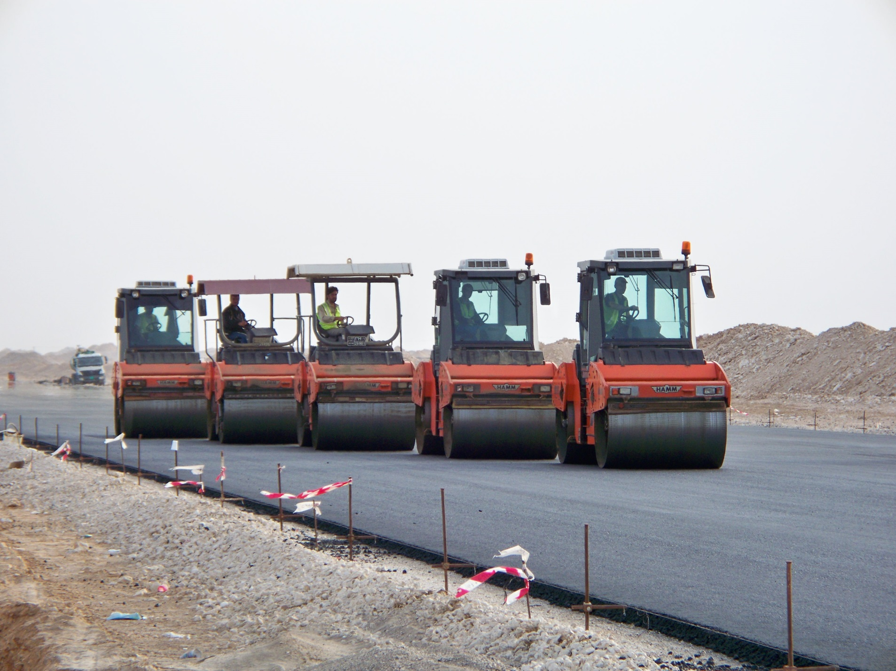
Additional Vibratory Rollers
Notes:
The photo shows two vibratory rollers working in tandem during the breakdown phase of compaction typically right behind the paver. Using two or more rollers like this puts the maximum compactive effort on the mat before it has a chance to cool off. This is becoming more and more commonplace especially on high production projects and on hard-to-compact asphalt mixtures. Tandem breakdown rolling is also a great way to address a scenario where there is a limited amount of time to complete compaction. Notice that this brand of roller allows the operator to offset the roller drums to increase the width of the passes.

Slide 47
Maximizing Our R.O.I.
Infrastructure loads continue to rise
Budget availability continues to fall
Increased pavement life can be economically achieved
Research shows a 10% increase in pavement life can be achieved by increasing compaction by 1%.
What would a 3% increase in compaction
do for our industry?

Slide 48
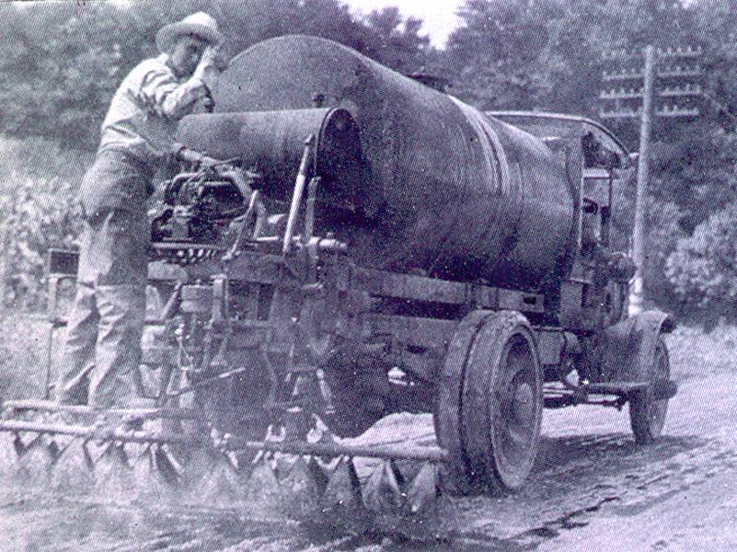
Thank You!
www.asphaltinstitute.org
Wayne Jones
Senior Regional Engineer
Asphalt Institute
wjones@asphaltinstitute.org

