Slide 1

Importance of Life Cycle Perspective
Dr Peter Taylor, PE (IL)

Slide 2
A Life Cycle Perspective
  Why bother
  Life cycle cost
  Life cycle environmental
  Anything else?

Slide 3
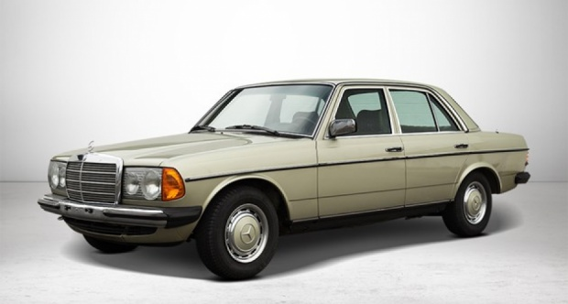
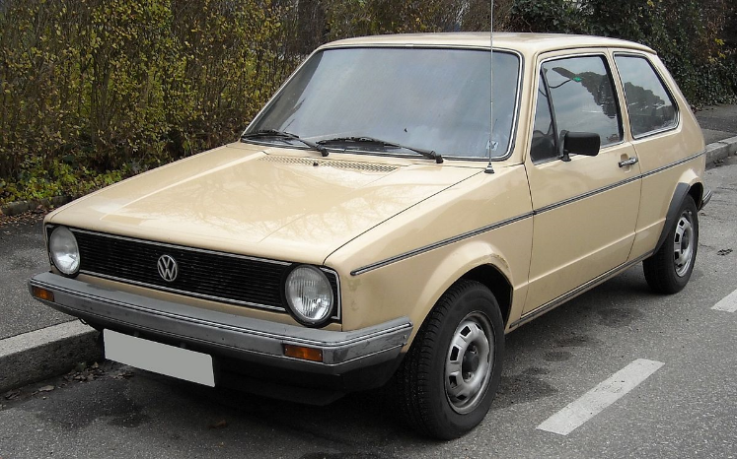
Life Cycle Thinking
  Which one was cheaper?
  To buy
  To own
    Resale
    Maintenance
    Cost of money

Slide 4
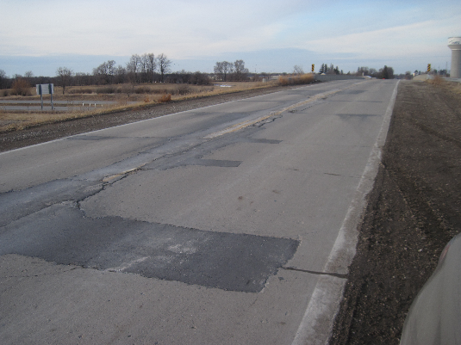
Life Cycle Thinking
  Agency income – flat / shrinking
  Traffic – growing
  Maintenance costs – …
  We have to be more efficient – just to keep up
  Do we buy miles, or years?
    And how do we maintain
    them?

Slide 5
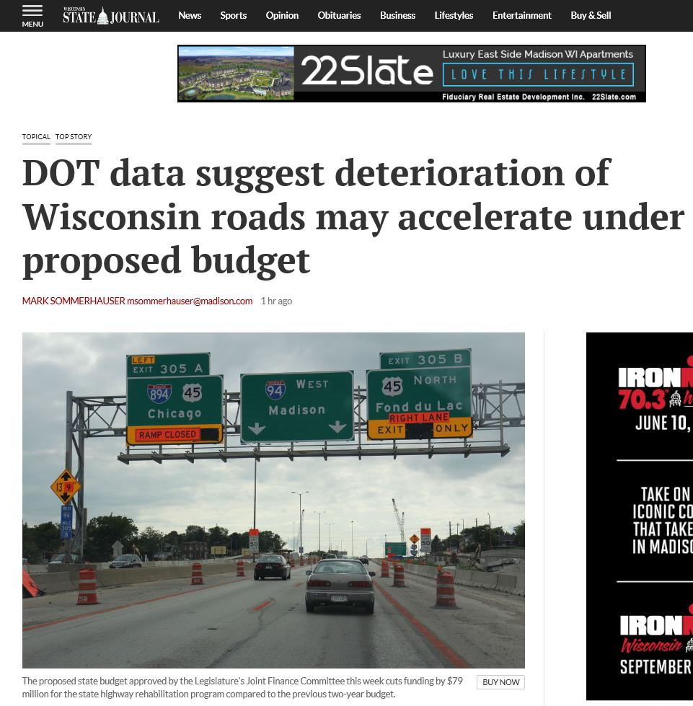
Life Cycle Thinking

Slide 6
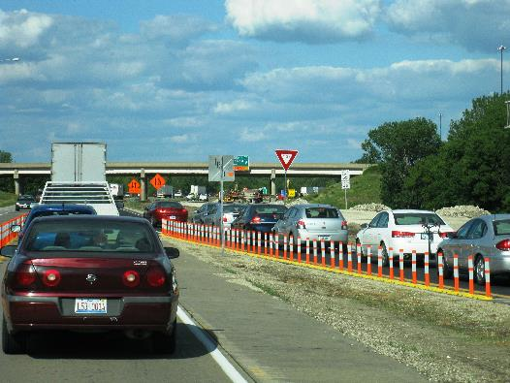
Life Cycle Thinking
  Cost
    Dollars are important
  Environment
    Can we reduce long term impacts?
  Safety
    Lives are lost every time we put up cones

Slide 7

But..
  How long?
    100 years ± 90
  What discount rate?
    Agencies don’t always borrow
  Whose money?
    Agency
    Travelling public?
  What metrics?
    CO₂
    Others?

Slide 8
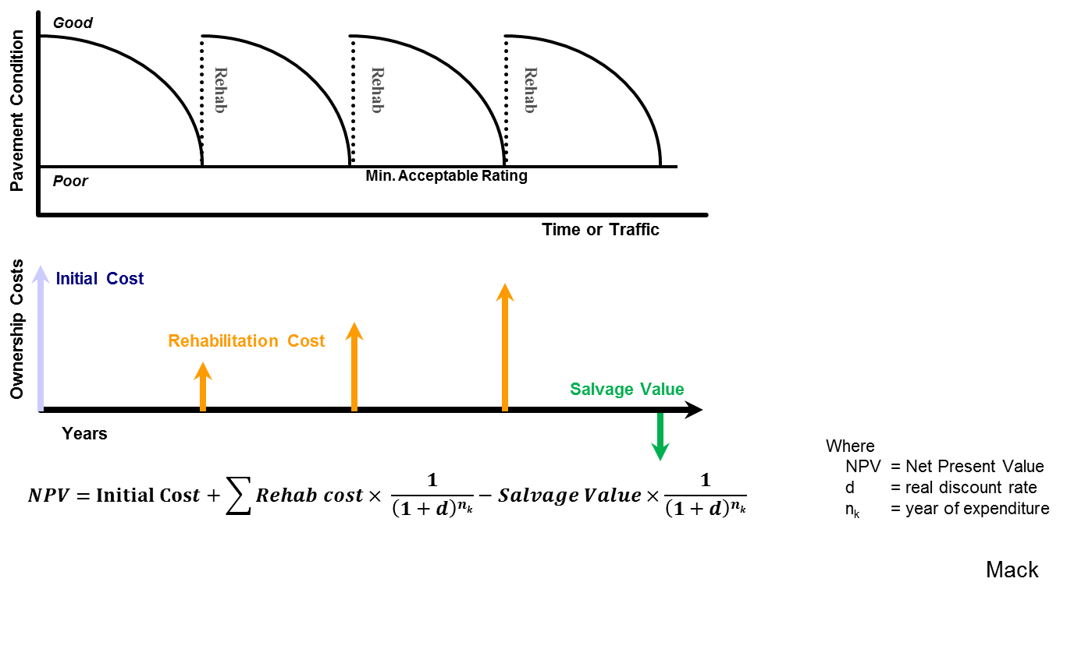
Life-Cycle Cost Analysis (LCCA)
Analysis technique to evaluate the total cost of an investment option in constant dollars over an analysis period.
Accounts for initial costs and discounted future rehabilitation costs
Assumes alternatives
are equal
Harvey

Slide 9
Variability
Good
Sources of Variability & Uncertainty
Rehab
Rehab
Rehab
Temporal - Timing of Rehabilitation Activities
    Historical vs Predicted
Scenario - What rehabilitation activities are done
    Preservation Options
    Overlay Options
Measurement - Cost
    Inflation
    Price Adjustment Clauses
    Unit Price
    Material Quantities
    Bidding Practices
    (Incentives and Disincentives, SY vs Tons, etc.)
Pavement Condition
Poor
Min. Acceptable Rating
Time or Traffic
Initial Cost
Ownership Costs
Rehabilitation Cost
Salvage Value
Years
Mack
Notes:
The decisions made today commits future resources (dollars & time) for maintenance and rehabilitation

Slide 10
LCCA
The process / decisions
  Analysis period
  Service life and activities
  Discount rate
  Agency costs
  User costs
  Economic evaluation approach
  Computational approach
  Software
Stantec

Slide 11
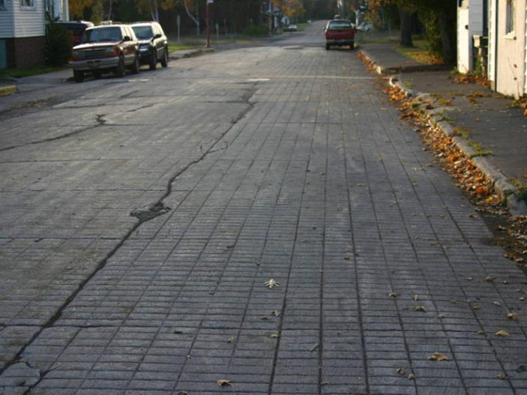
LCCA
Analysis period
  AASHTO
    High volume 30-50 years
    Low volume 10-25 years
  Canadian Provinces
    25-80 years
Stantec

Slide 12
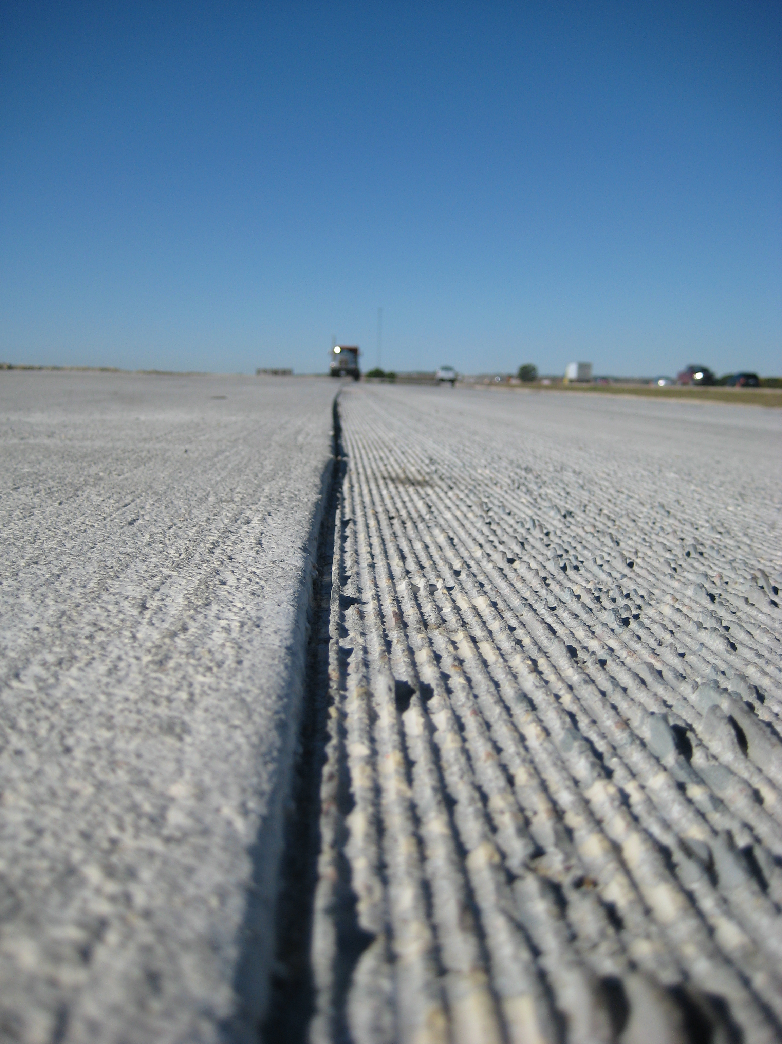
LCCA
Service life and activities
  For example
    Initial service life = 40 years
    Activity = CPR @ 10
    Diamond grind @ 18
Stantec

Slide 13
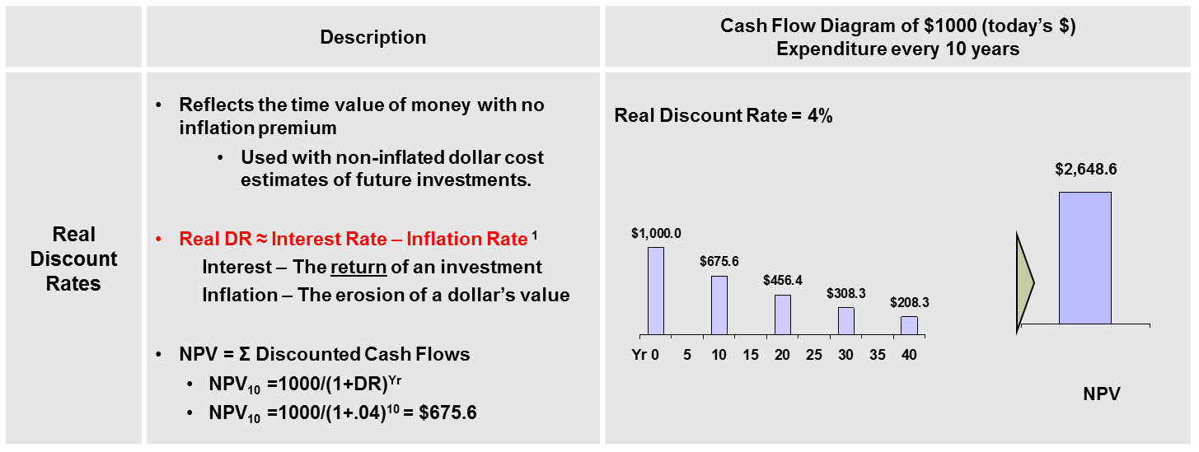
LCCA
Discount rate
  Time value of money adjusted for inflation
  Based on historical trends
  Affects outputs
  Typically 3 to 6%
Stantec

Slide 14
Inflation and Escalation
Escalation Rate (e) = Product Inflation – General Rate of Inflation
Construction Products | Product Inflation Rate |  | General Rate of Inflation |  | Escalation Rate (e)
Steel Mill Products | 5.16% | - | 4.39% | = | 0.77%
Lumber | 4.04% |  | 4.39% |  | -0.35%
Aggregate | 4.77% |  | 4.39% |  | 0.39%
Ready Mix Concrete | 4.39% |  | 4.39% |  | 0.01%
Concrete Products. | 4.35% |  | 4.39% |  | -0.04%
Cement | 4.42% |  | 4.39% |  | 0.03%
Paving Asphalt | 8.42% |  | 4.39% |  | 4.04%
Mack

Slide 15
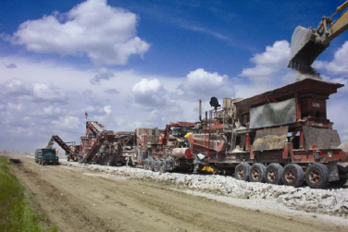
LCCA
Agency Costs
  Design
  Construction
  Maintenance
  Rehabilitation
  Less residual value (uncertain)
    Salvage
    Value of remaining life
    Value as support layer or recycled materials
Stantec

Slide 16
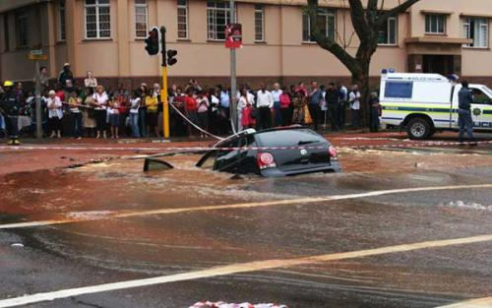
LCCA
User Costs
  Delays
  Operation
  Collisions
  Often excluded
Stantec

Slide 17
LCCA
Evaluation Method
  Net present value
  Equivalent uniform annual cost
  Internal rate of return
  Benefit / cost ratio
  Break even point
Stantec

Slide 18
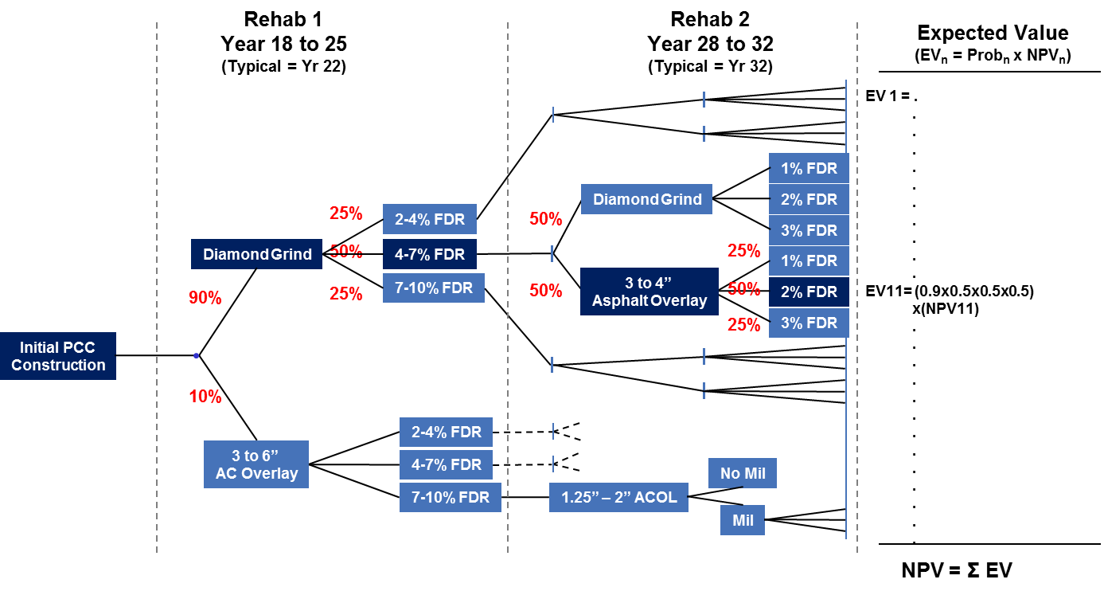
LCCA
Computational Approach
  Deterministic
  Probabilistic
Stantec/Mack

Slide 19
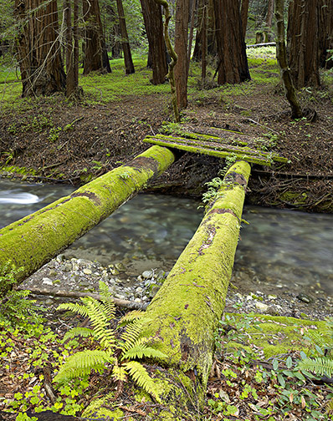
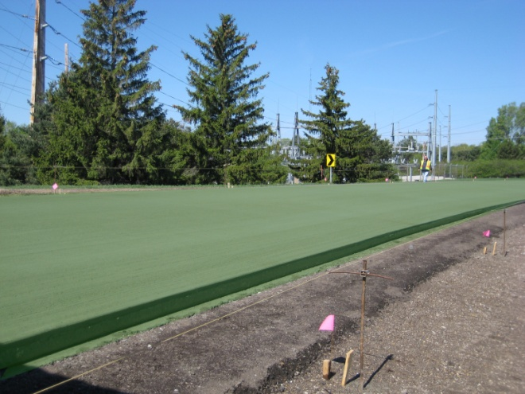
What About the Environment?

Slide 20
Life-Cycle Assessment (LCA)
Environmental impacts over the entire pavement life cycle.
Harvey

Slide 21
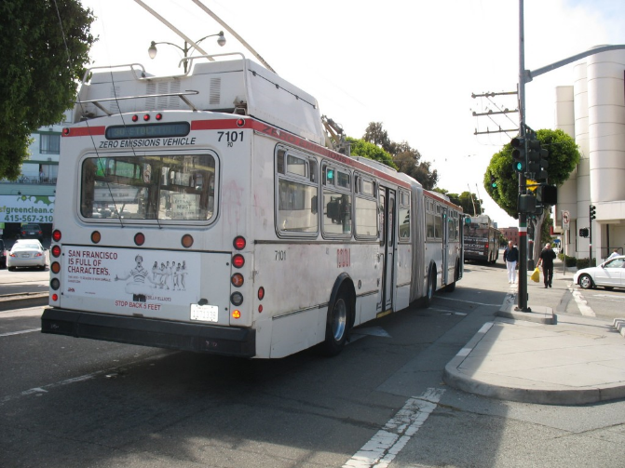
LCA
Examines all the inputs.
Identifies where the most significant improvements can be made.
Helps to filter out greenwashing.
Its complicated.
Harvey

Slide 22
LCA
The ISO 14000 family of standards
  Generally accepted worldwide
  Promotes completeness and transparency of LCA studies
  Leads to consistency and compatibility of practice across industries
  Specifics can vary greatly from one application to another
Industries are creating LCA-based Environmental Product Declarations (EPD)
Harvey

Slide 23
LCA
Process
  Define system boundaries
  Identify items that are the same across a comparison study
  Define the functional unit
  Define the approach required for sensitivity analyses
  Identify the types of operations and materials that occur within the system
  Identify life-cycle inventory data
Harvey

Slide 24
LCA
The process
Harvey

Slide 25
LCA
What do we measure?
Harvey

Slide 26
An Example
Case # | Case Description | Case ID | Analysis Rationale
Base | 355 kg cementitious, 15 % fly ash, 0% slag, 276 tonnes steel and regular M & R | 355CE-15FA-0SL-276DT-RR | Impacts of past practice
1 | 355 kg cementitious, 20% fly ash, 0% slag, 276 tonnes steel and regular M & R | 355CE-20FA-0SL-276DT-RR | Effect of additional fly ash
2 | 355 kg cementitious, 15 % fly ash, 25% slag, 276 tonnes steel and regular M & R | 355CE-15FA-25SL-276DT-RR | Effect of slag/ternary mix, if used
3 | 307 kg cementitious, 15 % fly ash, 0% slag, 276 tonnes steel and regular M & R | 307CE-15FA-0SL-276DT-RR | Effect of reduced cementitious material (tarantula optimization)
4 | 355 kg cementitious, 15 % fly ash, 0% slag, 126 tonnes steel and regular M & R | 355CE-15FA-0SL-126DT-RR | Effect of reduced steel
Sullivan
Notes:
- Base case plus eight alternative cases.
- A negligible change in the proportion of coarse and fine aggregates (61:39).

Slide 27
An Example (cont’d)
Case # | Case Description | Case ID | Analysis Rationale
5 | 307 kg cementitious, 20 % fly ash, 0% slag, 276 tonnes steel and regular M & R | 307CE-20FA-0SL-276DT-RR | Combined effect of reduced cementitious and increased fly ash
6 | 307 kg cementitious, 20 % fly ash, 0% slag, 126 tonnes steel and regular M & R | 307CE-20FA-0SL-126DT-RR | Combined effect of reduced cementitious and steel, and increased fly ash (new spec.)
7 | 307 kg cementitious, 15 % fly ash, 25% slag, 126 tonnes steel and regular M & R | 307CE-15FA-25SL-126DT-RR | Combined effect of new spec. and slag/ternary mix, if used
8 | 307 kg cementitious, 15 % fly ash, 25% slag, 126 tonnes steel and Extended M & R | 307CE-15FA-25SL-126DT-ER | Effect of extended M and R
Sullivan
Notes:
- Case 8 is intended to show the effect of possible extension of initial pavement service life (extended M & R) due to the use of ternary concrete mix or other means (e.g., pavement designed for a longer service life). In this case, the timing of the M and R treatments were arbitrarily delayed by 5 years from the regular M and R treatments.

Slide 28
GWP for the Base Case
Sullivan
Notes:
- Embodied effect (material and equipment) includes the effects of material manufacturing and equipment use.
The embodied transportation effect includes effects of material and equipment transportation.
The highest impact is due to the use phase M & R treatments.
The embodied effect due to material and equipment contributes to 78% of the total life cycle environmental impact.
The PVI contributes to 18% of the total life cycle environmental impact.
The impact of material and equipment transportation is small.

Slide 29
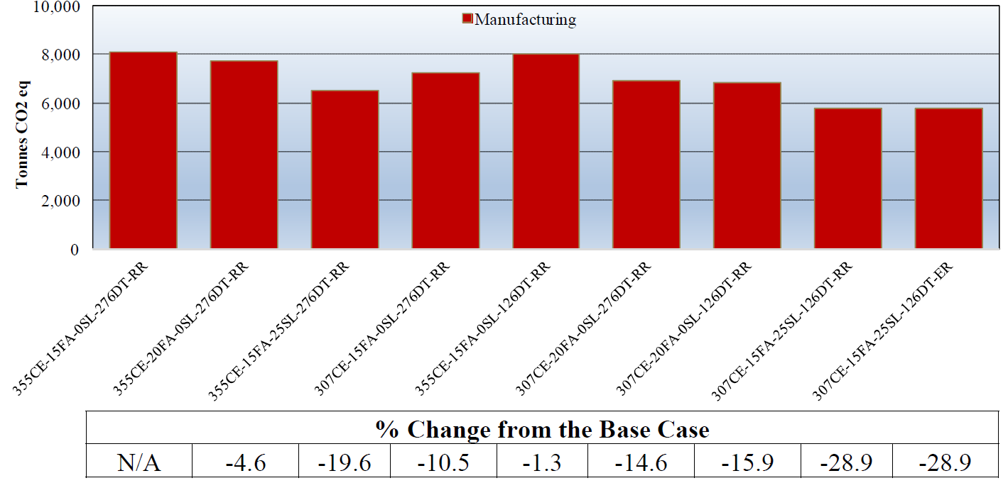
GWP Due to Material Manufacturing
Sullivan
Notes:
A 5% increase in fly ash = 4.6% reduction of GWP
25% replacement of cement by slag = 19.6% reduction of GWP
Reduction of paste from 355 kg/m³ to 307 kg/m³ = 10.5% reduction of GWP
Combined effect of mix design change = 14.6% reduction of GWP
Big reduction of steel quantity from 276 tonnes to 126 tonnes = only 1.3% reduction of GWP
Total 15.9% reduction of the GWP due to the adoption of new pavement structure and concrete mix design
Use of ternary concrete mix could reduce the GWP by 28.9%

Slide 30
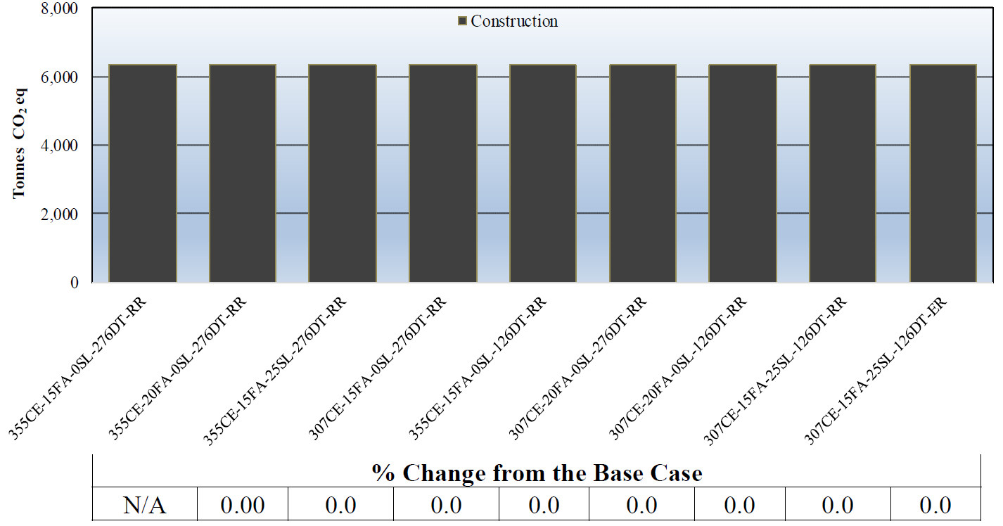
GWP Due to Construction
Sullivan
Notes:
- No change in construction practice = No change in GWP

Slide 31
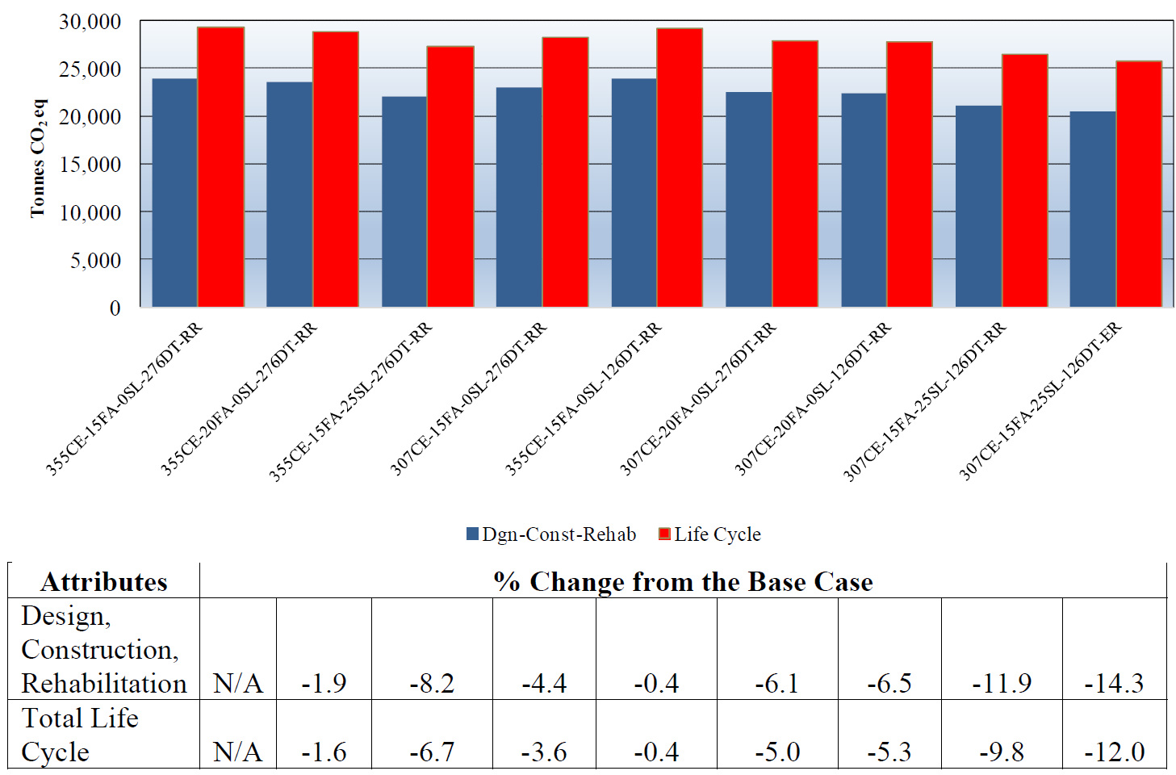
Life Cycle Impacts
Sullivan
Notes:
Comparisons of total GWP excluding and including the PVI.
Manitoba can expect a 6.5% reduction of the GWP, excluding the excess fuel consumption due to the PVI, with the adoption of the new concrete mix deign and steel configurations. Including the PVI, the overall life cycle GWP reduction is estimated to be 5.3% from base case.
Another (9.8% - 5.3% =) 4.5% reduction of the GWP may be possible with the use of ternary concrete mix and (12.0% - 9.8% =) 2.2% reduction of the GWP may be possible by extending the initial pavement service life by five years i.e., by constructing more durable pavements.

Slide 32
GWP for all scenarios
Sullivan

Slide 33
Conclusions for this example
LCA software can help assess alternative pavement strategies
Expect ~5% reduction of the GWP with the adoption of new:
  Concrete mix design, and
  Dowel/tie bars configurations
Further reduction of the GWP may be possible:
  With the use of ternary concrete mix and
  With the extension of pavement service life
Sullivan

Slide 34
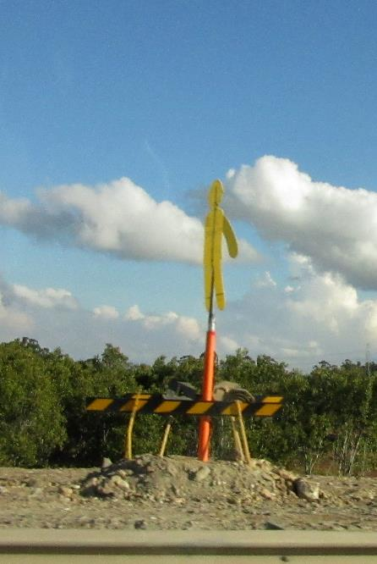
Safety
If safety is paramount – should it not be part of our life-cycle thinking?
  Travelling public
  Workers
  FOD

Slide 35

Closing
Life cycle approaches
  Changing our horizons
  Doing more with less
  Good engineering
  Good financial
  stewardship

Slide 36
QUESTIONS?

