Slide 1
Airfield Pavement Design and Construction- Sustainability Checklists and Matrices
Presentation to CAPTG Workshop - Halifax, September 18, 2017
George Nowak P. Eng.

Slide 2
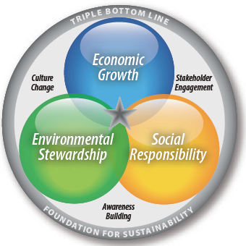
Sustainability - “Triple Bottom Line”
TBL Definition is most widely accepted approach to sustainability. (phrase coined by John Elkington, 1994)

Slide 3
Reminder: Green ≠ Sustainable
Green is only one aspect – green focuses solely on Environmental Stewardship which is very important but ….
Sustainable projects move beyond just the “green” component and must include Economic Viability, Social Responsibility and Operational Efficiency

Slide 4
Notable Airport Sustainability Agencies (1)
Sustainable Aviation Guidance Alliance (SAGA).
http://www.airportsustainability.org/
Volunteer Alliance : ACI-NA, ACC, AAAE, ATA
Formed 2008 )documents updated as recently as 2015
Searchable Sustainability Database – compendium of many airport checklists
Does not provide a rating system, although does identify practices from various US-based airports

Slide 5
Notable Airport Sustainability Agencies (2)
City of Chicago, Sustainable Airport Manual, First Issued 2003 (now Nov. 2014 issue)
http://www.flychicago.com/community/environment/Pages/default.aspx
O'Hare Modernization Program
Planning, Design and Construction Checklists
Sustainable Specifications

Slide 6
Notable Airport Sustainability Agencies (3)
Los Angeles World Airports (LAWA) Environment/Sustainability https://www.lawa.org/uploadedFiles/LAXDev/News_for_LAXDev/Sustainable%20Airport%20PDC%20Guidelines%20Jan08.pd
Detailed Guidelines – Started 2007 now in Version 5.0 Dated February, 2010
Planning and Design Checklist (Matrix) with Point System
Construction Checklist (Matrix)

Slide 7
Notable Sustainability Agencies (4)
New Group – Institute for Sustainable Infrastructure (ISI) founded by ACEC, APWA and ASCE in 2011. Emulating LEED® for non-building (infrastructure) work.
http://www.sustainableinfrastructure.org/
Rolled out in early 2012
Service fee for rating
Useful info on website
Envision “professionals”

Slide 8
Sustainability Criteria for Matrix Analysis and Comparison
Many standard “checklists”, criteria and rating “metrics” are available for guidance, but there is no universally accepted “standard” like LEED® - at least not yet.
You and your stakeholders/advisory panel need to establish sustainability goals for your specific airport pavement project - one size does not fit all.

Slide 9
Typical “Airport Pavement” Sustainability Rating Criteria
Planning and Design
Electronic Submissions
Outreach and Stakeholder Plan
Environmental Review Process
Life Cycle Analysis and Inventory
Optimal Airside Geometric Design
Noise Control
Climate Change Adaptation
SWM and Erosion Control Plan
Water Use Efficiency
Heat Island Reduction
Light Pollution Reduction
Energy Alternatives/Efficiency
Emission Impact Mitigation
Design for Material Resources and Recycling
Construction and Operations
Electronic Submissions (RFI, CO and Record Plans)
Quality Control Plan
Noise Mitigation Plan
Waste Management Plan
Erosion Control and Sedimentation Plan
Recycling Plan
Low-emissions Plan (vehicle and site transportation)
Greenhouse Gases Emission Plan
Employee Development Plan
Pavement Management System
Long Term Efficient Operations Plan

Slide 10
Case Study – Sustainability Matrix Analysis and Monitoring
Calgary International Airport (YYC)
New Parallel Runway (RDP)

Slide 11
YYC New Parallel Runway (RDP)

Slide 12
RDP Key Scoping Elements
$620 million project (excluding AT tunnel)
4,267 m (14,000ft ) CAT III ICAO Code F runway and taxiways
7.5 million m³ earthworks
500,000 m³ gravels
260,000 m³ concrete (LCC done)
5000+ runway, taxiway and approach lights
In service date June, 2014

Slide 13
YYC Airfield Pavement Sustainability
YYC has ISO 14001 Compliant Environmental Management System (EMS)
YYC committed to a self – directed Full Environmental Assessment
Sustainable Aviation Guidance Alliance (SAGA) guidelines adopted for the Runway Development Program (RDP)
Project Specific Design and Construction Sustainability Matrices established

Slide 14
RDP Sustainability Workshop Criteria (Key to Matrix Cell Creation)
Soils (22) (4)
Groundwater (3) (3)
Vegetation (19) (1)
Dust Management (10)
Stormwater Management (20)
Water Conservation (6)
Surface Water and Aquatic Resources (2)
Lighting and Light Pollution Reduction (9)
Building Design (5)
Noise Pollution Reduction (1) (1)
Fuel Reduction (5)
Paving (7)
Waste Minimization (12)
Socio-economic (8) (3)
Miscellaneous (17)
Transportation (8) (1)
Climate and Greenhouse Gases (11) (1)
Air Quality (16) (1)
Noise (2) (2)
Wildlife, Land, Health Monitor (6)
Developed Sustainability and Mitigation or Mitigation-by-Design measures
Design/Construction - 193
In-Service Monitoring - 22

Slide 15
RDP Matrices and Procedures
Design and Construction Sustainability Matrices
Design Matrix was completed and revisited 3 times during design phase to see how points target was being achieved and to push for greater progress through the sustainability monitor on the program management team – more proactive
Same approach occurred in construction

Slide 16
RDP Design Matrix - Summary
Administrative Procedures
(4 tasks – 15 points)
Soils
(6 tasks – 20 points)
Groundwater
(2 tasks – 3 points)
Energy and Atmosphere
(7 tasks – 17 points)
Water Efficiency
(8 tasks – 30 points)
Noise Pollution Reduction
(2 tasks – 5 points)
Materials and Resources
(11 tasks – 35 points)
Socio-Economic
(5 tasks – 10 points)
Miscellaneous
(5 tasks – 15 points)
150 Maximum Points
50 Tasks

Slide 17
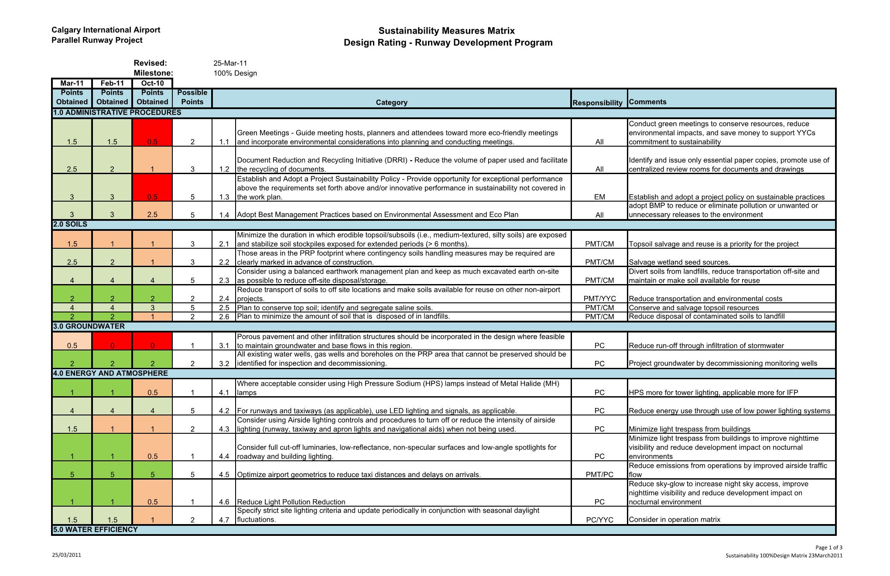

Slide 18
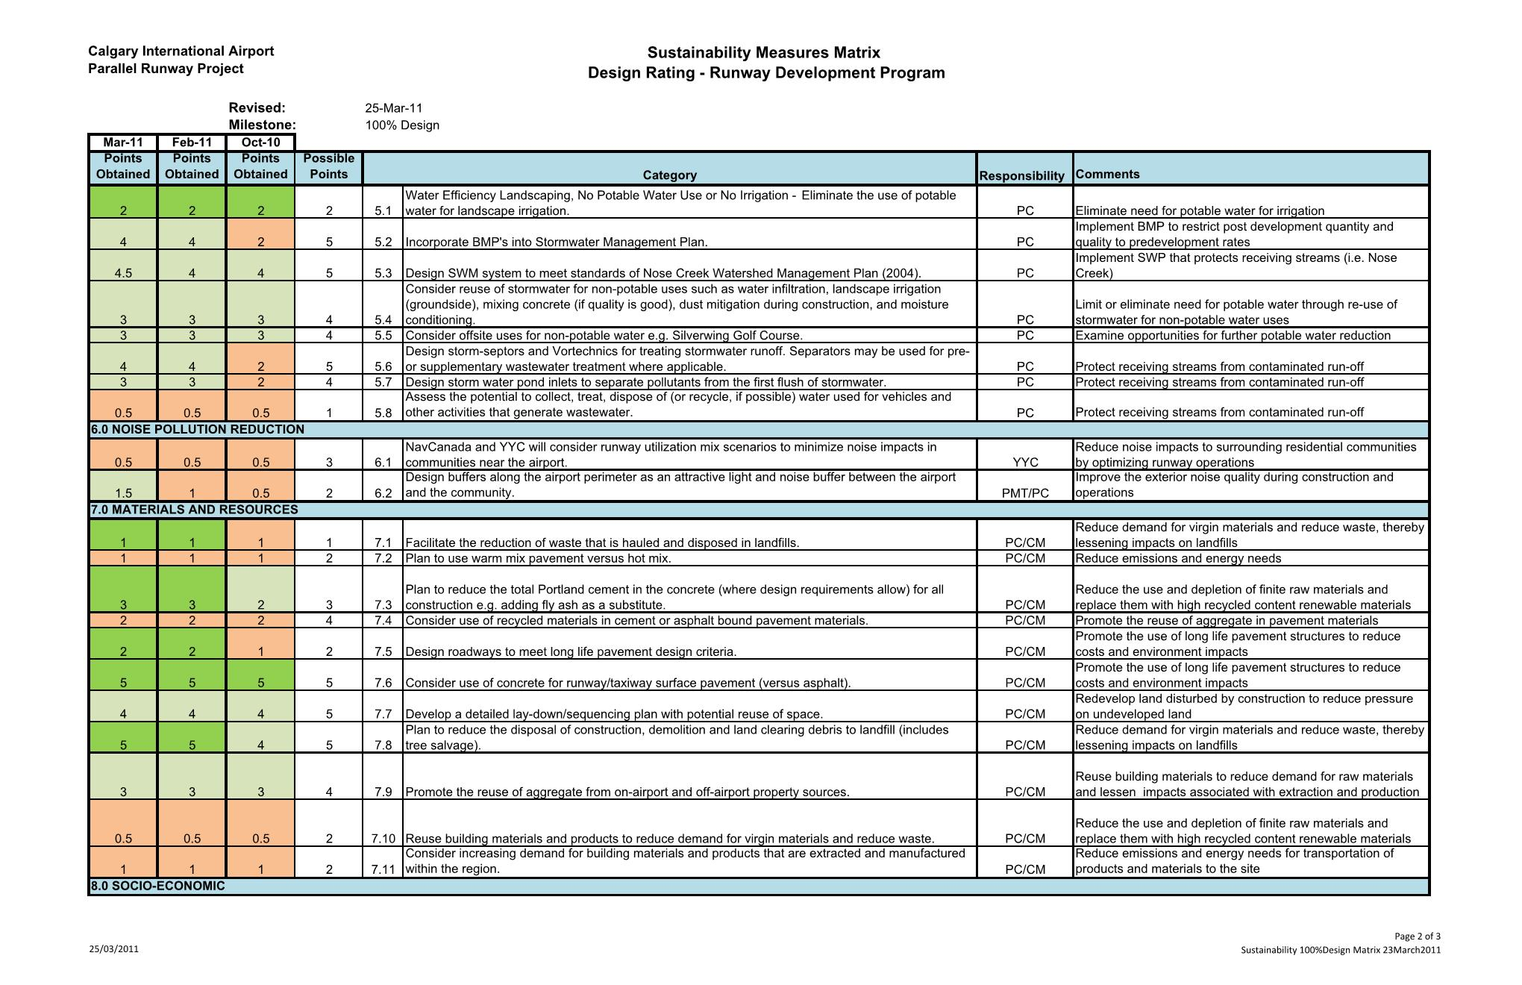

Slide 19
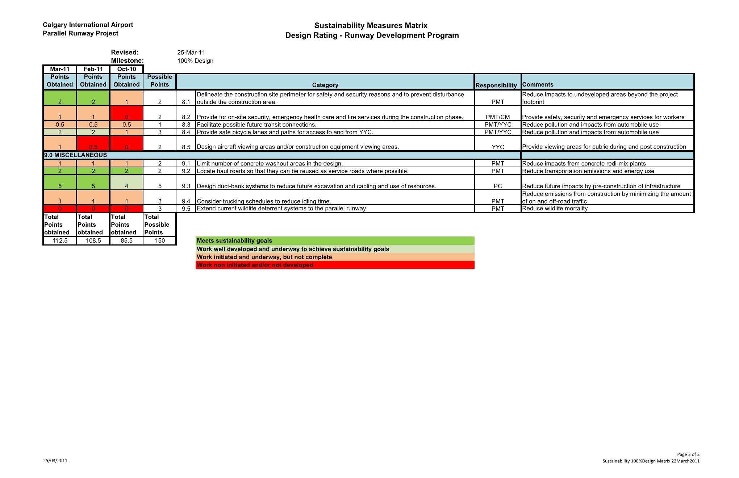

Slide 20
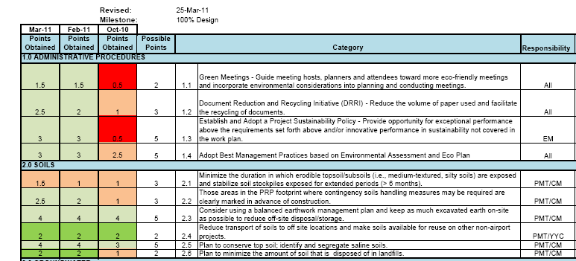
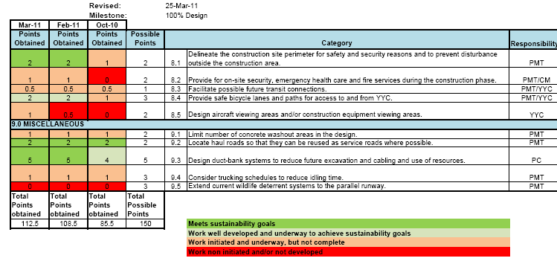
Design
Revisited
Total
Points
RDP
Design
Matrix
50 Criteria
150 Points

Slide 21
RDP Construction Matrix - Summary
Administrative Procedures
(5 tasks – 19 points)
Soils
(6 tasks – 24 points)
Groundwater
(2 tasks – 3 points)
Energy and Atmosphere
(5 tasks – 17 points)
Water Efficiency
(6 tasks – 20 points)
Vegetation
(5 tasks – 13 points)
Materials and Resources
(8 tasks – 27 points)
Wildlife
(4 tasks – 11 points)
Miscellaneous
(6 tasks – 16 points)
150 Maximum Points
47 Tasks

Slide 22
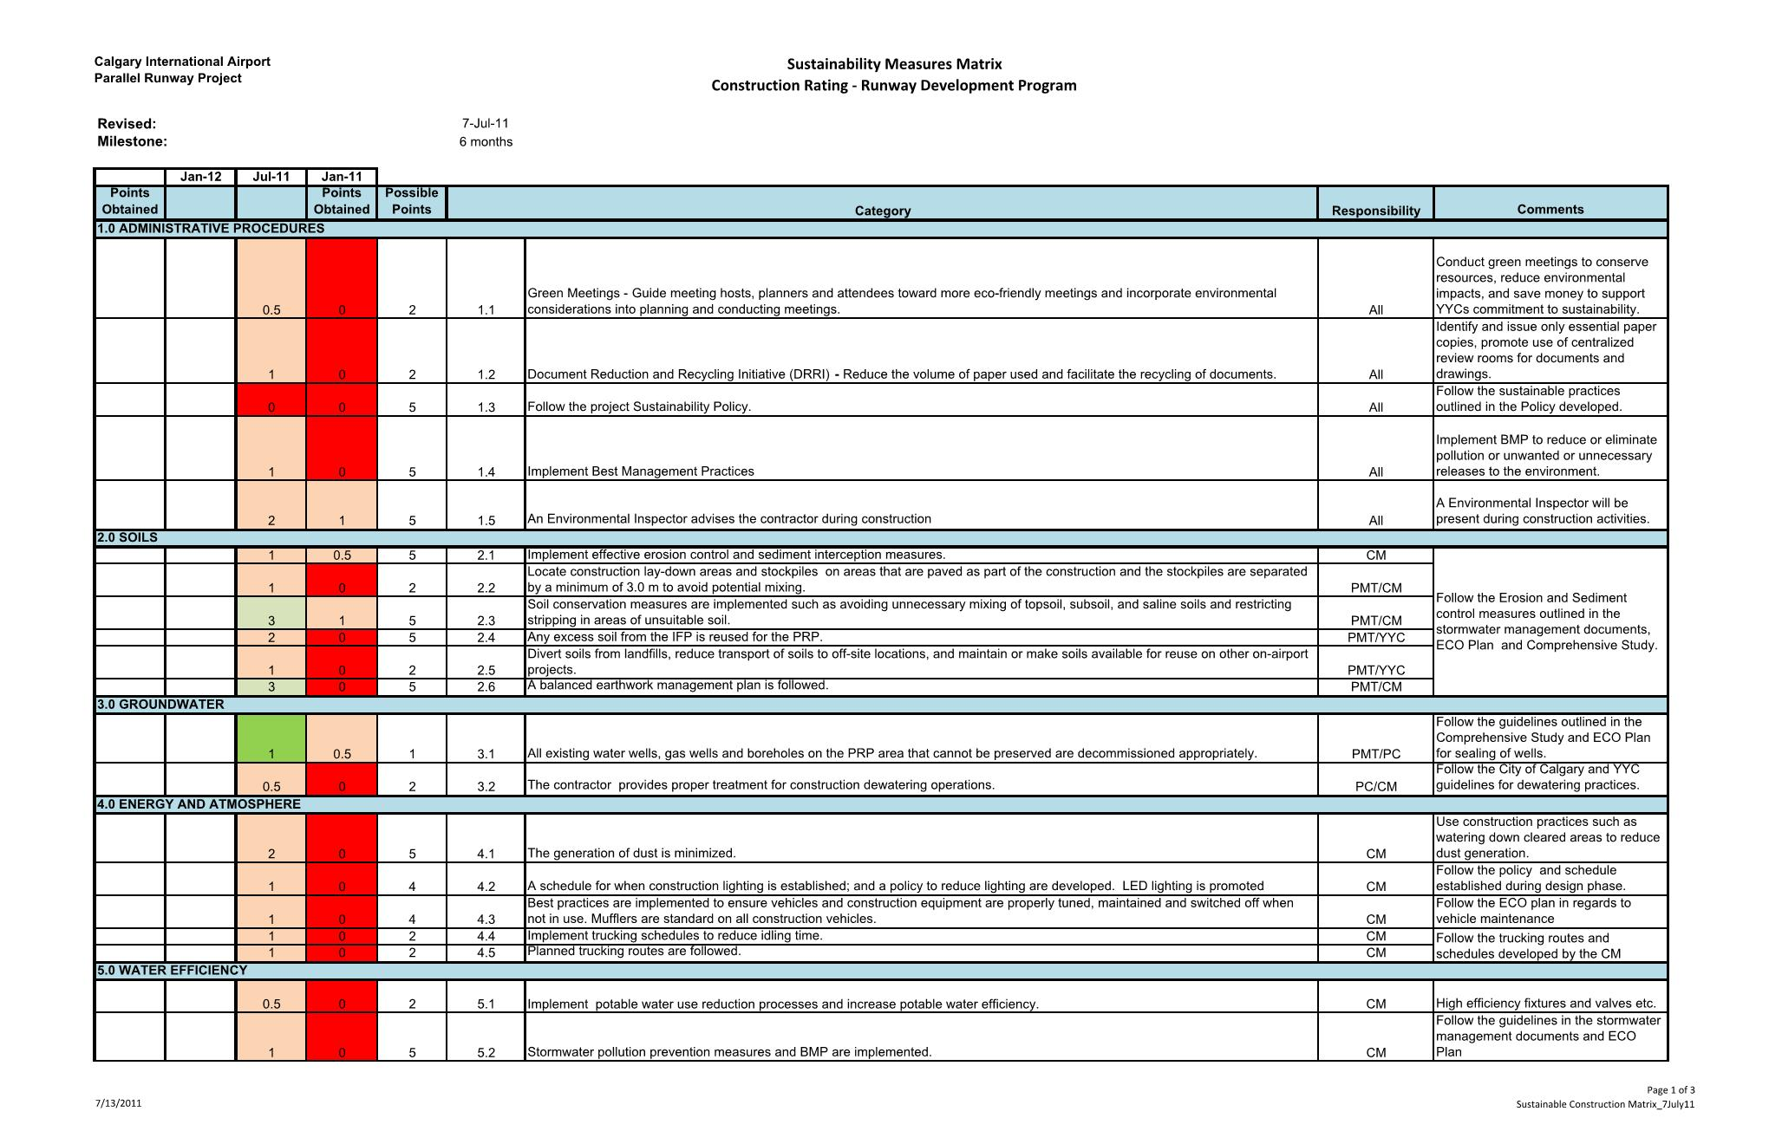

Slide 23
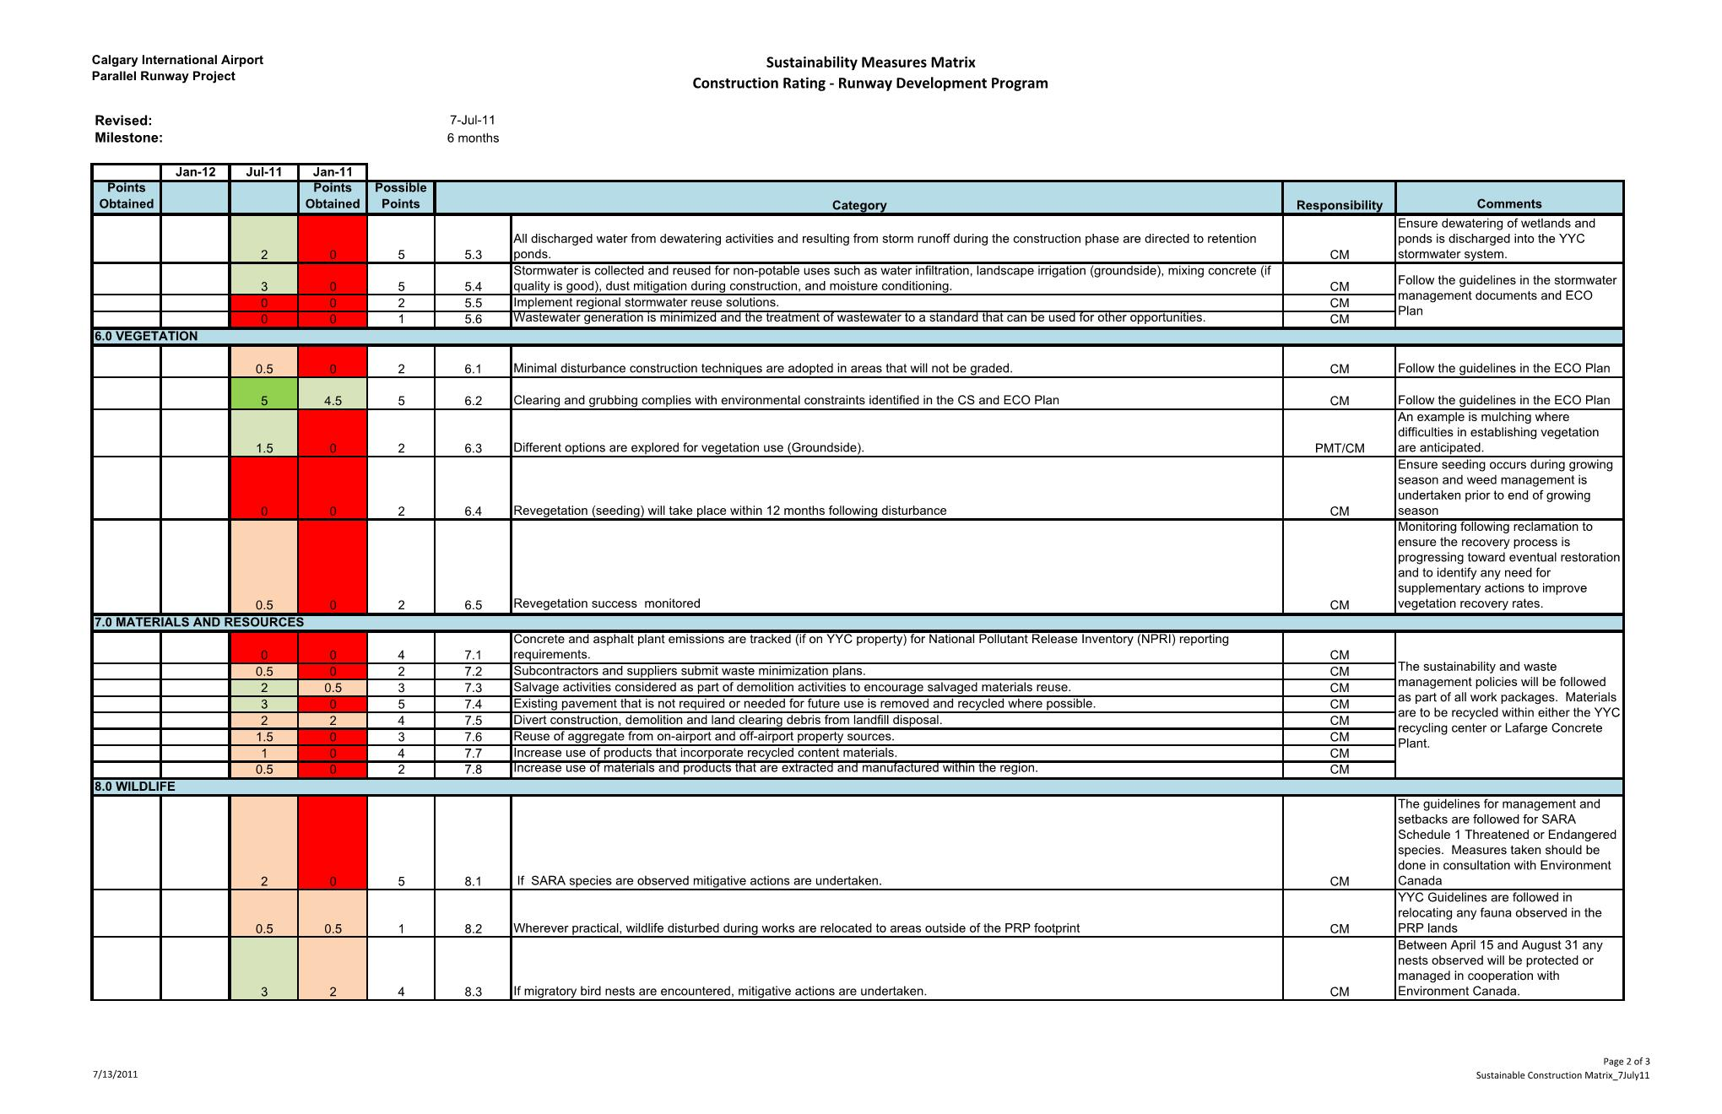

Slide 24
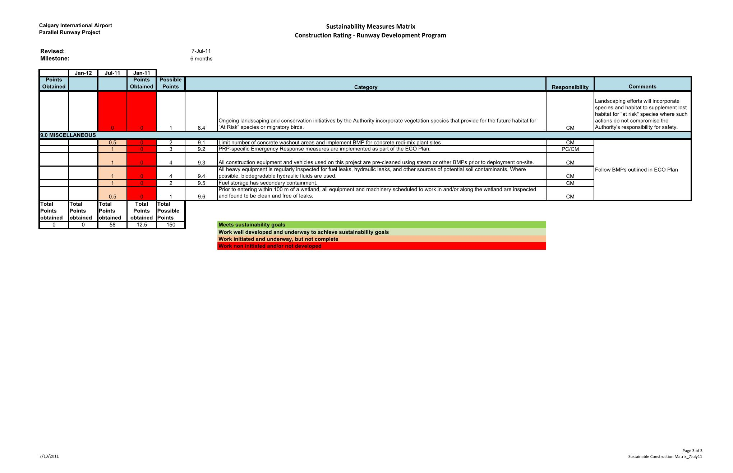

Slide 25
YYC – Airfield Pavement Construction Sustainability Matrix

Slide 26
Lessons Learned- Pavement Sustainability
Design Considerations
Pavement Types – New and Rehab
Concrete (rigid) and Asphalt (flexible)
Pavement Life
Life considerations (Life Cycle Cost Analysis)
Pavement Layers and Material Choices
PCC, HMA, Stabilized Layers, Granulars, Recycling
Pavement Support
Earthworks, Drainage, Landscaping

Slide 27
Lessons Learned- Pavement Sustainability
Construction Considerations
Dedicated Haul Routes
Recycling and On-site Batch Plants
Preliminary Design Review by Contractors and CM where applicable
Airport Tenant/Other Stakeholder Engagement

Slide 28
Lessons Learned- Pavement Sustainability
Earthworks stockpiling areas
Contaminated Material Handling
Sedimentation and Erosion Control Plan
Construction Equipment Review
As-built and Survey Requirements

Slide 29
Sustainability Matrices Conclusions -1
Excellent web sources for airport sustainability guidelines with step-by-step procedures and checklists/matrices.
Still up to airport to determine what criteria are important for specific project, local site conditions and local stakeholders.
Developing matrices with important tasks and appropriate weightings excellent way to monitor sustainability progress during design and construction.

Slide 30
Sustainability Matrices Conclusions - 2
Pavements are not buildings – no universal equivalent to LEED® rating system at present time. Maybe in next 3-5 years, but will be likely be infrastructure based and not pavement specific.
One size does not fit all – make sure your matrix fits with your airport’s overall sustainability plan. It’s your sustainability plan and rating system.

Slide 31
Thank You... Questions?

