Slide 1

Asphalt Pavement
Recycling Practices and
Technologies

Slide 2

Asphalt Repair and
Maintenance Techniques
H Wayne Jones, P.E.
Senior Regional Engineer
Asphalt Institute

Slide 3
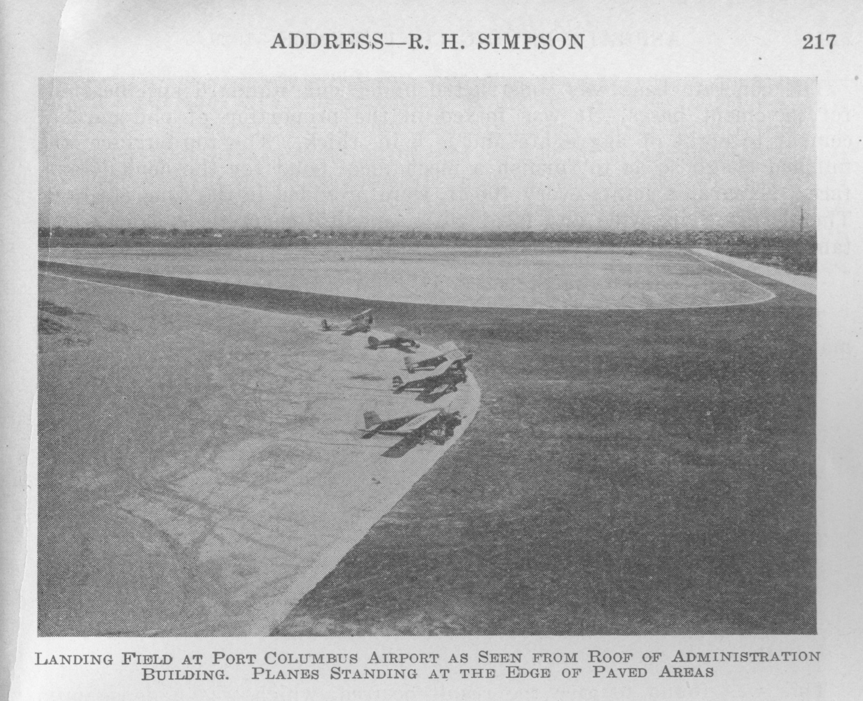
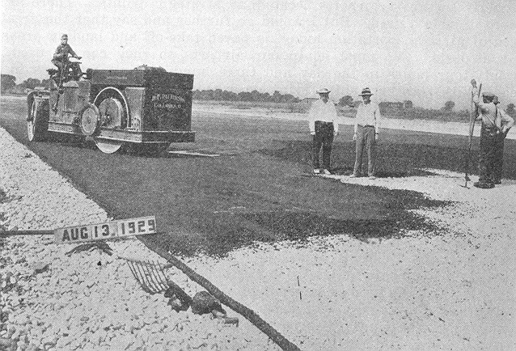
Port Columbus

Slide 4
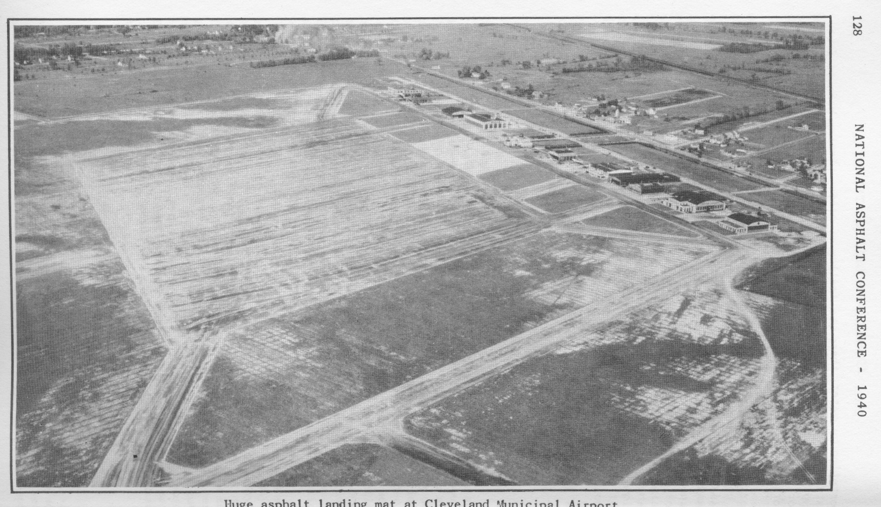
Cleveland Hopkins
1935 “Allway” Landing Mat
2000 ft square

Slide 5

Airport Pavement Technical Workshop
Covers:
Asphalt Pavement Design,
Construction, and Maintenance
(22 PDH Credits)
Sponsored by the
FEDERAL AVIATION ADMINISTRATION
&
ASPHALT INSTITUTE
November 14-16, 2017
Baltimore, Maryland
www.AsphaltInstitute.org
April 24 – 26, 2018
Dallas-Fort Worth

Slide 6
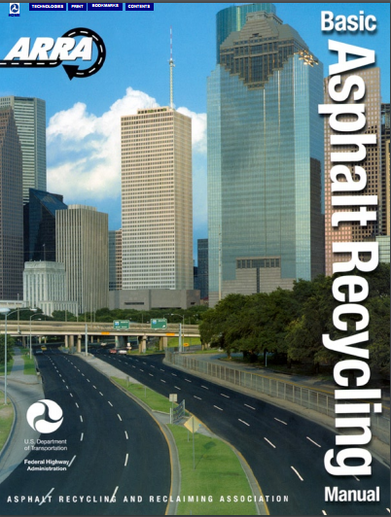
Basic Asphalt Recycling Manual
FHWA
Asphalt Recycling & Reclaiming

Slide 7
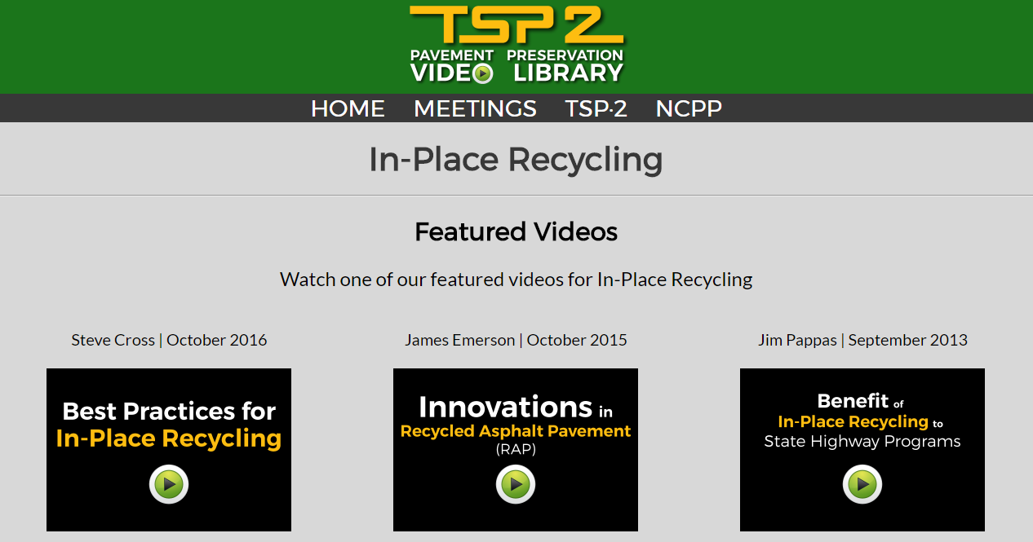
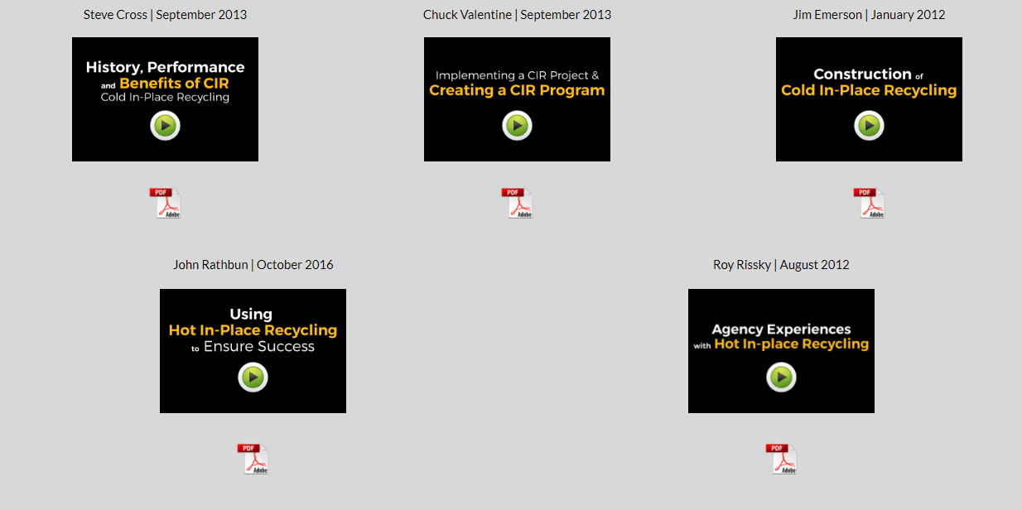
https://www.pavementpreservation.org/video_library/pavement/In_Place_Recycling.html

Slide 8
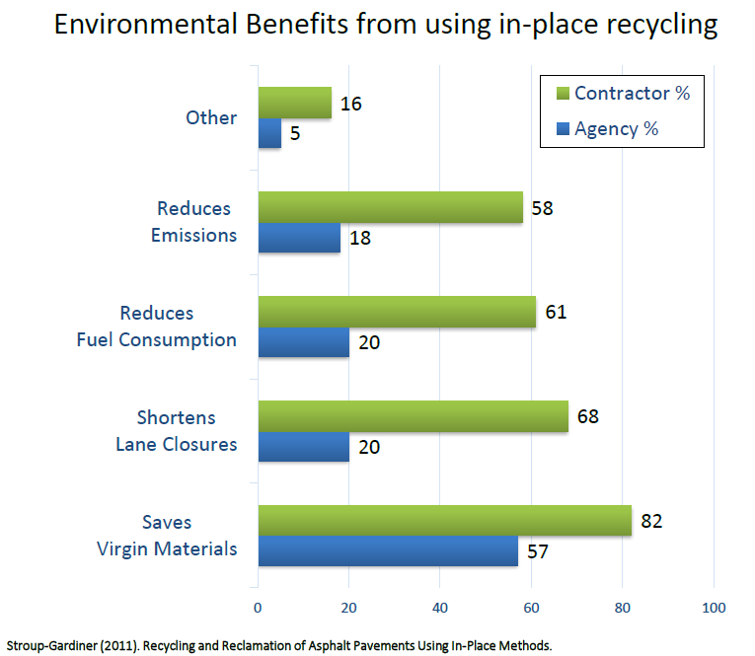

Slide 9
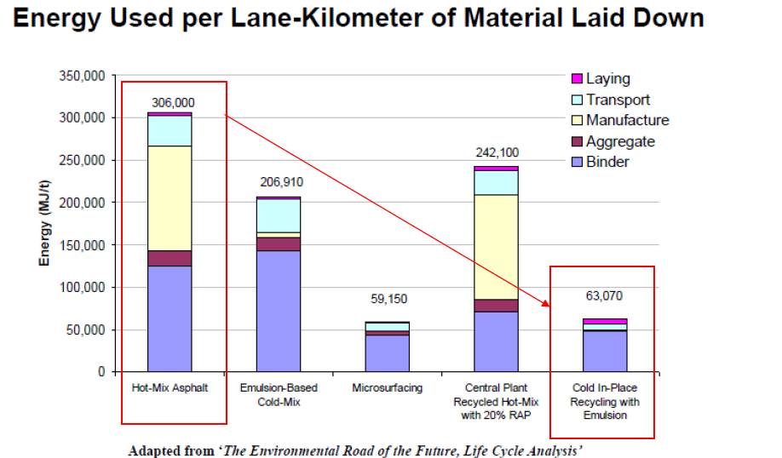

Slide 10
 | CONTRIBUTING CAUSES |  |  |  | MAINTENANCE |  | REHABILITATION
PAVEMENT | Structural | Mix | Temp. | Constr. | Patch/ Crack | Surface | Surface | Structural | Structural | Recon-
DISTRESS | Failure | Compos | Moisture | Deficiency | Seal | Treatment | Recycle | Overlay | Recycle | struction
Alligator Cracks | X |  |  |  | X | X |  | X | X | X
Long&Tran Cracks |  |  |  | X | X |  |  | X | X
Reflective Cracks |  |  | X |  | X | X |  | X | X
Shrinkage Cracks |  | X | X |  |  | X | X | X | X
Slippage Cracks |  |  |  | X | X
Rutting | X | X |  | X |  |  | X | X | X | X
Corrugation | X | X |  | X | X |  | X | X | X | X
Depressions | X |  |  | X | X |  |  |  |  | X
Upheaval/Swell |  |  | X |  | X |  |  |  |  | X
Potholes | X | X | X | X | X |  |  | X | X
Raveling |  | X |  | X |  | X | X
Bleeding |  | X |  | X |  | X | X
Polish Aggregate |  | X |  |  |  | X | X
Loss of Cover Agg. |  | X |  | X

Slide 11
In-Place Recycling
Three commonly used techniques are:
Hot in-place recycling (HIR)
Cold in-place recycling (CIR)
Full depth reclamation (FDR)

Slide 12
3 Types of HIR
Surface Recycling
Surface Repaving
Remixing
Usually the most appropriate approach for airport pavements

Slide 13
Steps in Repaving Process
Surface Recycling:
Heating, reworking and rejuvenating 1-2 inches
  Preparation for seal coat, micro-surfacing or overlay
Repaving:
Heating, reworking and rejuvenating 1 inch
  Simultaneously applying an overlay while the temperature of the recycled layer is 200°F
Remixing:
Heating, reworking and rejuvenating 1-2 inches
  Adding virgin aggregate and/or admix
  Mixing in a pug mill
  Layingas a binder or surface course.

Slide 14
Steps in Repaving Process
Multiple heating units to soften asphalt
Scarify softened pavement
Add and mix recycling agent with RAP
Strike off the recycled mix with screed
Spread the new mix on top of the recycled mix
Compact both layers of recycled and new
Notes:
The following are the steps involved in the repaving process:

Slide 15
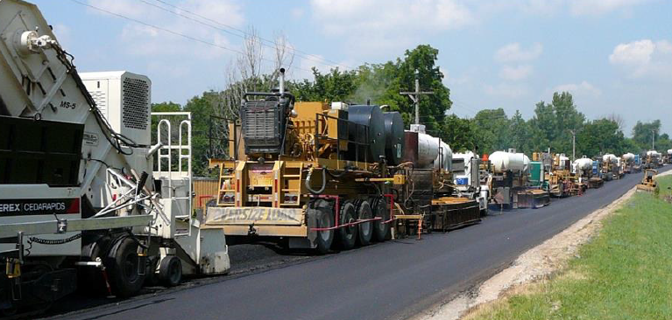
Steps in Repaving Process

Slide 16
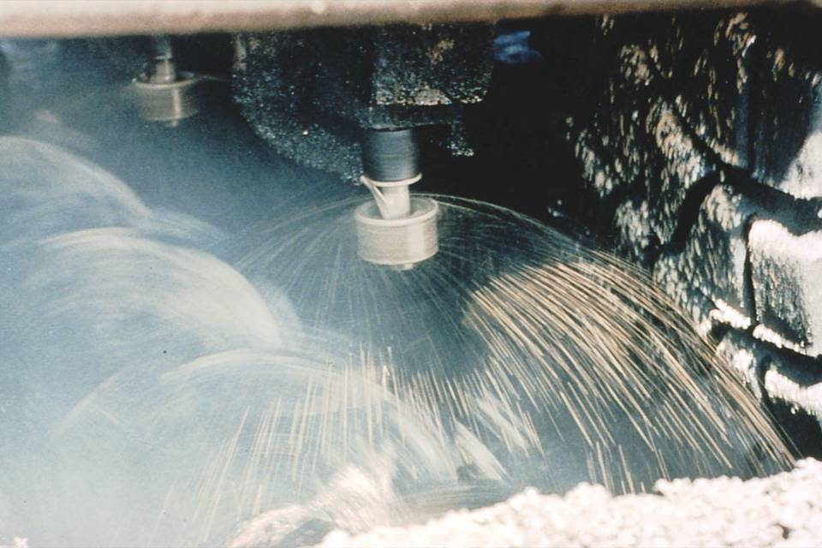

Slide 17
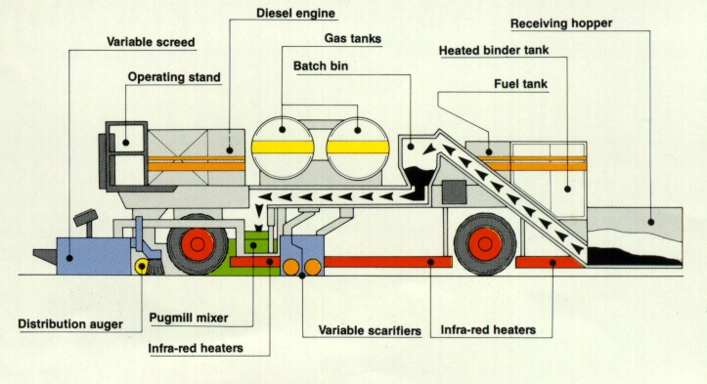
Single Pass Remixing Equipment
Notes:
This slide shows a schematic of a single pass remixing equipment.

Slide 18
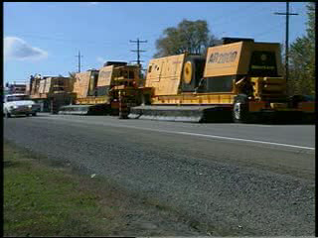

Slide 19
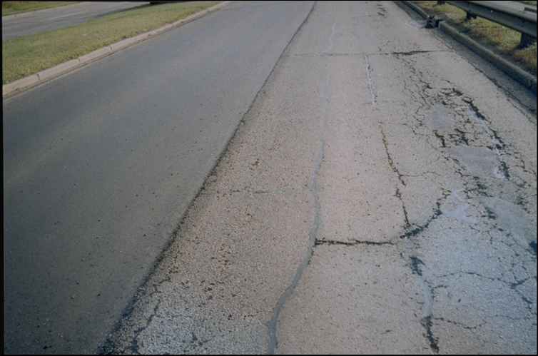
Recycled Road
After
Before
Notes:
This slide shows condition of a road before and after remixing operation.

Slide 20
Limitations to HIR
Only addresses surface problems
  Raveling, surface-initiated cracking
Drainage, structural distress, excessive deformation
must be corrected
Any coal-tar based sealers must be removed
Crack fillers can produces smoke
Excessive rubber (skid marks, crack sealants)

Slide 21
Cold In-Place Recycling (CIR)
Normally applicable for G/A airports
Process:
  Scarify existing asphalt-bound materials
  Screen/crush oversized materials
  Controlled blending with binding agent
    Traveling pugmill
    Asphalt emulsion-usually ~1.5% and additives
  Placement/compaction/curing
  Place HMA surface

Slide 22
Cold In-Place Recycling (CIR)
Single Unit Train
Pulverize
Add Recycling Agent
All in Cutting Chamber of Milling Machine
Two-Unit Train
Pulverize
Add Recycling Agent Based on RAP Weight
Mix in Pugmill
Multi-Unit Train
Pulverize, Screen, Crush
Add Recycling Agent Based on RAP Weight
Mix in Pugmill

Slide 23
Single Unit Train

Slide 24
Two Unit Train

Slide 25
Multi-Unit Train
Notes:
This slide shows a photo of the CIR train.
Recycling Train
Shows the first three elements of the recycling train.

Slide 26
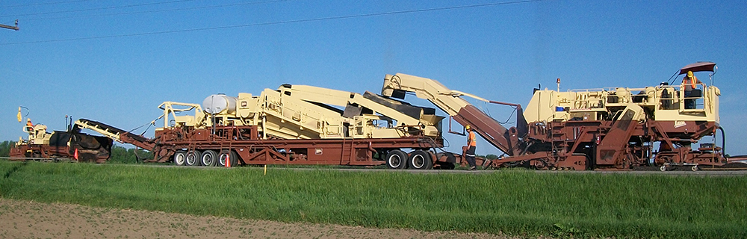
Multi-Unit Train
Notes:
This slide shows a photo of the CIR train.
Recycling Train
Shows the first three elements of the recycling train.

Slide 27
Recycling Additives
Asphalt emulsions
  Mixing grade emulsions - SS-1, CSS-1, etc.,
  Including modified emulsions to improve old AC
Expanded Asphalt (Foam)
Cement or Lime can be added in small
quantities to:
Improve Moisture Resistance
Decrease Curing Time
Increase Initial Strength
Notes:
The most common recycling additives for CR mixtures are asphalt emulsions and emulsified recycling agents because they are liquid at ambient temperatures, and can be readily dispersed throughout the mix. Polymer modified versions of asphalt emulsions and emulsified recycling agents have been used to improve early strength, resist rutting, and reduce thermal cracking.
This slide is covered in double Jeopardy workshop (Cold In-Place Recycling - $400).

Slide 28
Advantages/Disadvantages of CIR for Airport Pavements
Plusses
Removes source of future distress
  Eliminates cracking
  Thermal/shrinkage
Conserves resources
  Utilized existing materials
  Without having to transport
  Reprocess materials offsite
Consistent foundation
  Prior new surface
Minuses
10-14 days of curing
  Without Specialized Emulsions
Mixture design/control

Slide 29
Full-Depth Reclamation
Creates a new Stabilized Base
  Utilizing existing surface in place
  25% aggregate base materials
  Correct deficient gradations
Chemical Stabilizers
  Asphalt emulsion
  Foamed asphalt
  Hydrated lime,
  Portland cement,
  Chloride salts, or combinations as binding agents
Increases existing structural capacity
CIR, FDR require a new wearing course

Slide 30
Pavement Distresses Treated by FDR
All types of cracking
  Bottom-up Fatigue cracking
  Reflective
  Shrinkage
  Top-down
Permanent deformation:
  Rutting, corrugations, and shoving
Notes:
Pavement distresses which can be treated by FDR include:
Essentially almost all pavement distresses can be treated with FDR.

Slide 31
Main Steps in FDR
Pulverize existing pavement
Introduce additive
Additional aggregates
Mix
Shape the mixed material to new cross-section
Compact
Apply a wearing course
Notes:
The main steps in FDR consist of: pulverization of existing pavement, introduction of additive and mix, shaping the mixed material, compaction and application of a wearing course.
This slide is covered in Double Jeopardy workshop (Potpourri - $1000).

Slide 32
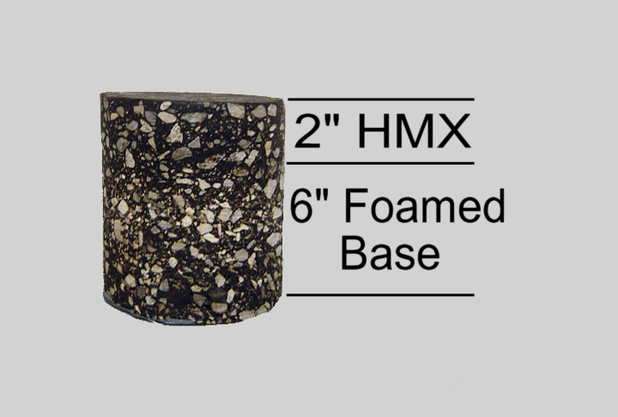
Full-Depth Reclamation
In-Place Recycling
Notes:
Do we want to get into a discussion on SN and layer coefficients before we get started with the in depth details of each process?
Is the local DOT using GBE or Layer Coefficients?
Granular Base = 1
HMX = 2
Is your local DOT office using 0.44 or 0.40 for asphalt layer coefficient?
Etc…

Slide 33
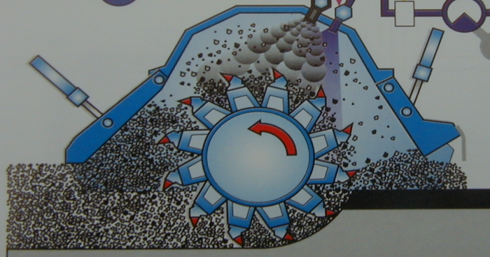
Full-Depth Reclamation
In-Place Recycling
Compaction
Rap
Particle
Asphalt
Globule
Particles are not “Coated”
Stuck Together
  Coated fines for paste
Rap
Particle

Slide 34
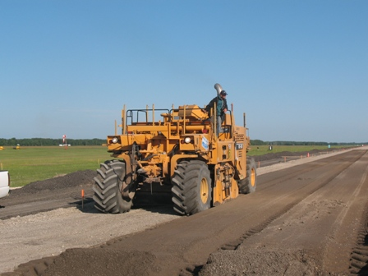
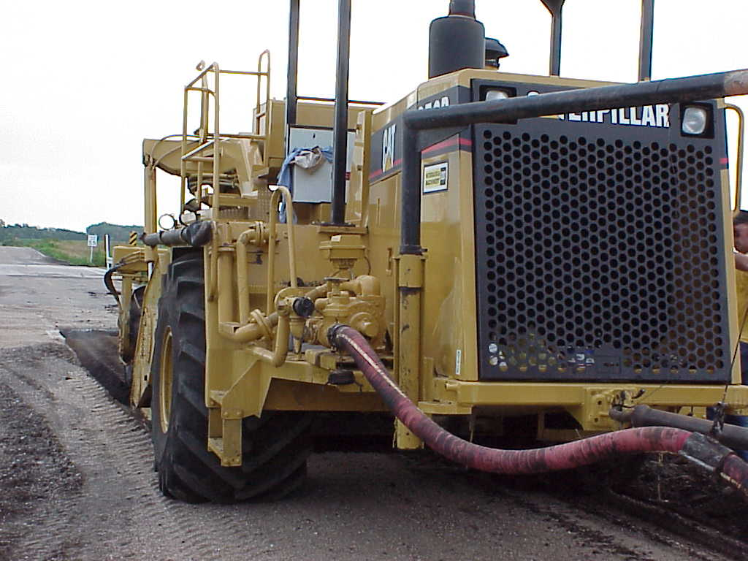
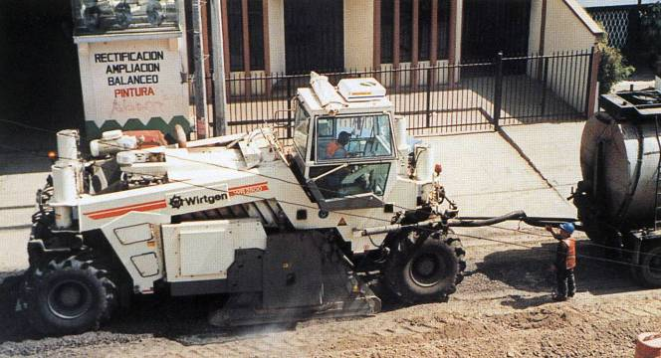
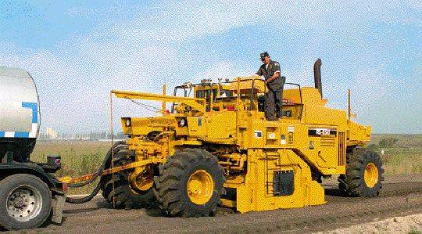
Equipment
Wirtgen

Slide 35
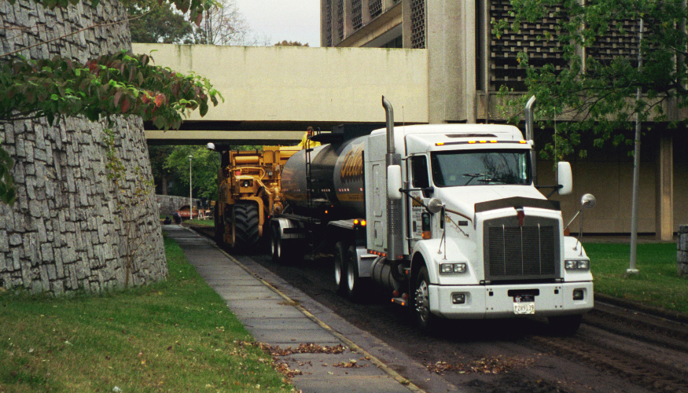
Full-Depth Reclamation
In-Place Recycling
Notes:
Overhead clearance can’t be overlooked
Mention that it is also a good time to consider any road widening improvements, could mention the article in City and County magazine if appropriate

Slide 36
What is Foamed Asphalt?
Addition of 1-3% water to hot asphalt
AC expands 15 to 20 times volume
“Foamed” AC is mixed with aggregate
Base course is processed by traditional methods
Lime or Portland cement used to form mortar

Slide 37
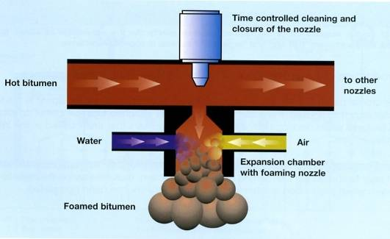

Foaming and Mixing
Courtesy: Wirtgen
Foamed asphalt
Water for compaction

Slide 38
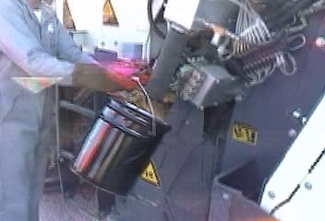
Foamed Asphalt
Courtesy: Michael Smith, FHWA

Slide 39
Foamed Asphalt
Combines with fines
  Forms a mortar/paste
  Requires
    at least 5% P-200 material,
    maximum 20% P-200
Principle advantages:
  Workable under a wide range of weather conditions
  No curing time requirement after compaction

Slide 40
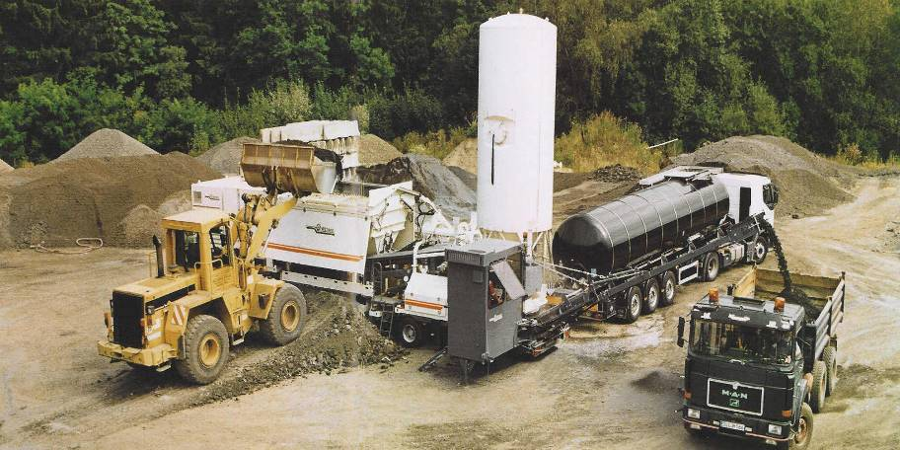
Mobile Cold Recycling Plant

Slide 41
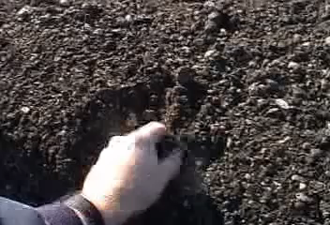
Foamed Asphalt

Slide 42
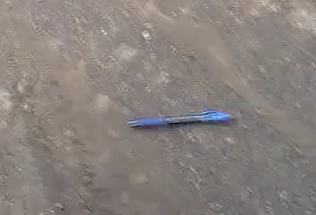
Foamed Asphalt

Slide 43
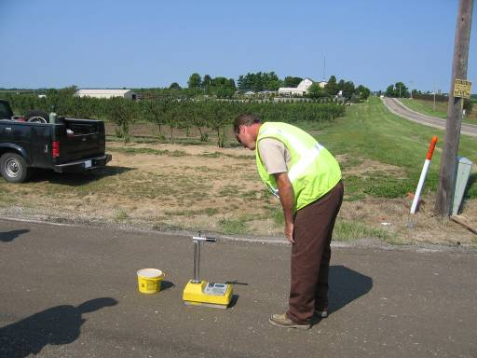
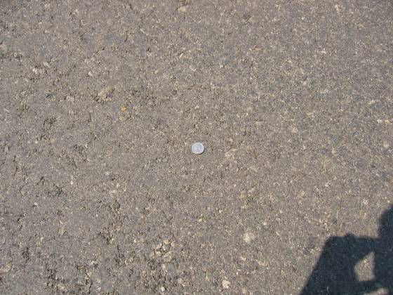
Finished Surface

Slide 44

Finished Surface

Slide 45
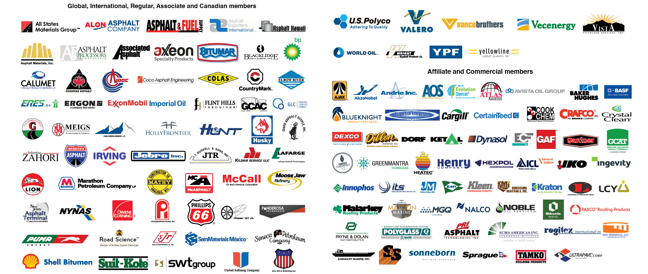
Thank You !!
H Wayne Jones, P.E.
Senior Regional Engineer
Asphalt Institute
wjones@asphaltinstitute.org
Asphalt Institute.org

